Slide 1
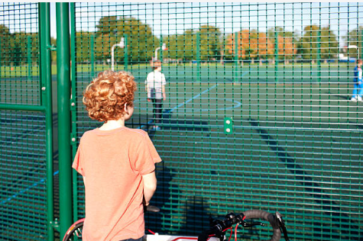

Session 5
Lost but not lost

Slide 2


It is session 5 already! Matthew and Gemma are back to tackle one of the most worrying things many Year 6 students think about when going to secondary school: getting lost!
Matthew Burton
Gemma Oaten

Slide 3
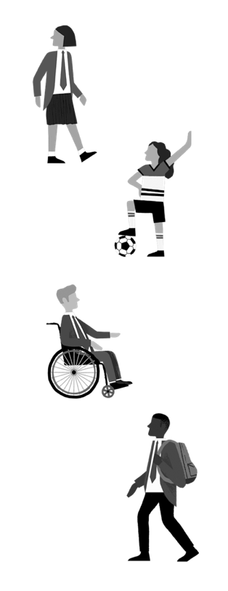
In Session 4, we looked at managing change and all the things that will be different when you go to secondary school.
We looked at some ways of managing that change and encouraged you to have a great first day.
It is going to be a great time to meet new people and to try new things.

Slide 4

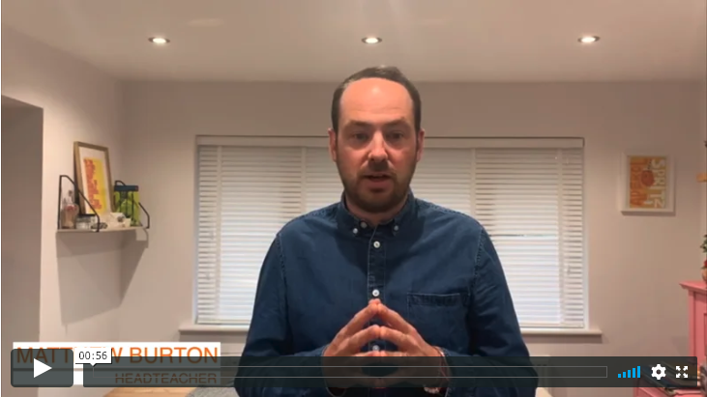

Here is Matthew Burton to introduce today’s session:
If you are reading alongside these sessions, then you can read up to page 56.

Slide 5
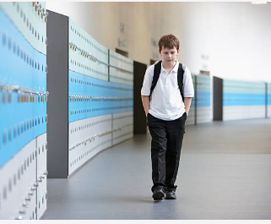
Have you ever felt lost?
Sometimes we all feel lost and it might be during the following situations:
Moving schools
Moving home
Going to a new club
Playing a new sport
Trying a new skill or task
Solving a problem

Slide 6

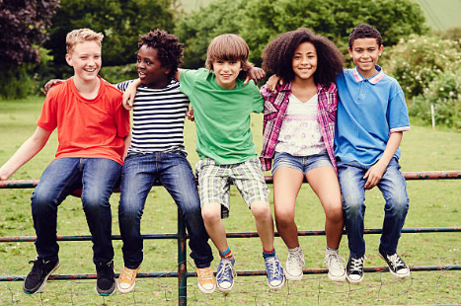
Starting a new school can make you feel a bit lost BUT remember that you are NOT ALONE.
We can often have fears of being lost and that is okay.

Slide 7
You don’t need to worry about being lost and here is why!
You will have a virtual tour which you can watch multiple times.
You will have an older student and/or your tutor to give you a tour.
Everyone else in your form class will be feeling exactly the same.
Your tutor is there is help you.
For the first day, or more, you and your class are usually all together in one place anyway.
On the first day there are only Year 7 and Year 12 in the school so it’s quieter
You can ask older students where to go – they will want to help.
Hinchingbrooke is full of staff who want to help you – ask them!

Slide 8
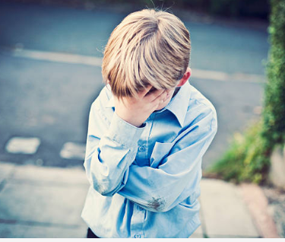
Being physically lost is more obvious, but sometimes we can also feel emotionally lost.
These are some of the signs:
Missing what you know
Feeling numb
Feeling hopeless
Not interested in hobbies
Wishing things were the same as before
Feeling helpless
Unable to concentrate
Lack motivation

Slide 9
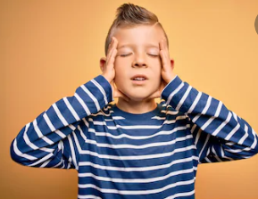
If you are worried then sometimes you can experience:
Feeling tired or having no energy
Feeling sick
Trouble sleeping
Feeling anxious
Feeling tense
Having a headache
Not feeling hungry

Slide 10
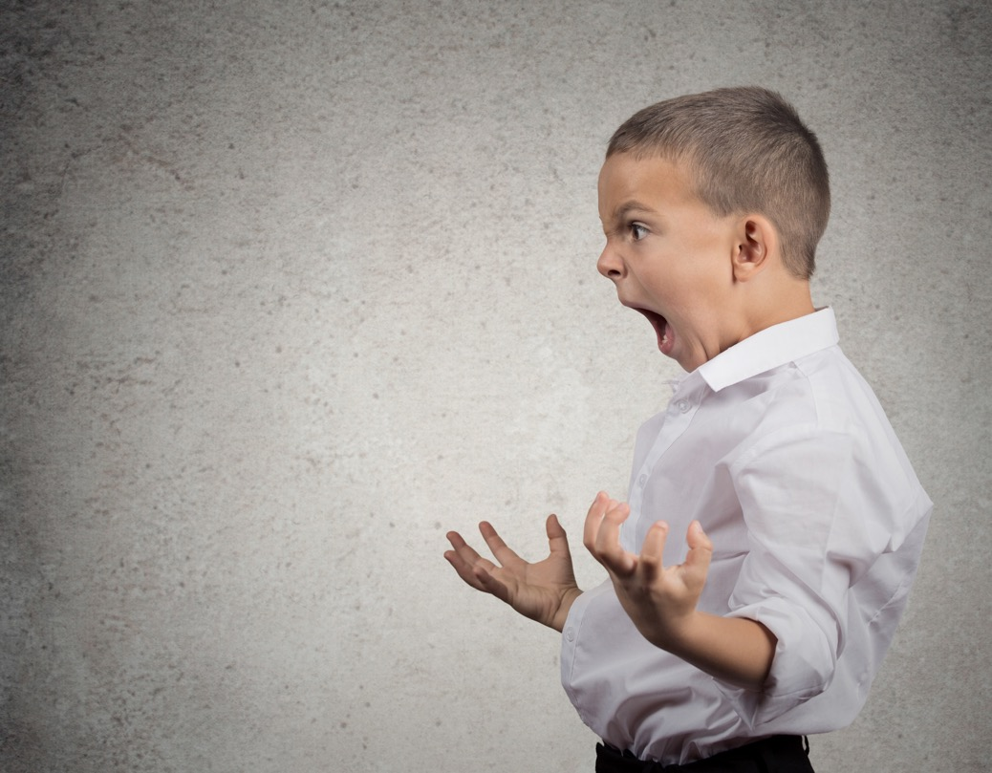
We all have times when we feel a bit strange because everything is different. This is a normal part of going through change and it does pass.

Slide 11
Remember when Matthew Syed talked about a ‘growth mindset’?
Now is the time to remind yourself of that!
In your workbook, change the statements on the left so that they are positive and hopeful. Your brain sometimes tells you negative things that are not based on fact. Your job is to tell your brain that there is another way to think and that it is wrong sometimes!
Statement | Transform it!
I won’t ever fit in. | This is not true – I will find people who are like me; I just need to find them!
I will always be lost.
I can’t do these subjects.
I won’t make friends like I had in Year 6.
I miss my primary school.
One of your own:

Slide 12
Matthew suggests some ways to help when you feel both
kinds of ‘lost’ – emotionally and physically!
Ask your way around.
Accept help and find your ‘go-to’ person – someone you feel able to go to if you have questions or concerns. Your tutor might be that person.
Be honest – tell people how you feel.
Do your research – work out where things are.
Make sure you have your Triangle of Trust (more in a moment).
Don’t look back – focus on this new world.

Slide 13
This is the Triangle of Trust
Write down who is in your Triangle of Trust. Put their names on the triangle in your workbook.
Who can you talk to about different things?
What three things make you feel happy and good?
Where is your safe place to just relax?
Mr Burton’s Triangle of Trust:
YOU!
Home/Parents
School/Teachers

Slide 14
Starting anything new is both exciting and a bit scary BUT it is worth it because being at Hinchingbrooke is going to build on all of the great things you have experienced at primary school. It is the time when you are going to work out what kind of person you want to be and the kind of things you like.
Soon you will be in a routine and everything will become familiar. That ‘new Year 7’ feeling doesn’t last very long.
After a week, you will start to feel at home.

Slide 15
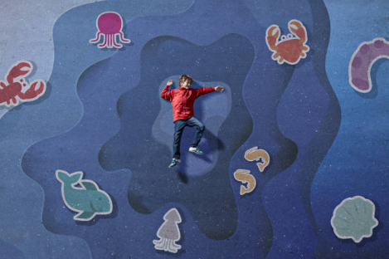
Now start to let yourself feel excited!
Secondary school will be great because you meet loads of new people.
That means there will be more room to swim and more fish to jump around with!

Slide 16
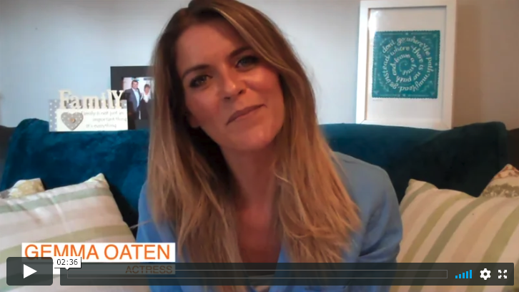
Gemma can help us navigate some of these feelings too.

Slide 17
© 2020 The PiXL Club Ltd and Hachette UK
This resource may be shared with any primary school Year 6 student in its current form, and parts thereof, to enhance your transition work with students. All opinions and contributions are those of the authors. The contents of this resource are not connected with, or endorsed by, any other company, organisation or institution.
If there are any inadvertent omissions or errors in the acknowledgements or usage, this is unintended and we will remedy these on written notification.
Hachette UK own 'You Are Awesome' by Matthew Syed and 'Go Big' by Matthew Burton, which may be purchased by individuals and schools, should they wish to do so to enhance these resources for students. 'You Are Awesome' illustrations copyright © Toby Triumph. 'Go Big' illustrations copyright © Chris Madden.

