Slide 1



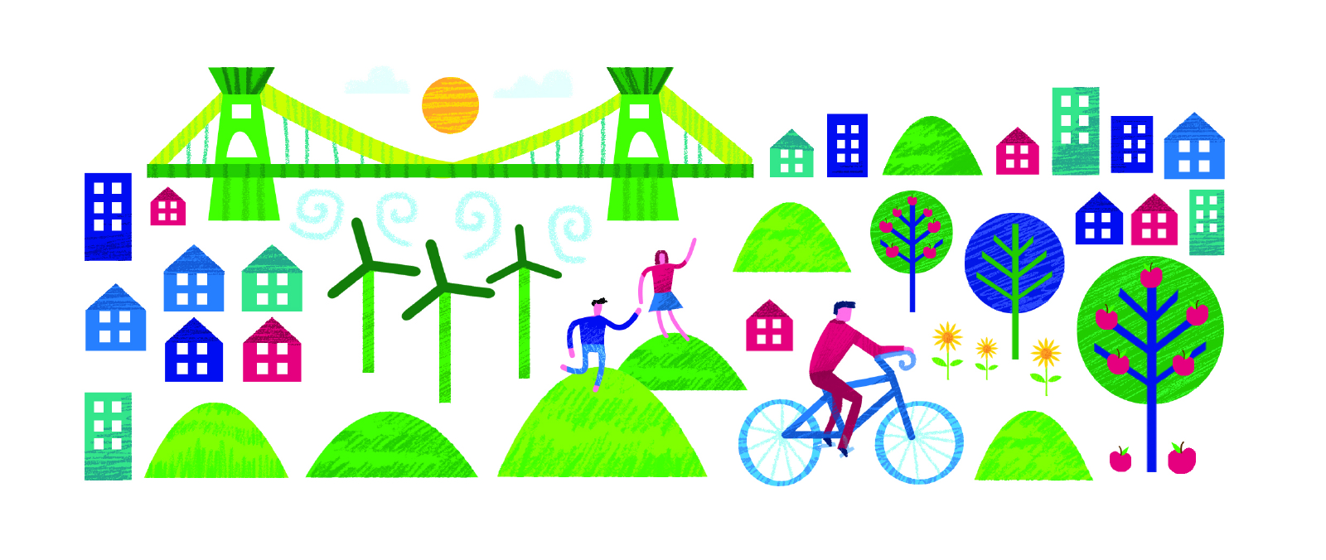

Slide 2
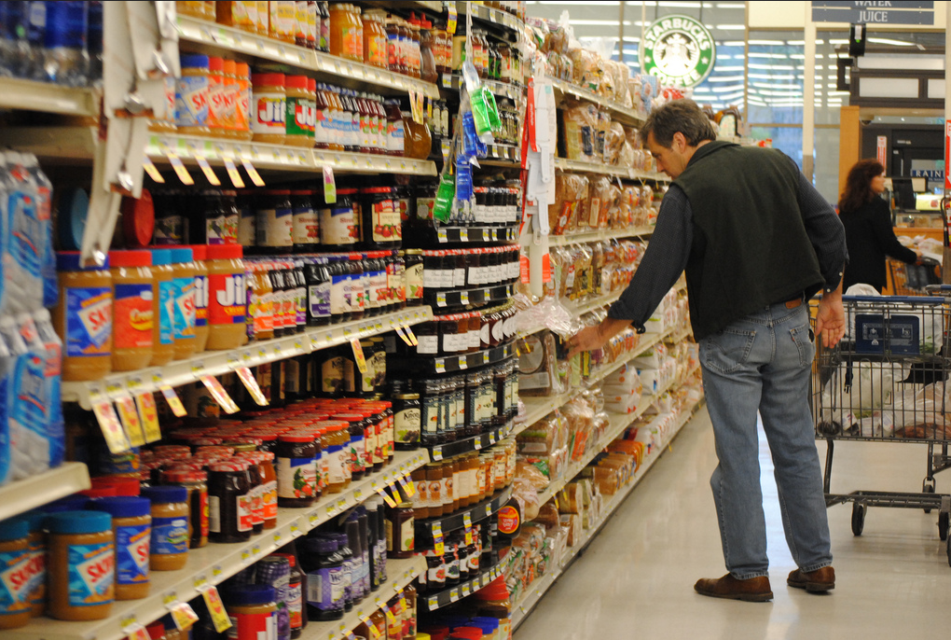
Food
Photo Anthony AlbrightCC By
Notes:
These slides can be printed and given to children. In groups or talk partners, the children could hold a discussion based on their thoughts about what they can see and present to the rest of the class.

Slide 3
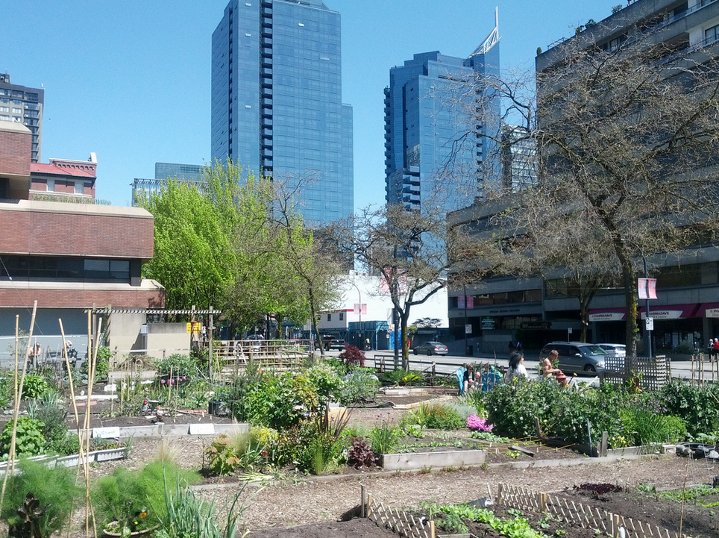
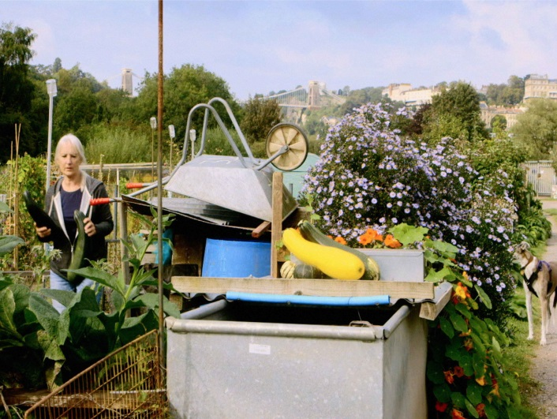
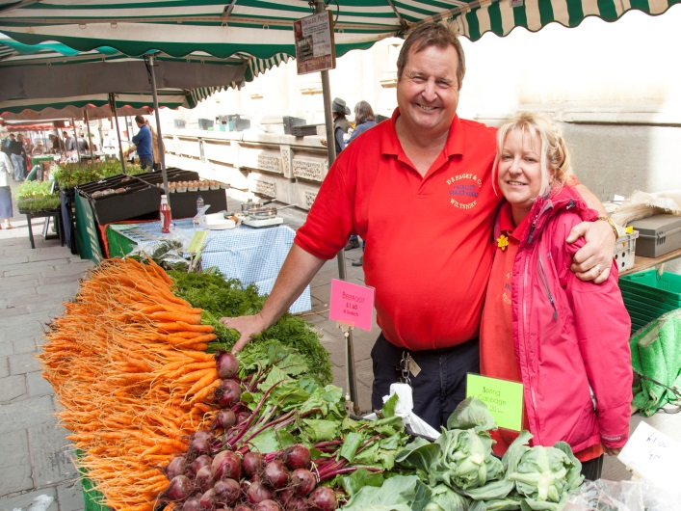
Food
It is predicted that global food production will need to increase by up to 70% to meet the needs of the rising population
Costs of transporting food will increase, so we’ll need to grow more food on plots within, or closer to our cities
People will need to grow more of their own food (indoors/outdoors, wherever they can find space) and waste less food than they do currently.
Photo James CridlandtCC By
Sustainable Solutions
Photo by Chris Bahn
Photo by Chris Bahn
Notes:
It is predicted that global food production will need to increase by up to 70% to meet the needs of the rising population; an additional 2.3 billion people by 2050 (Food and Agriculture Association)
What can we do? Brainstorm ideas with a thinking partner, for example:
1. Be a smart shopper and buy what you think you will eat. We should try to reduce the amount of food we have to throw away: don’t over buy, plan meals and use shopping lists
2. Be a thoughtful eater. When cooking, only make as much food as you think you will eat. Don’t have eyes bigger than your stomach!
3. Shop locally. This means you are eating food which has not had to travel around the world. This is friendlier for the environment, more fun and you can guarantee it will taste better too!
See resources at www.greenforgood.co.uk for lesson plans about food miles and food waste

Slide 4
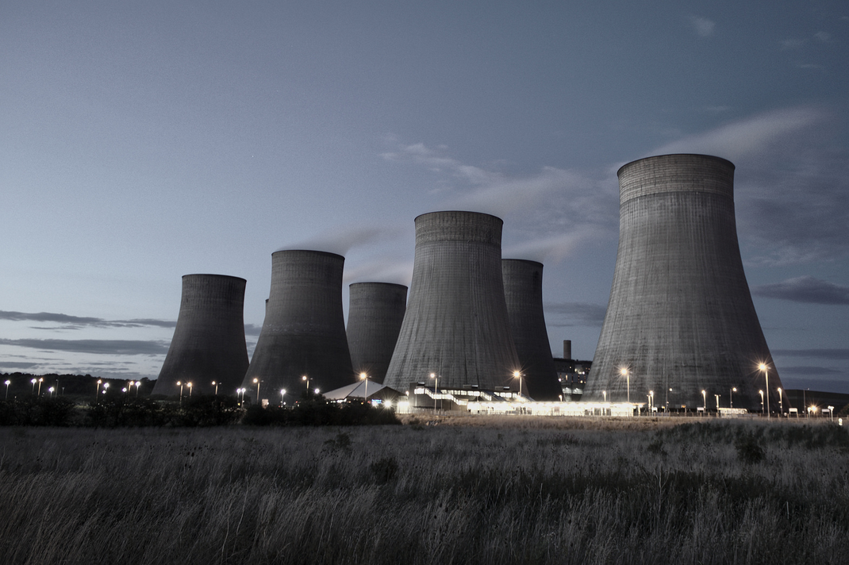
Energy
Photo Leo McArdleCC By

Slide 5
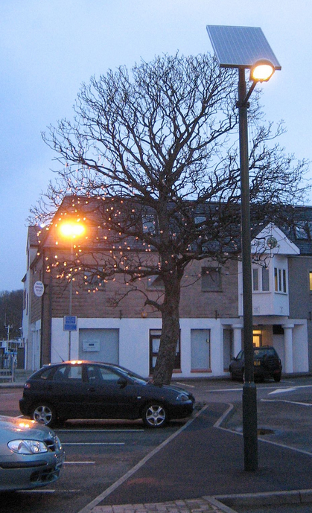
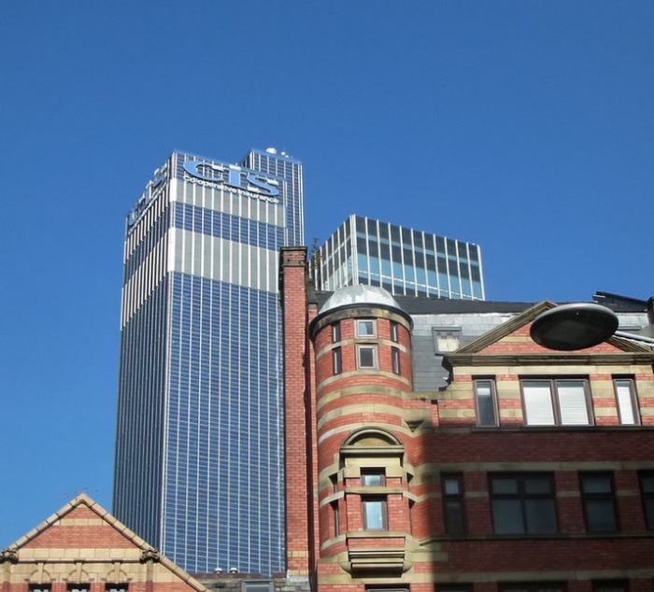
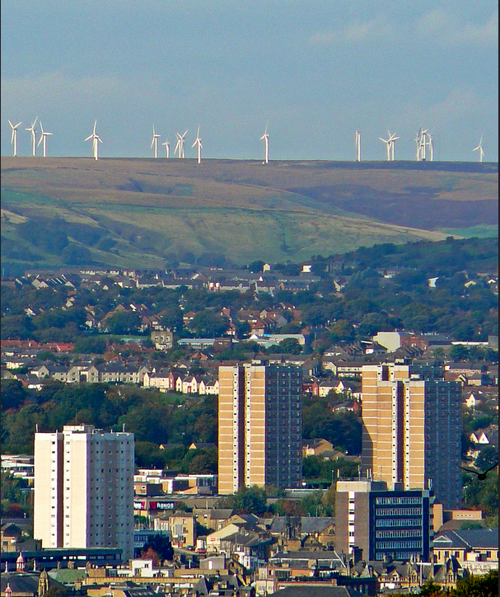
Energy
Over the last 200 years an ever-increasing proportion of our energy has come from non-renewable sources such as oil and coal. While demand for energy rises these resources are running out.
Consequently, we are ever more reliant on fossil fuels like oil, coal and gas. These are finite and non-renewable.
Creating vast amounts of CO2, as well as other harmful gases contributes to global warming, causing sea levels to rise. It is also having a disastrous effect upon the lives of the animal and plant life.
Photo Crispin SemmensCC By
Sustainable Solutions
Photo MikeyCC By
Photo by Tom Green CC By
Notes:
Facts:
Cities occupy 2% of the Earth’s land but consume 60 – 80% of the world’s energy and 75% of all carbon emissions (UNEP 2012)
Fossil fuels, as the name suggests, are very old. North Sea oil deposits are around 150 million years old, whilst much of Britain’s coal began to form over 300 million years ago. Although humans probably used fossil fuels in ancient times, as far back as the Iron Age1, it was the Industrial Revolution that led to their wide-scale extraction. In the very short period of time since then – just over 200 years – we’ve consumed an incredible amount of them, leaving fossil fuels all but gone and the climate seriously impacted. Fossil fuels are an incredibly dense form of energy, and they took millions of years to become so. When they’re gone, they’re gone pretty much forever. (Ecotricity)

Slide 6
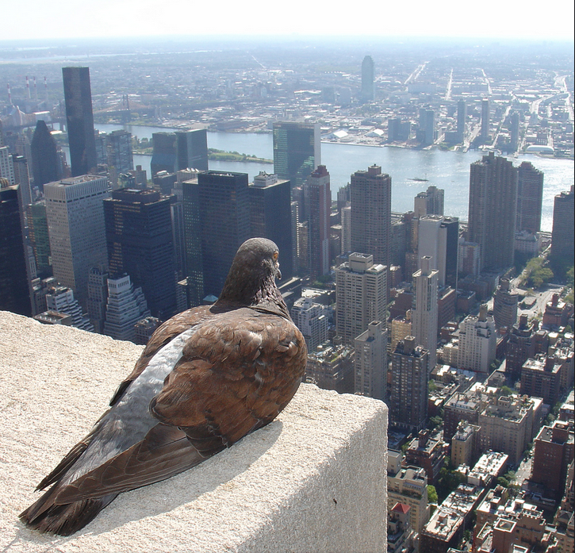
Nature
Photo ZeroOne CC By
Notes:
Despite the city landscape the tall buildings still share their space with plenty of urban wildlife.
What wild animals do we tend to find in cities in the UK? Pigeons, gulls, ducks, peregrine falcons, squirrels, red foxes, rats, mice, hedgehogs and bats, spiders, flies, bees, wasps, cockroaches and moths. More unexpected species can be found in British water ways such as otters, eels and seals. Even porpoises have been seen in the Thames in London since the quality of the water has improved. Did you know that there are an estimated 30,000 wild parakeets living in suburban areas of London?! However, almost 60% of urban plants and animal species have declined since the 1970s as a result of less gardens, sports fields and parks. (BBC 2007)
What benefits are there for these animals?
Safety of high ground on tall buildings or underground in subways and sewers and waste land. Easy food, scavenging on human waste, lack of natural predators
What problems might animals living in the countryside face if they moved to the city?
Some animals are able to adapt to urban environments, but not all. Sprawling areas of concrete and tarmac makes it difficult for some creatures to find natural habits and to move around safely. Roads are especially troublesome. Their food chain is limited and animals are forced to scavenge and live on an abnormal diet of human waste. The busyness, noise and smog is pretty unpleasant for humans but it can cause animals stress too.

Slide 7
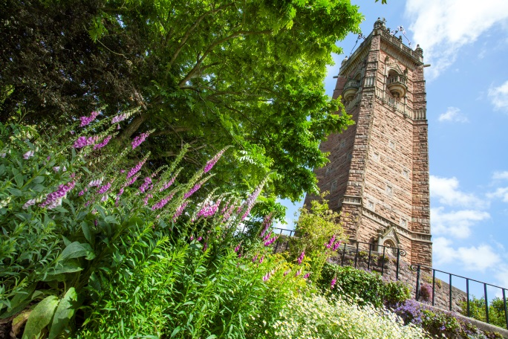
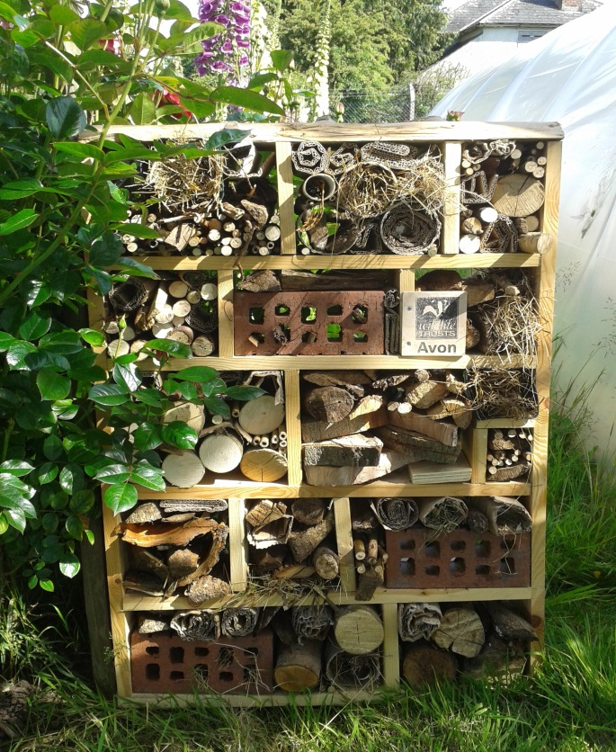
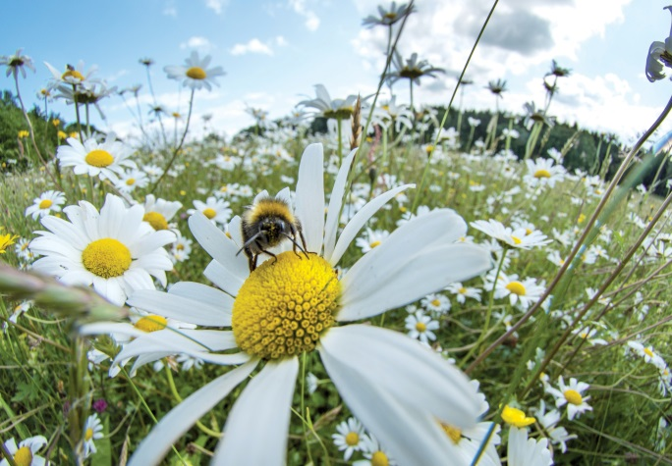
Nature
As human population increases and our cities grow in size there are less green areas in and around our cities
How our landscapes connect with large areas of concreate and tarmac can make it really difficult for animals of all shapes and sizes to get around
Animals that pollinate flowering plants, which we need to help grow our food, are in decline. One big reason for this is the toxic chemicals farmers use to spray their crops.
Chris Bahn
Sustainable Solutions
Avon Wildlife Trust
Steve Nicholls
Notes:
Facts:
Animals that live in the city have managed to adapt to the environment and are able to cope with the dangers as well as the unnatural light and noise.
The city landscape has similarities to the natural environments. For example, tall animals which have evolved to live on cliffs adapt survive on tall buildings, sewers and drains are like waterways and gardens and parks are similar to forests and meadows.
40% of London is actually green space making it one of the greenest city, for it’s size, in the world. Therefore, we should make sure this space is as animal and plant friendly as possible. (City of London 2013)

Slide 8
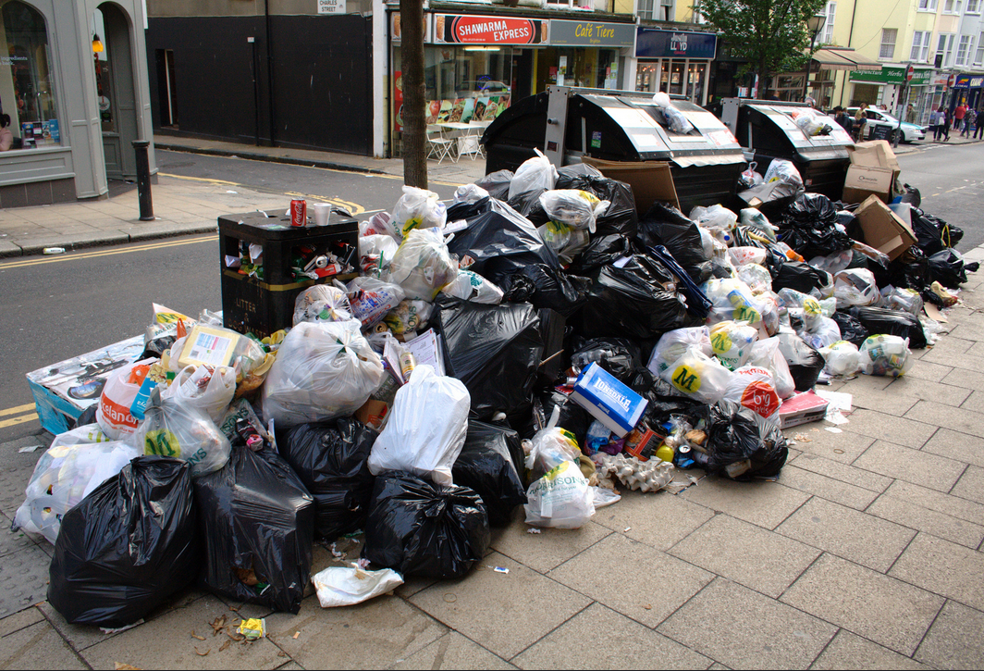
Waste
Photo Dominic AlvesCC By

Slide 9
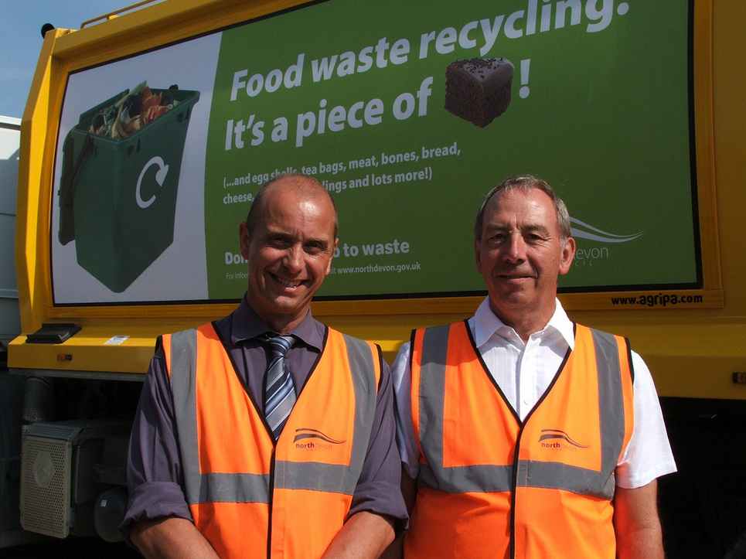
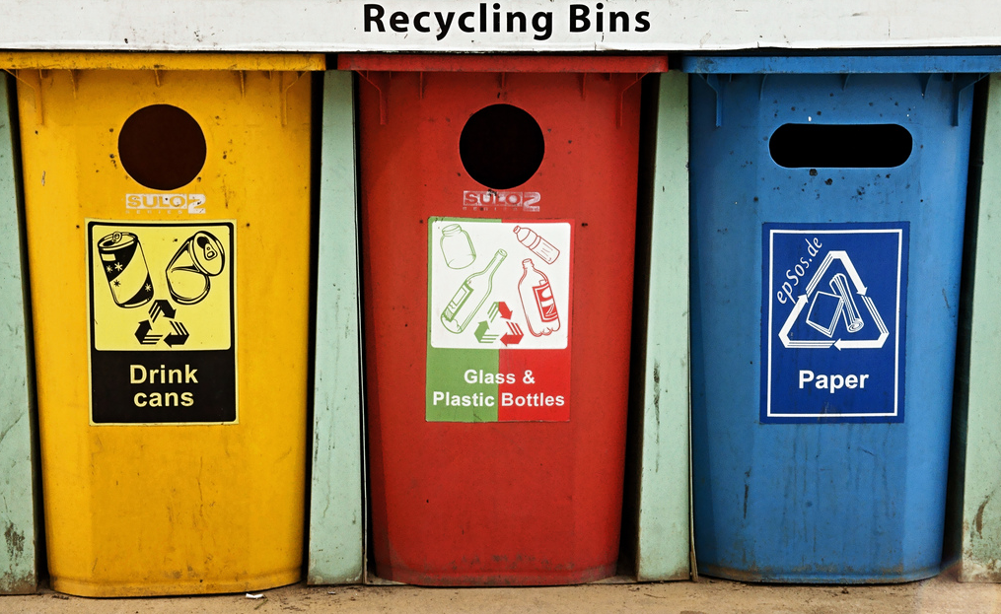
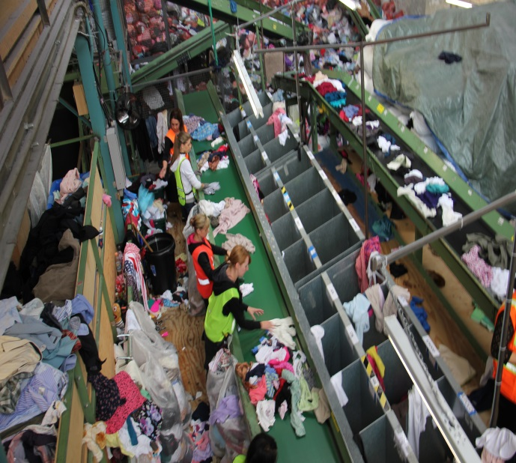
Waste
Most of this waste we throw away globally is from developed countries like the UK. We produce more than 290 million tonnes of waste every year and this number is increasing. A lot of this rubbish doesn’t rot away and finding somewhere to put all is a serious problem!
A lot of the waste we produce is actually recyclable.
We actually save energy by recycling.
Photo North Devon CouncilBy
Sustainable Solutions
Photo EpSos .deBy
Notes:
Facts:
The UK generates 290 million tonnes of waste per year, of which 22.9 million comes from our homes. (The Independent)
It is estimated that 80% of what goes into out dustbins can be recycled or composted. (CB Environmental Ltd)
We produce more than 20 times as much plastic as we did 50 years ago (Recycle Now)
Do you take your canvas bags with you when you go to the supermarket? Most plastic bags are used only once and they take over 100 years to decompose.
Why not track all the rubbish you throw away in a day? Multiply that by 64 million and you can get a rough idea about much waste we produce in the UK each every day.

Slide 10
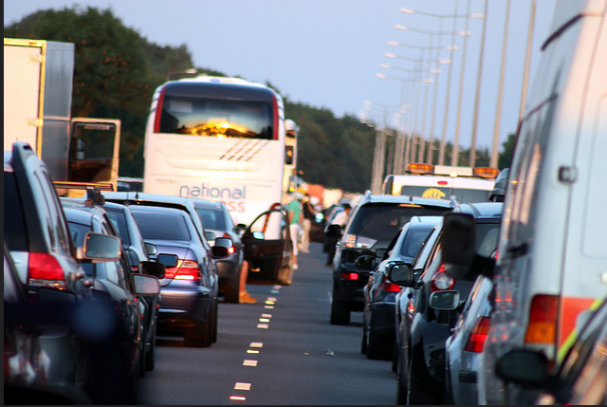
Transport
Photo Davind BoltonCC By

Slide 11
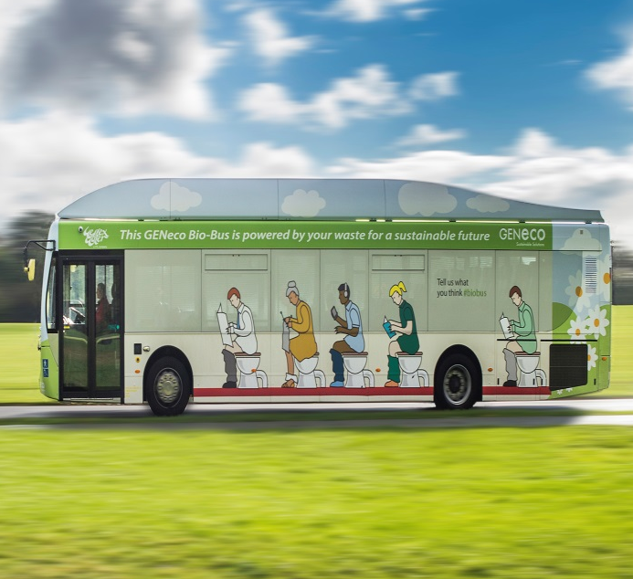
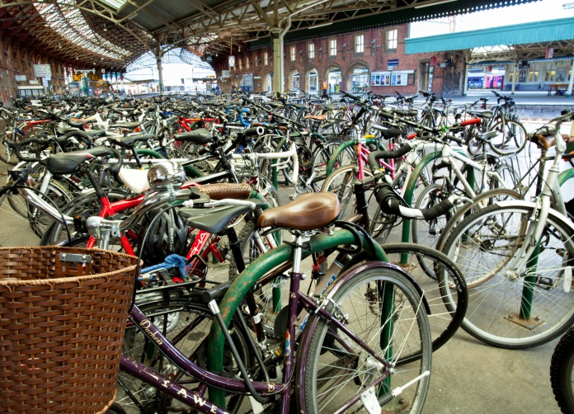
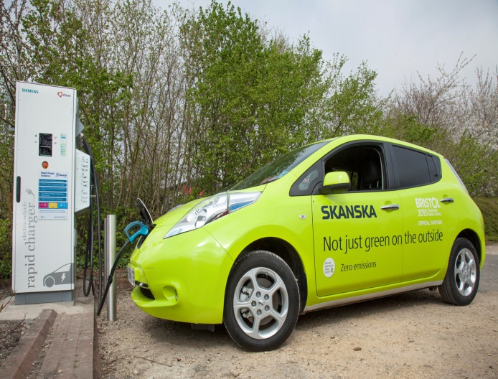
Transport
People face increasing levels of traffic congestion and parking difficulties; more car parks is not really a long term solution!
People who travel into cities for work are spending longer commuting. This leads to problems including stress, isolation and poor health through obesity.
Most cars need oil, which is turned into petrol, to run. This finite resource also creates smog and carbon monoxide pollution which is contributing to climate change.
Photo by Chris Bahn
Sustainable Solutions
Phot by Chris Bahn
Photo by Wessex Water
Notes:
Facts:
In Mumbai, India the commuter trains carry more than 7.5 million people every day. During their rush hour they carry 3 times the number of people they were designed for (Mumbai Suburban railway)
The Avenida 9 de Julio, located in the city of Buenos Aires, Argentina, is the widest road in the world with 16 lanes for traffic!
In London, it is estimated that 9,500 people die every year from exposure to air pollution (Kings College London (2015)

