Slide 1
Note to teachers
Thank you for downloading this presentation from the Young People’s Trust for the Environment. You are welcome to modify it by adding your own slides or deleting ones you don’t need.
Please do not remove the photo credits from any of the photos you use and we would be very grateful if you could leave YPTE’s logo and web address on the relevant pages.
We want to encourage more and more young people to learn about taking care of our world for the future. Our website is a great starting point for this, where you can find lots more supporting information - http://ypte.org.uk

Slide 2
SUSTAINABLE FOOD
4. FOOD WASTE
Registered charity number 1153740

Slide 3
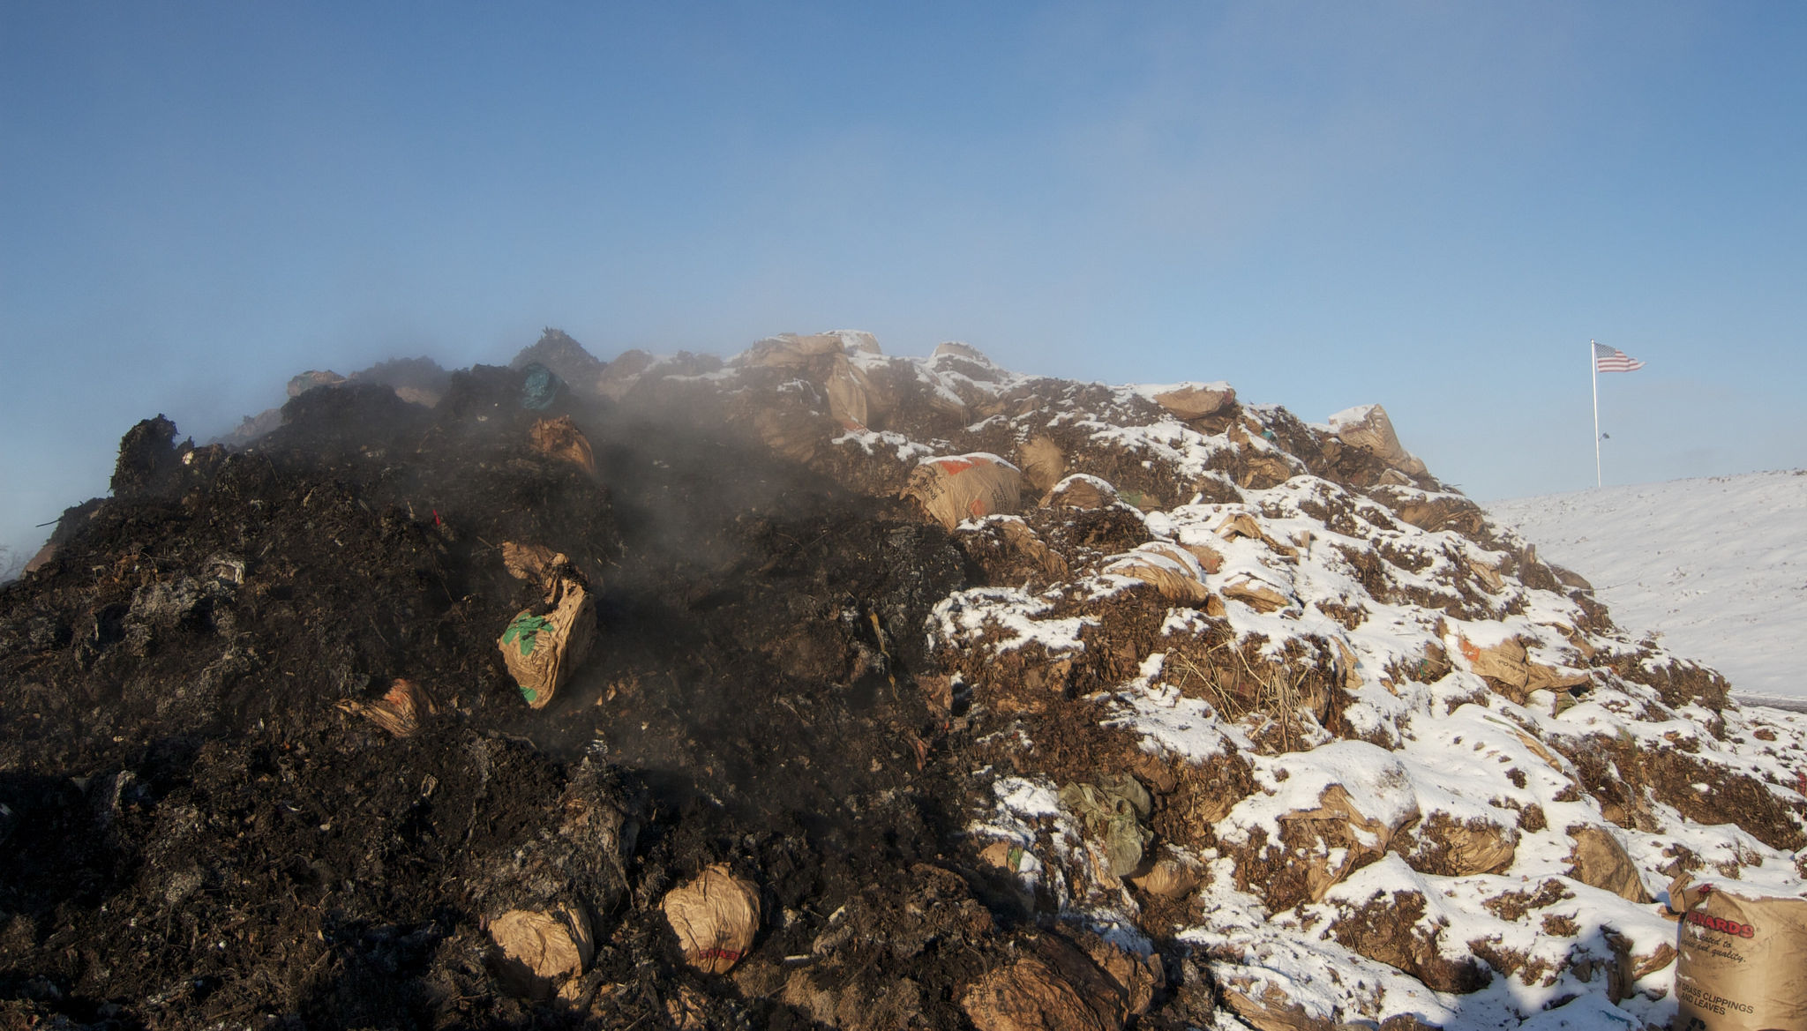
Each year 1.3 billion tonnes of food, about a third of all that is produced, is wasted
Commercial composting facility
Photo: MPCA Photos
This is enough to build a mountain 2 miles across and almost 8,000 feet high

Slide 4
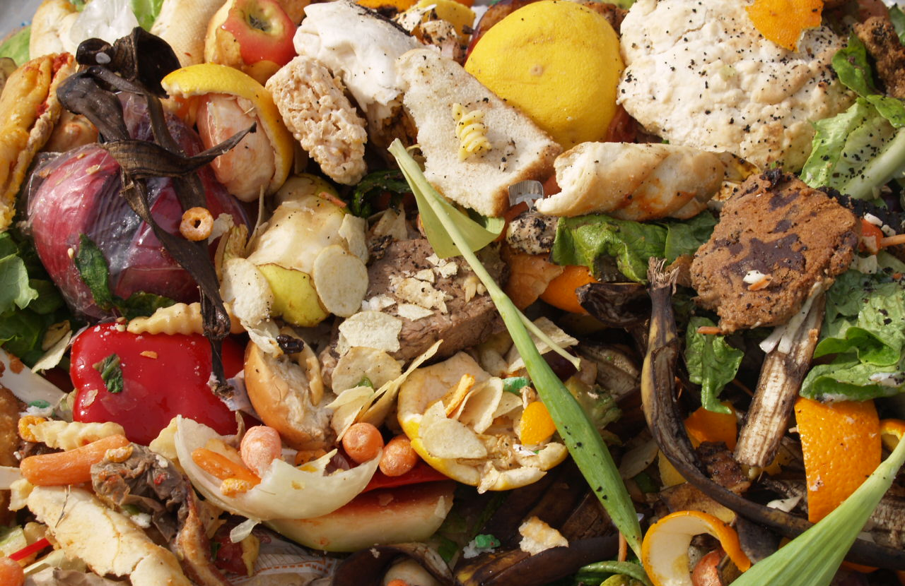
In 2015, the UK topped the chart of EU food waste
Photo: Starr

Slide 5
Food waste happens throughout the food supply chain
Food Waste
Crops grown but never harvested
Crops harvested but wasted
On-farm food waste
Storage & manufacturing spoilage and spillage
Supermarkets with surplus stock
Food left on plates in restaurants
Food thrown away at home

Slide 6
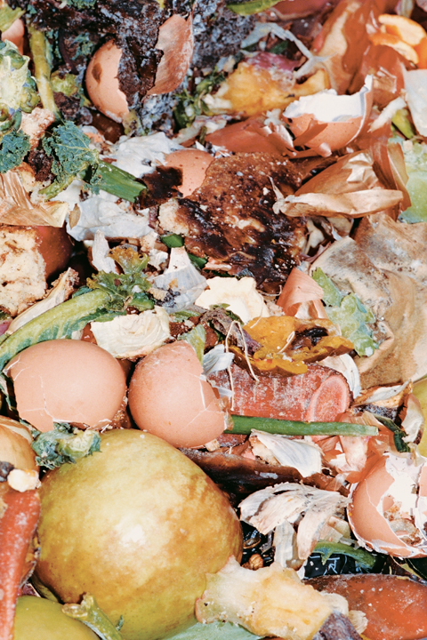
In 2016, 10 million tonnes of food & drink was wasted in the UK post-farm gate food chain.
60% of this could have been avoided.
Photo: brian james

Slide 7
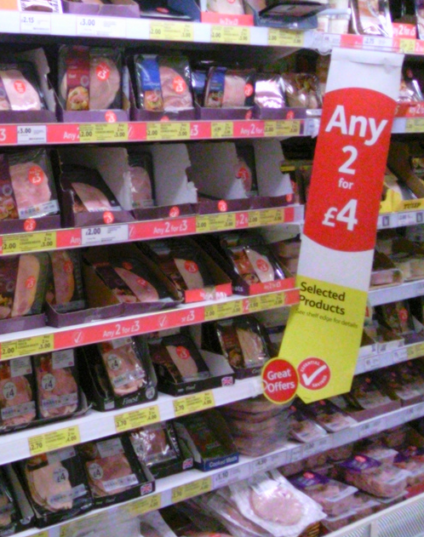
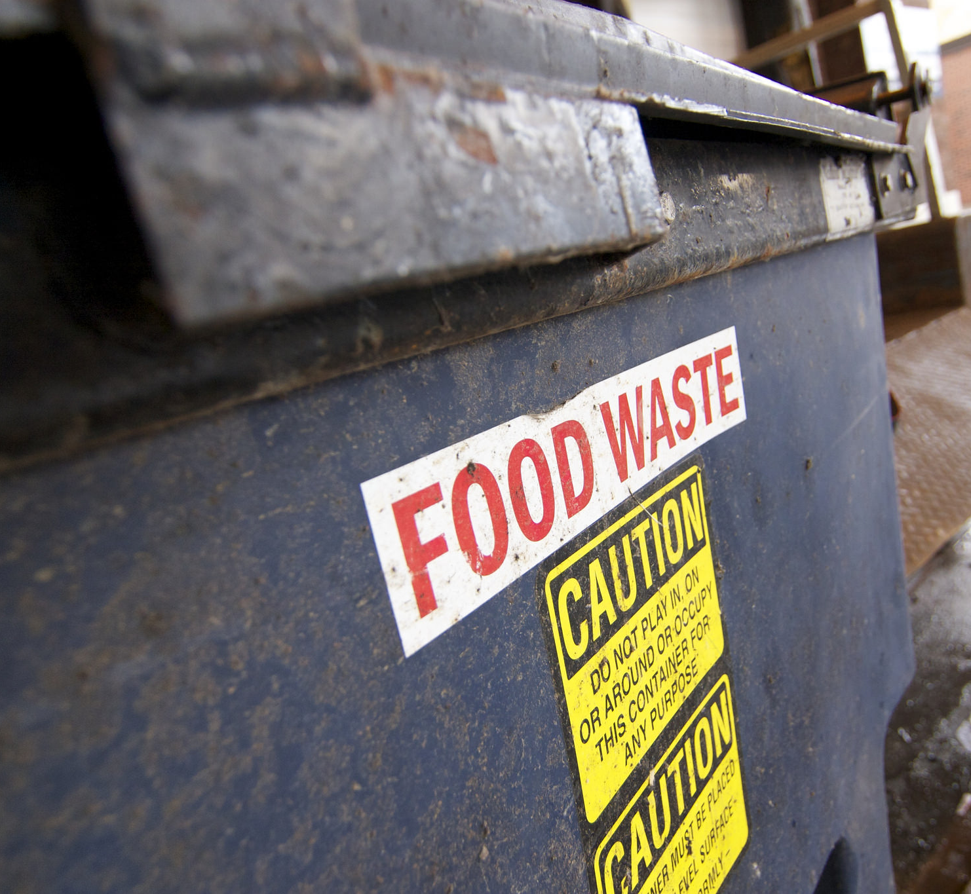
UK supermarkets throw away at least 115,000 tonnes of perfectly good food each year
Photo: MPCA Photos
Photo: Karen Bryan

Slide 8
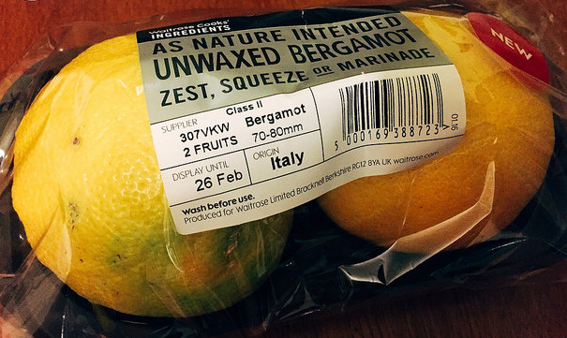
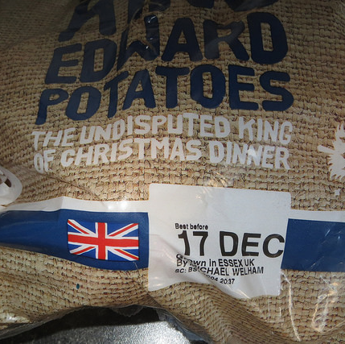
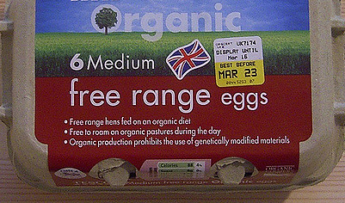
Unnecessarily strict sell-by dates mean that food is disposed of when it could still be eaten
Photo: Tom Ellis
Photo: David Short
Photo: duncan c

Slide 9
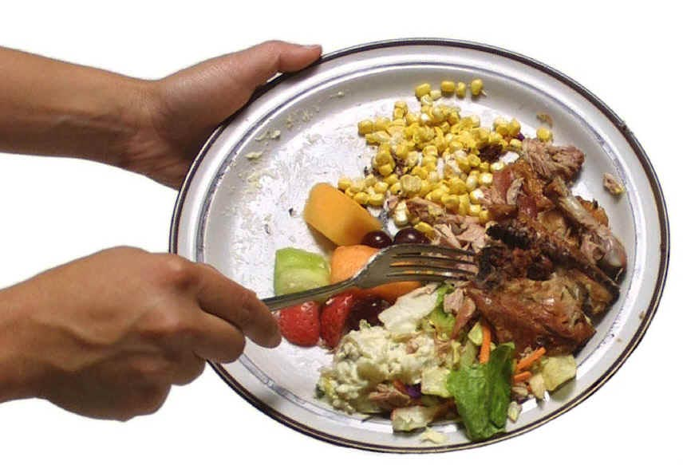
70% of post-farm gate food waste is produced by households
Photo: jbloom

Slide 10
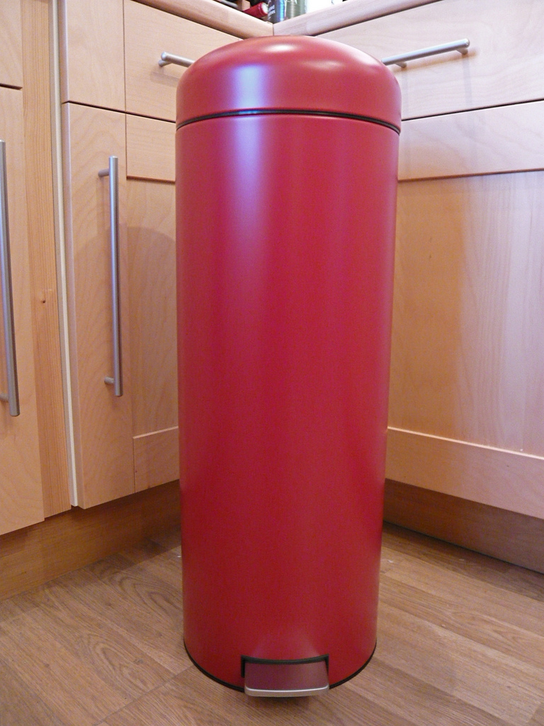
In 2015 an estimated 7.3 million tonnes of household food waste was thrown away
Much of this was avoidable waste
Photo: Jessica Spengler

Slide 11
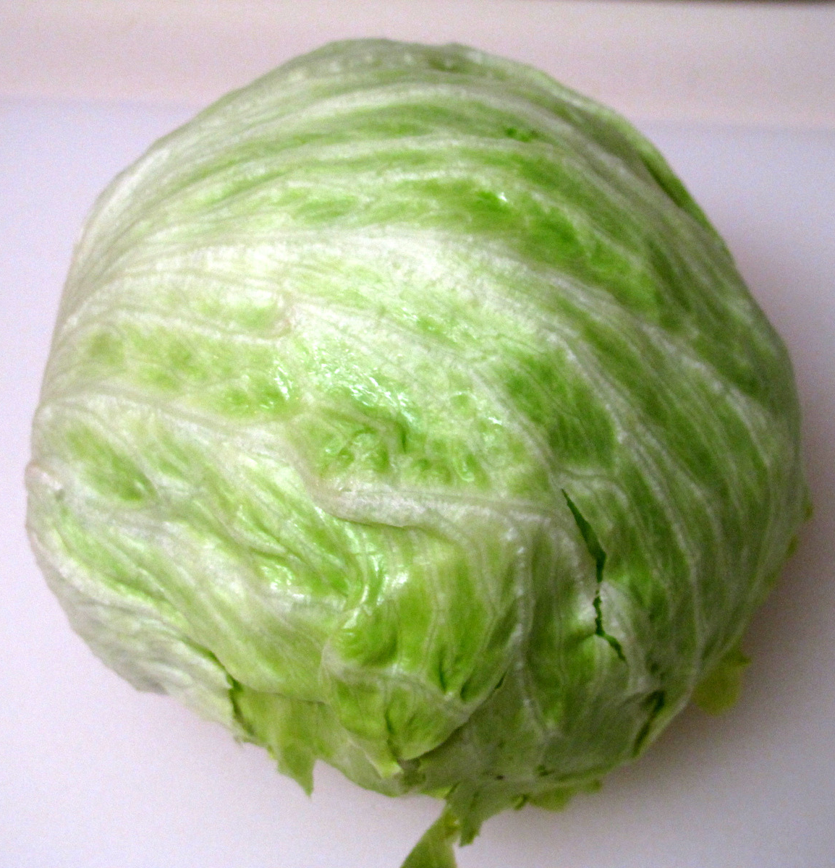
Did you know?
We throw away 38.7% of all lettuce
Photo: Julia Frost

Slide 12

We throw away 22.4% of all bread
Photo: Liz

Slide 13
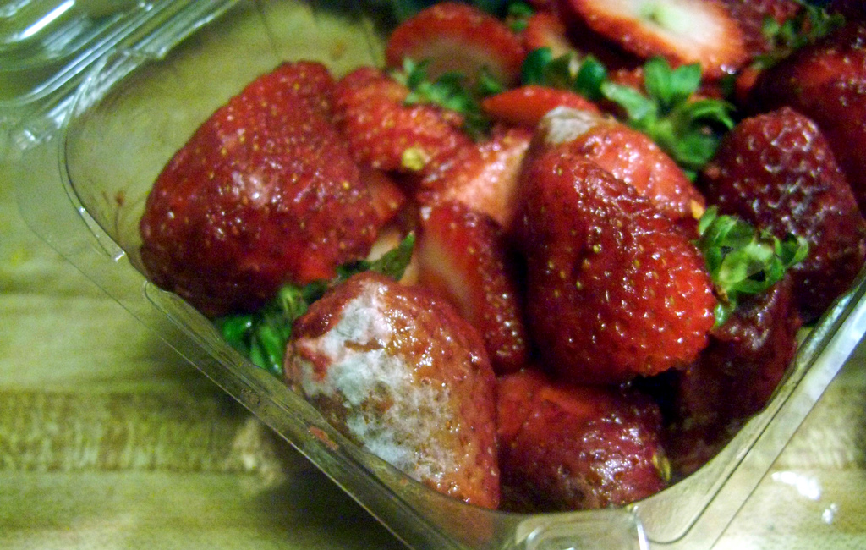
40% of food thrown away that could have been eaten is fresh fruit and vegetables
Photo: Jo Naylor

Slide 14
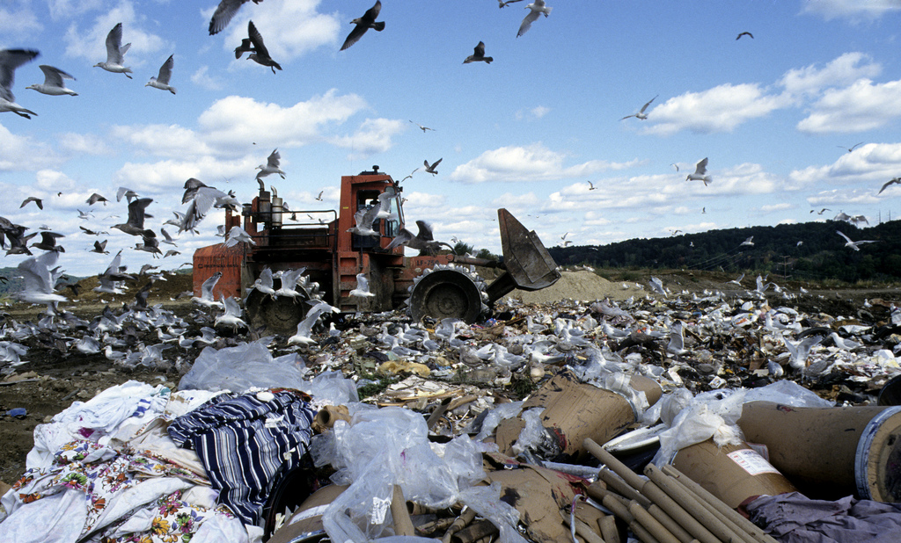
Tonnes of food ends up in landfill each year in the UK. As it rots, it releases methane which is a greenhouse gas.
Photo: United Nations Photo
Photo: United Nations Photo

Slide 15
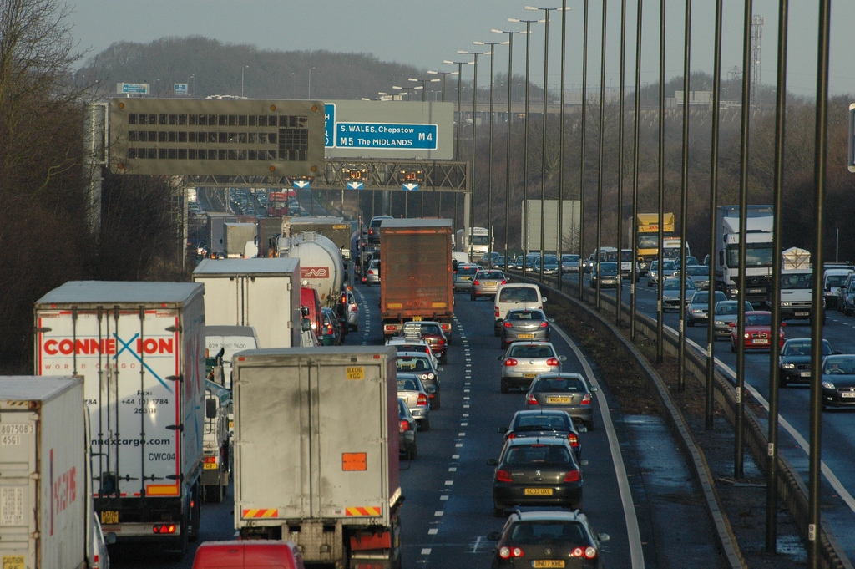
If avoidable food waste was prevented it would have the environmental benefit of taking 1 in 4 cars of UK roads
Photo: jonbgem

Slide 16

The cost of food waste to an average family with children is around £700 per year
Photo: AJ Cann

Slide 17
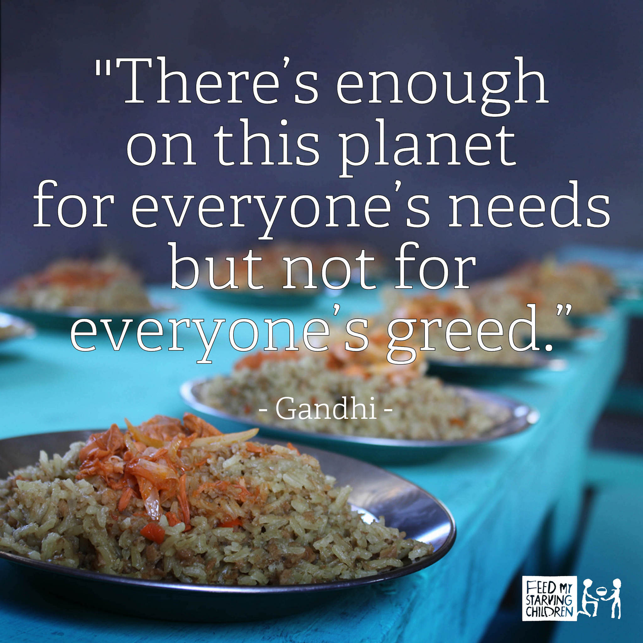
Nearly 1 billion people in the world don’t get enough to eat.

Slide 18
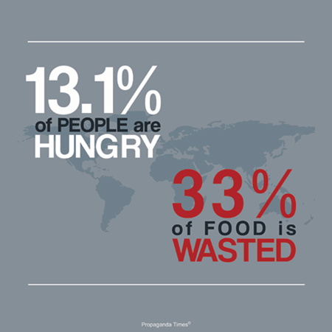
In the UK 7.3 million tonnes of food is thrown away by households each year.

Slide 19

The Love Food Hate Waste campaign encourages people to waste less food.
Together we can all make a big difference.
Photo: University of Salford Press

Slide 20
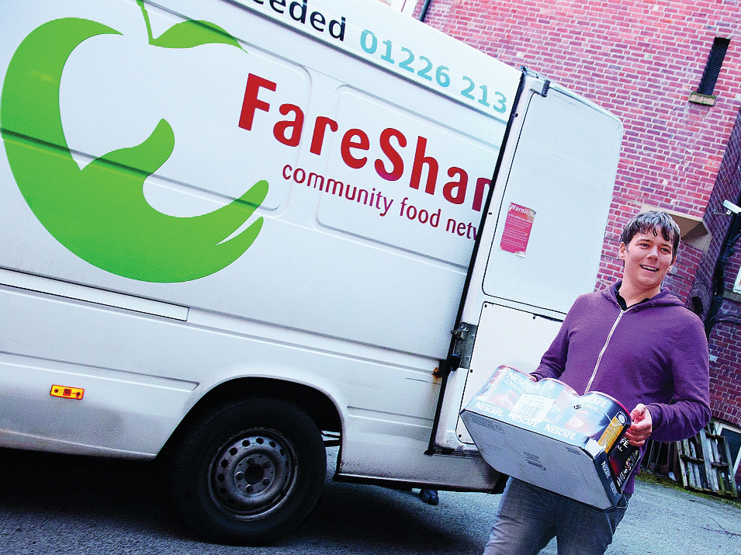
Food redistribution schemes save food from being wasted and make sure it gets to those who need it
Photo: Nestle

Slide 21
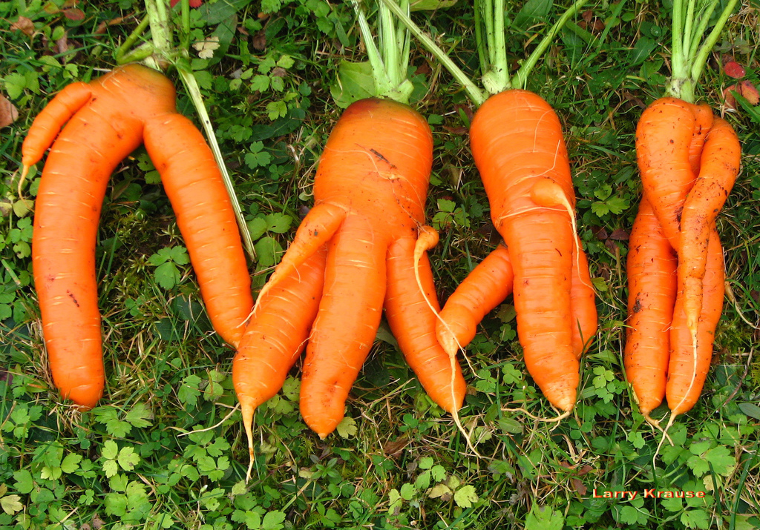
Many supermarkets have launched ‘wonky veg’ ranges in order to reduce food waste
Photo: Larry Krause

Slide 22
The Waste Hierarchy
Reduce
Reuse
Recycle/Compost
Energy Recovery
Landfill
Most favoured option
Least favoured option

Slide 23
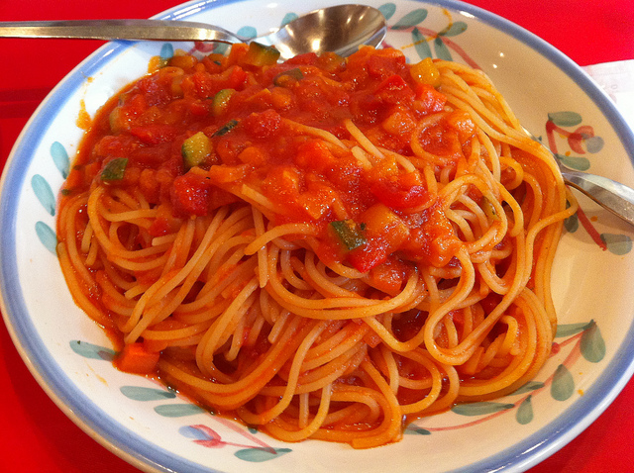
Try to reduce food waste
Think about portion sizes
Photo: Junya Ogura
Keep an eye on best before dates
Photo: duncan c

Slide 24
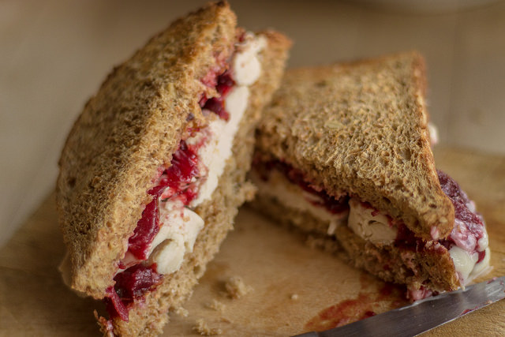

Waste is not waste until we waste it
Photo: Stevesworldofphotos
Photo: Fahara F
Don’t waste the leftovers from your roast turkey - they could make sandwiches for lunch the next day or a delicious curry

Slide 25
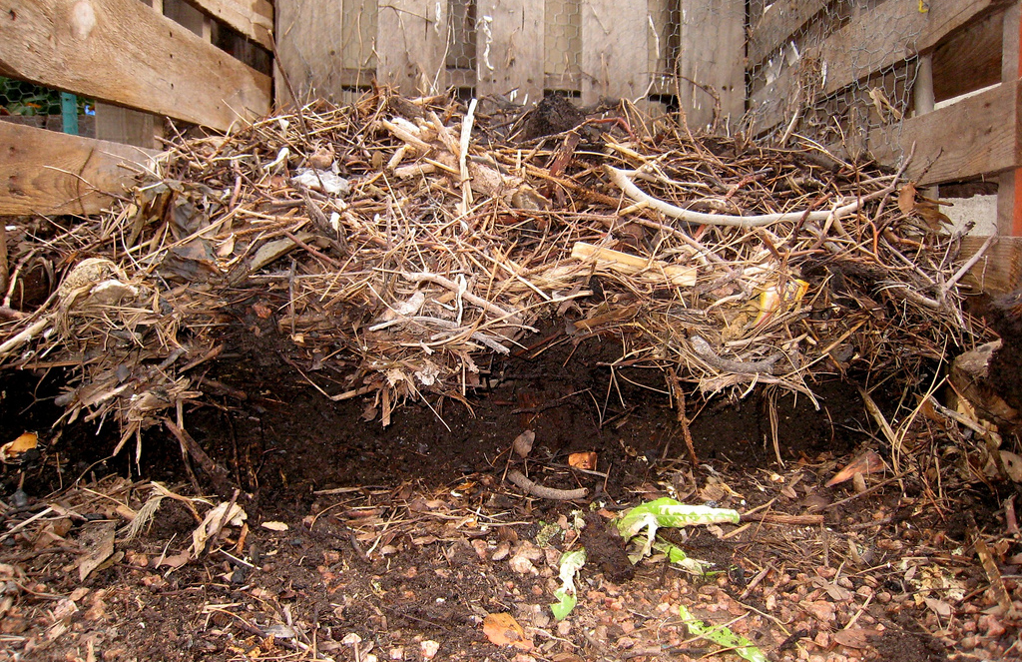
Do you have space at home or at school for a compost heap?
Photo: Alan Levine

Slide 26
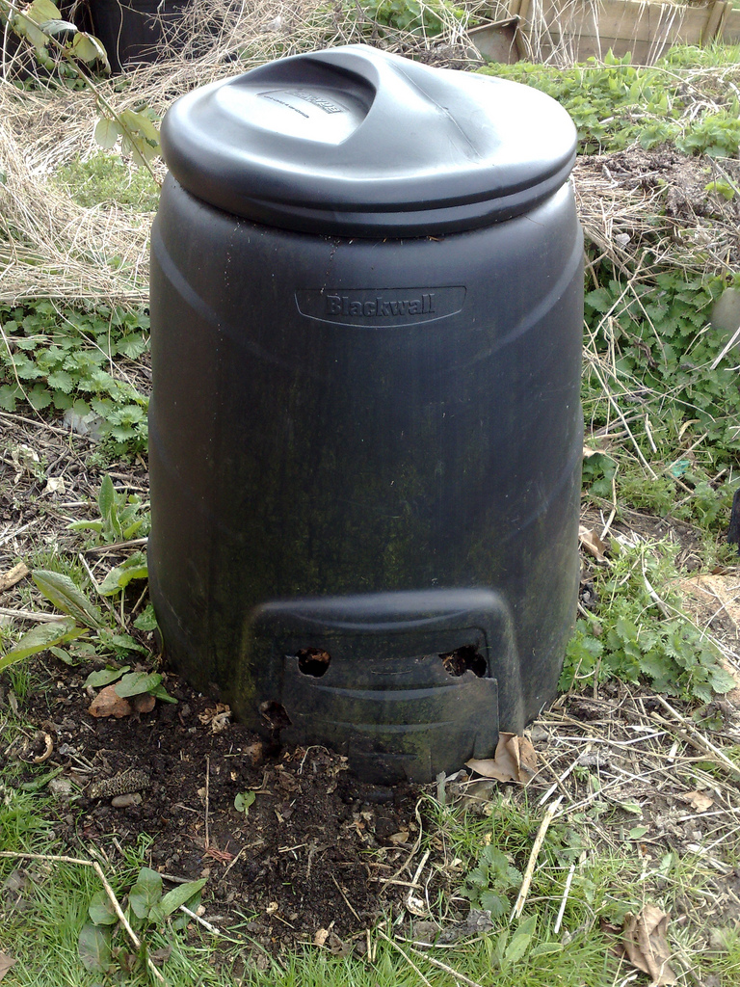
Home composting stops food waste ending up in landfill and reduces greenhouse gas emissions
Photo: Pat Joyce

Slide 27
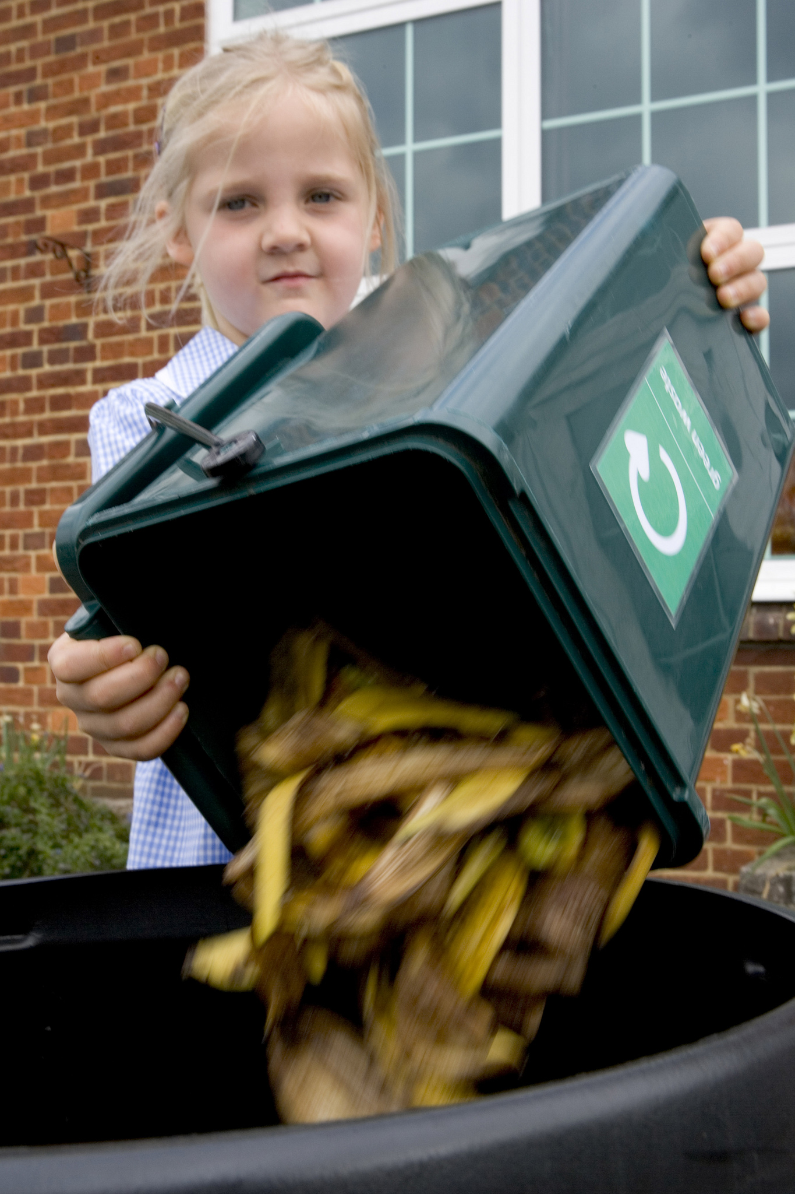
Can you introduce food composting at your school?
Photo: wastebusters

Slide 28
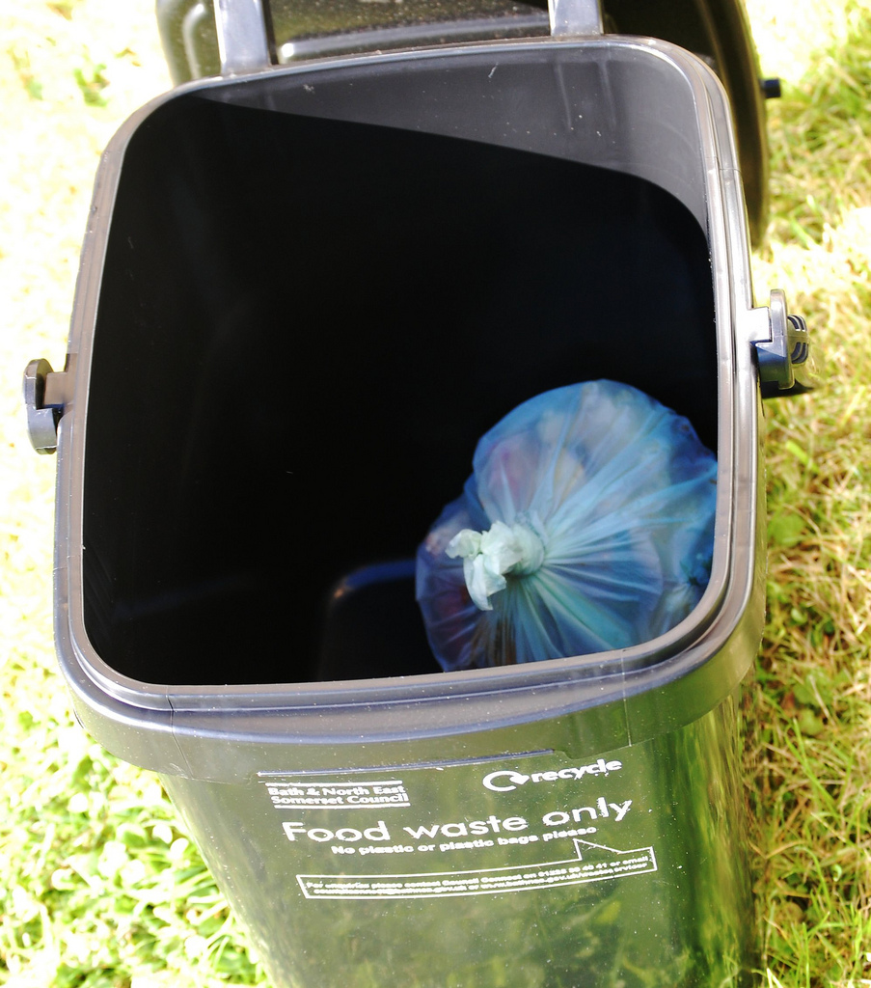
Food waste can be recycled into a fertiliser and
even generate electricity that can be fed back into the national grid
Photo: evil nick

Slide 29
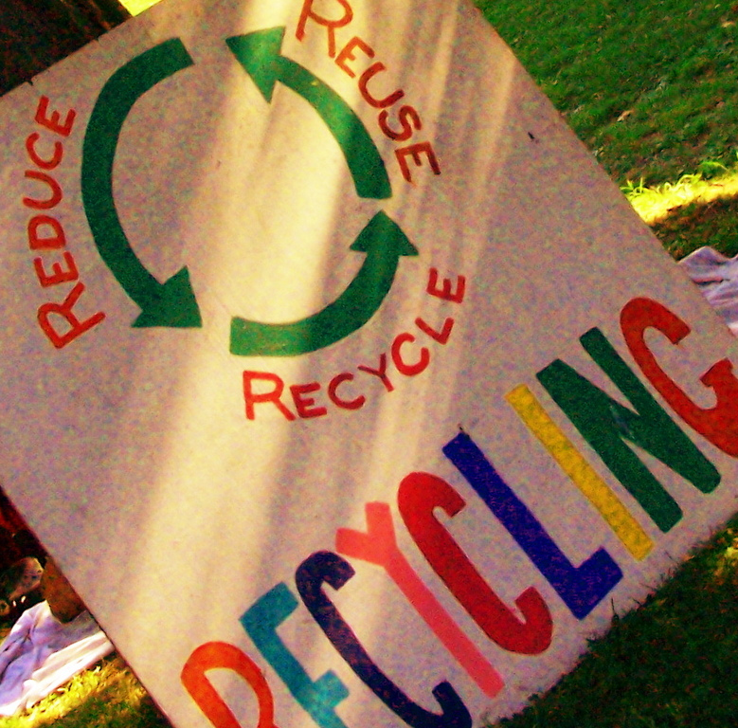
We are all responsible for reducing food waste.
By making a few small changes, we can all make a difference.
Photo: Andy Arthur

Slide 30
To find out more, please visit
ypte.org.uk
Registered charity number 1153740
Creating a better future by inspiring young people to look after our world

Slide 31
Credits
YPTE would like to thank all the amazing photographers on Flickr who allow the use of their photos for non-commercial purposes.
Your photos are helping young people to learn more about environmental issues. We couldn’t have created this presentation without you!

