Slide 1
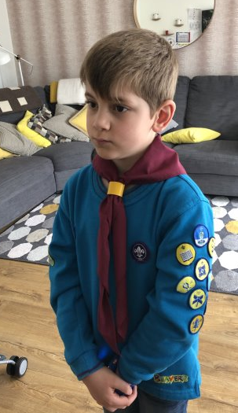
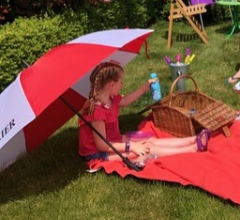
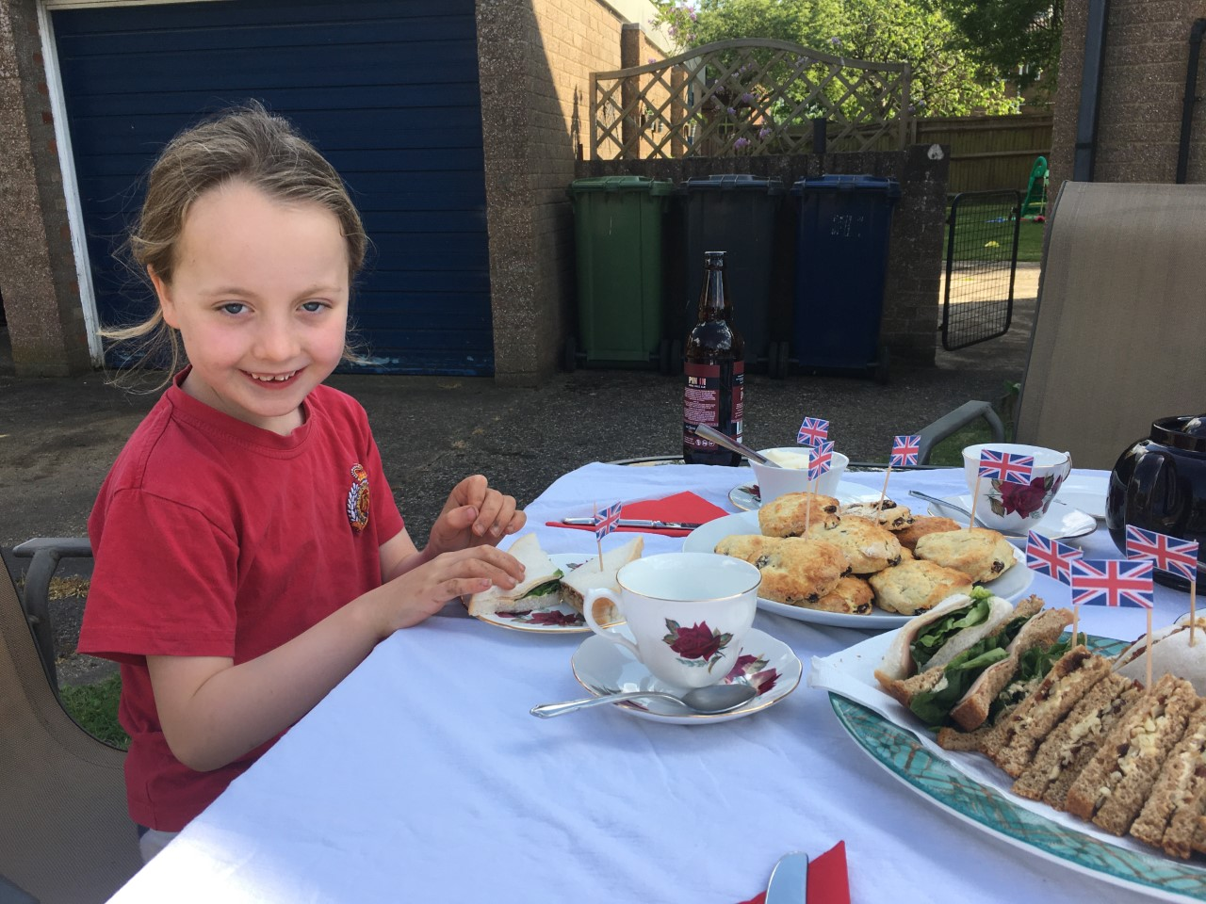
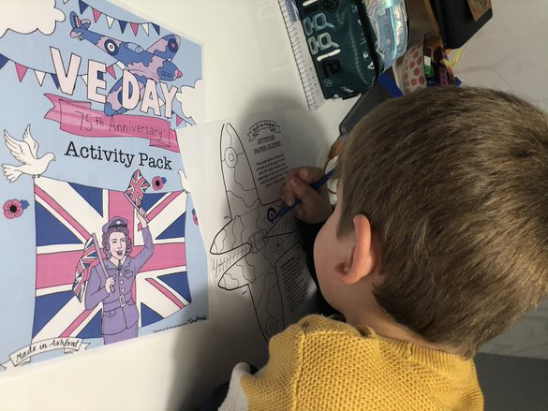
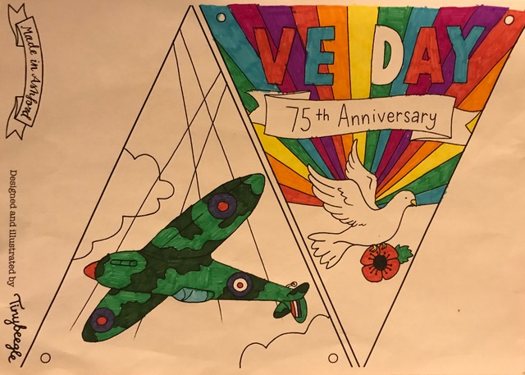
Thanks for the V.E. Day photos. Jack you look so smart, Ellie that tea looks yummy and is making me hungry and Ella your picnic in the sun looks brilliant, Mrs Tarpey xxx
(If I have missed anybody off please tell me and I can add you on)

