Slide 1
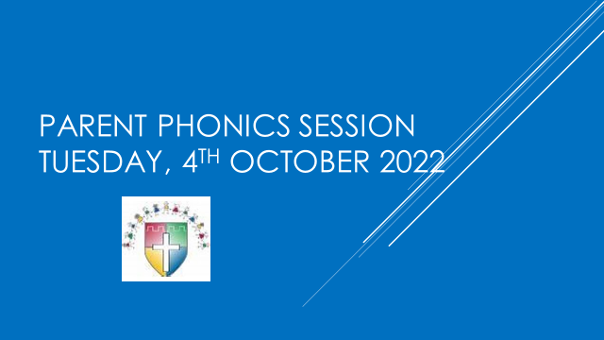

Slide 2


Slide 3
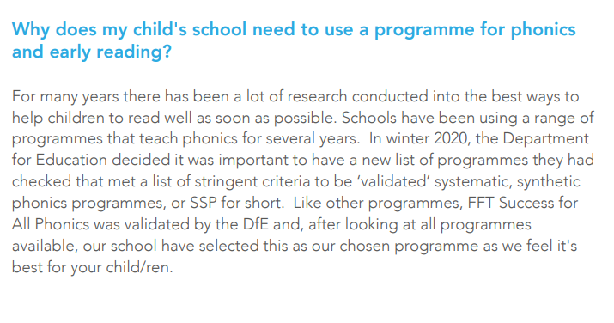

Slide 4
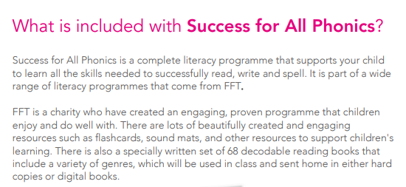

Slide 5
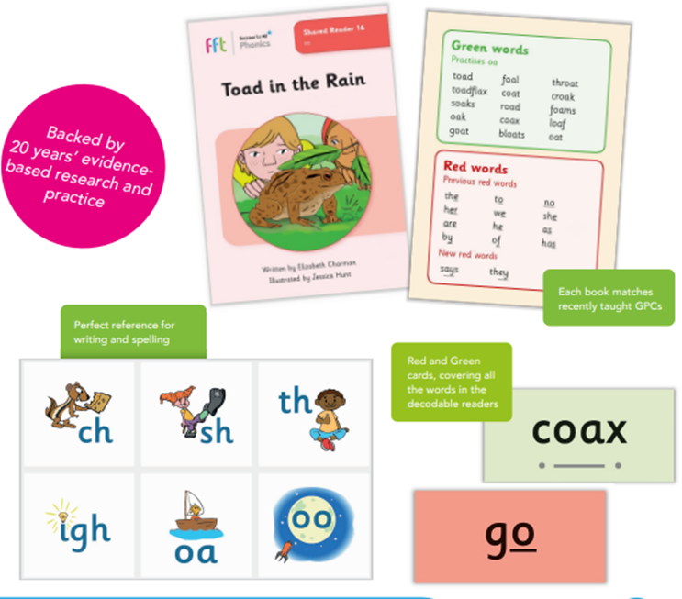

Slide 6
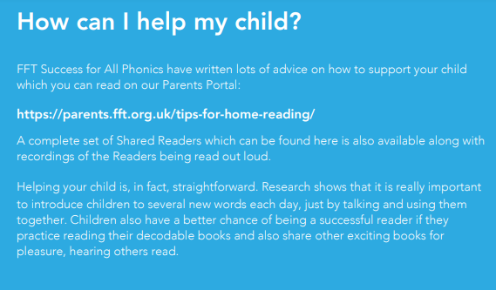
Link to parent portal

Slide 7
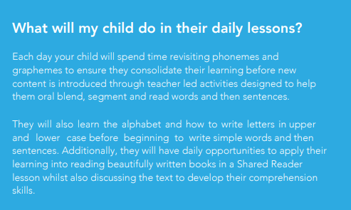

Slide 8
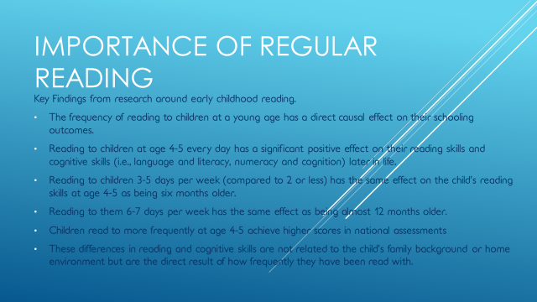

Slide 9
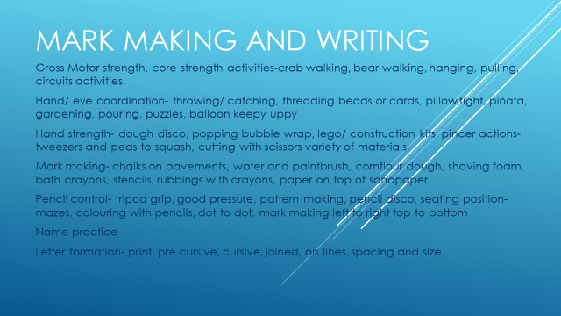

Slide 10
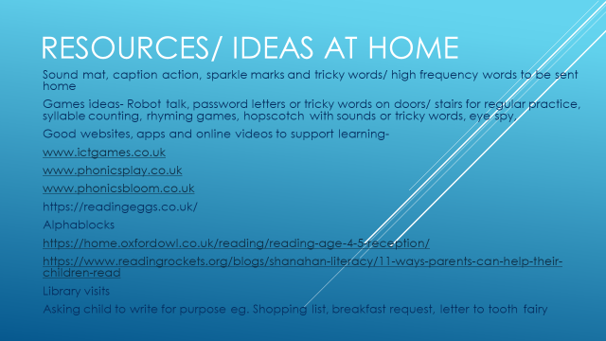

Slide 11
https://www.cambridgeshire.gov.uk/residents/children-and-families/schools-learning/help-with-school-learning-costs/free-school-meals#eligibility-2-0
Eligibility
Your child will get free school meals if you receive any of the following:
Income Support
Income Based Job Seekers Allowance
Income-related Employment and Support Allowance
Child Tax Credit - but no element of Working Tax Credit - and have an annual income (as assessed by HM Revenue and Customs (HMRC)) that does not exceed £16,190
If you are supported under Part VI of the Immigration and Asylum Act 1999
Guarantee element of State Pension Credit
Working Tax Credit during the four week period immediately after your employment finishes or after you start to work less hours per week
Universal Credit with an annual net earned income of no more than £7,400 (as from 1 April 2018)

