Slide 1


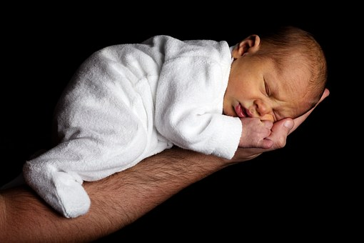
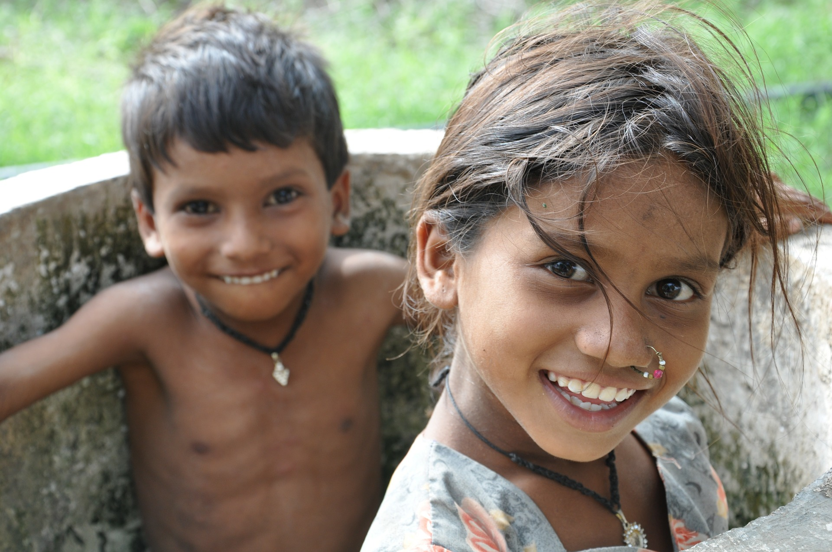

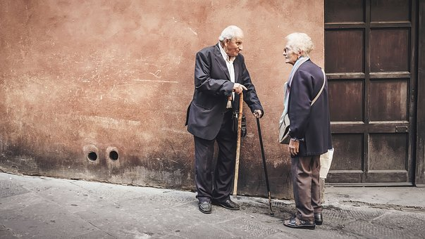

S02.05.10 Handout
We would like you learn how humans grow by looking at how babies grow into adults.
In this exercise, we want you to sort the images into the correct sequence. Draw them in the right order and label them correctly.
Stretch:
To label then place the growing stages in the correct sequence and explain the difference.
Challenge:
To label then place the growing stages in the correct sequence.
word bank:
baby
toddler
child
teenager
adult
elderly
Developing Experts Ltd. © 2022

