Slide 1
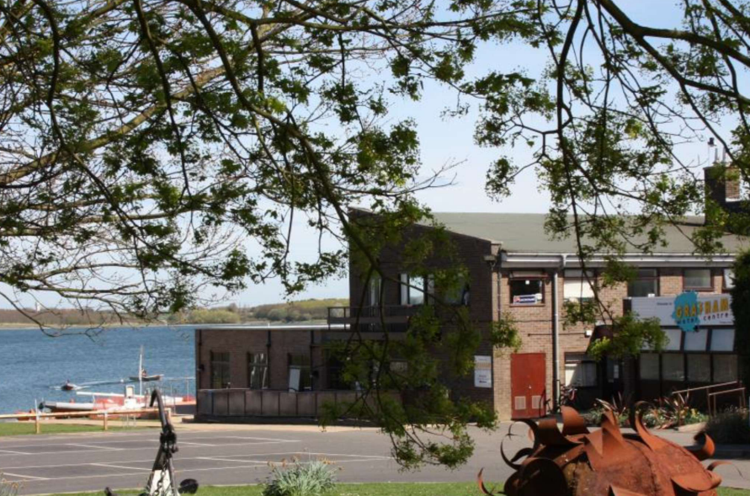
Grafham Water residential
Monday 28th – Wednesday 30th March

Slide 2
Agenda
Aim of the trip
Schedule
What to bring / Tips
Sample menu
Video
On the day
Questions

Slide 3
Aim of the trip
Teamwork, communication and respect for others
Self awareness, confidence, taking responsibility
Problem solving, planning, leadership, creativity
Developing Outdoor Activity skills
Supporting other subjects in the National Curriculum
Making memories
Growing independence

Slide 4
Schedule
Breakfast – altogether
Activity – in groups
Lunch - altogether
Activity - in groups
Dinner – altogether
Chill time – altogether
Bedtime – allocated bedrooms

Slide 5
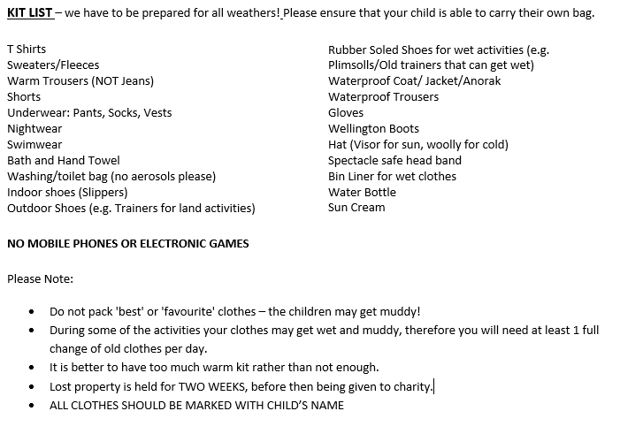
What to bring
There is a souvenir shop onsite so children can bring £5 in a named envelope that will be kept by an adult.
This should be handed into the office by Thursday 24th March.

Slide 6
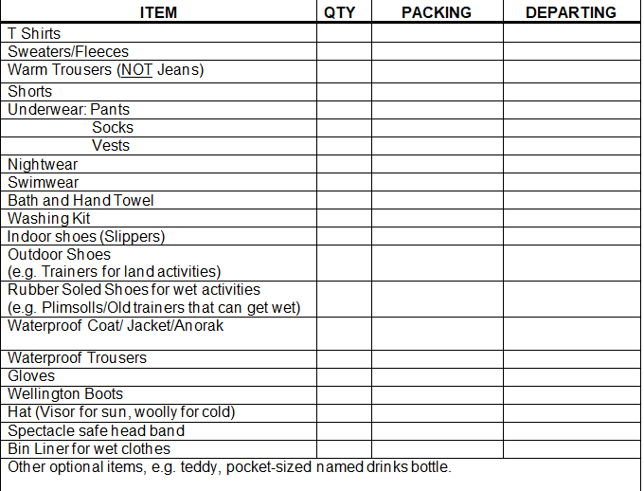
Tips
Label everything.
Pack with your child.
A change of clothing per day.
Layers – warmer options.
Bin liner – for dirty clothes.
NO devices /electronics. NO aerosols
Lost property held for 2 weeks.

Slide 7

Sample menu

Slide 8
Video
Residential Visits - Grafham Water Centre (grafham-water-centre.co.uk)

Slide 9
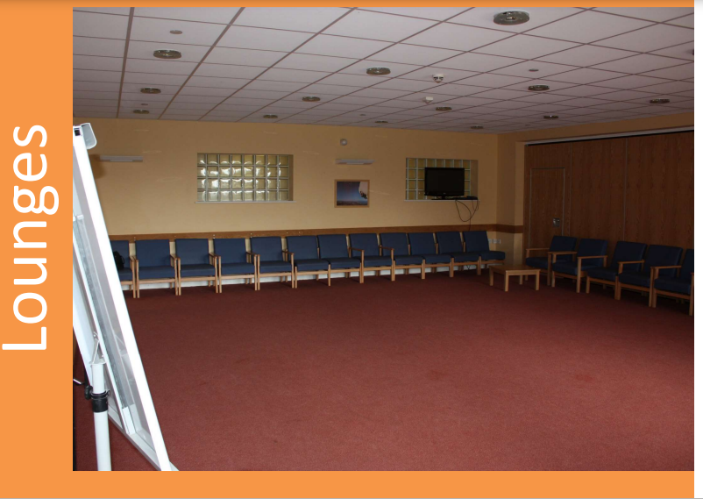
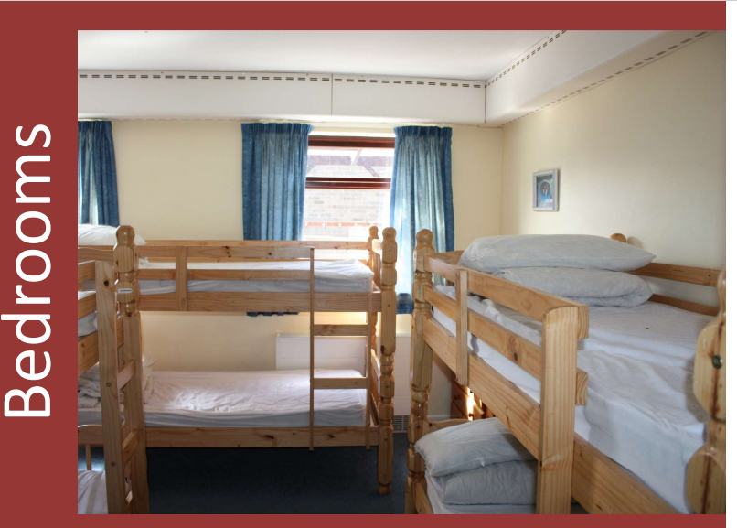
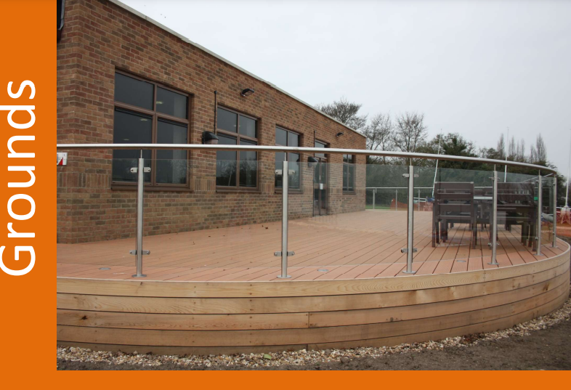
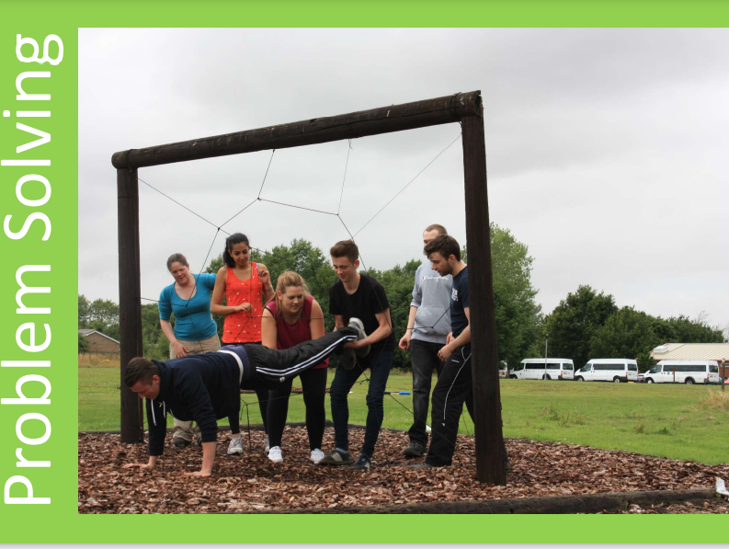

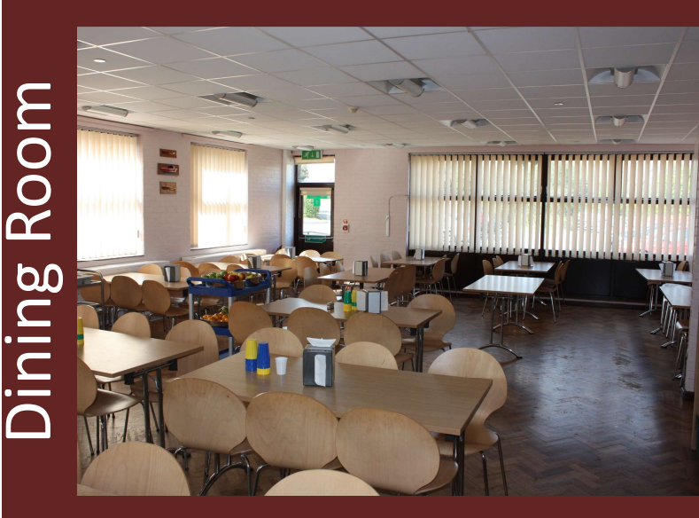

Slide 10
On the day
Arrive at 10.00 – 10.15 on Monday 28th March
Grafham Water Centre, Perry, Huntingdon, Cambridgeshire, PE28 0GW
Bring a packed lunch and a water bottle they will use all week.
Bring a completed medical form should have been filled in and hand any medicines, named to at Mrs Holl.
(Medicines, including travel sickness tablets, should be prescribed, in the original packaging with the chemist’s instructions should be clearly labelled with the child's name. Apart from asthma inhalers, all medicines should be handed in on the morning of departure.)
Pick up 14.30 on Wednesday 30th March from Grafham Water Centre
If you need to contact the staff on the residential visit, please contact the school office.

Slide 11
Questions?

