Slide 1


Slide 3

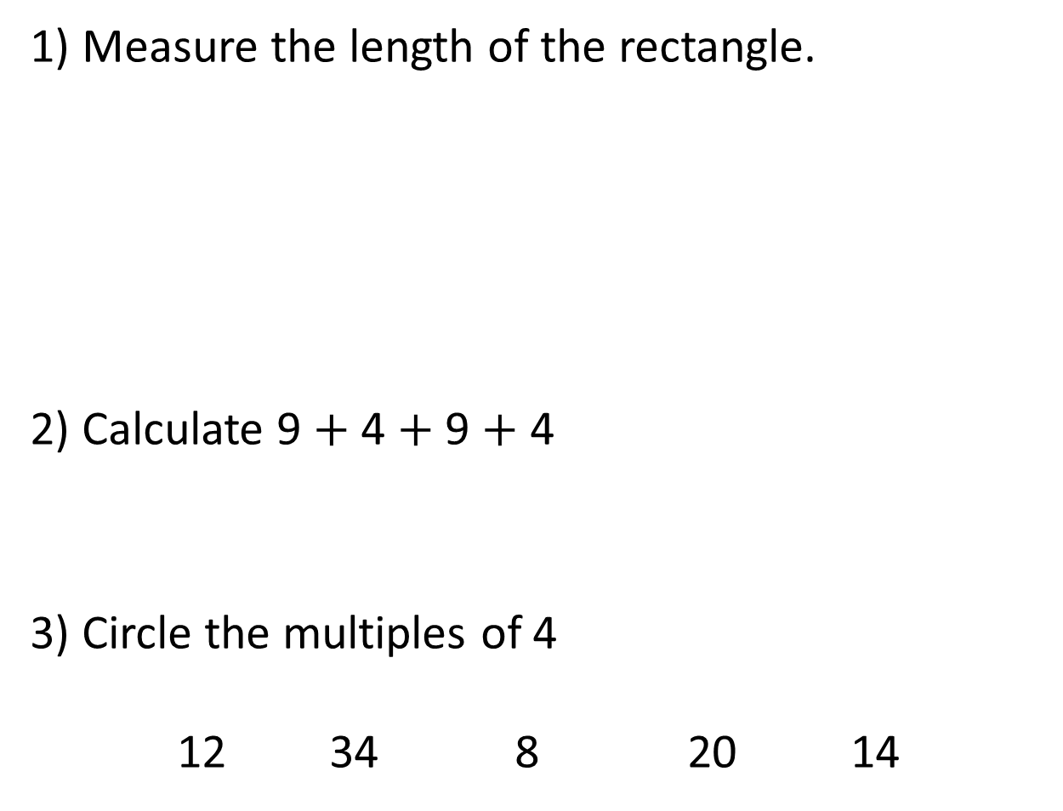
1) Measure the length of the rectangle.
2) Calculate 9 $+$ 4 $+$ 9 $+$ 4
3) Circle the multiples of 4
12 34 8 20 14
cm

Slide 4
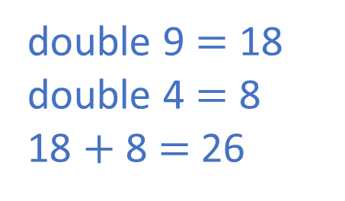
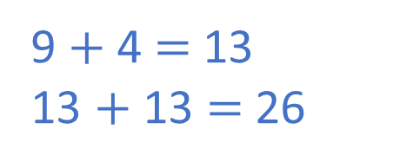
1) Measure the length of the rectangle.
2) Calculate 9 $+$ 4 $+$ 9 $+$ 4
3) Circle the multiples of 4
12 34 8 20 14
11 cm
cm
double 9 $=$ 18
double 4 $=$ 8
18 $+$ 8 $=$ 26
9 $+$ 4 $=$ 13
13 $+$ 13 $=$ 26

Slide 6
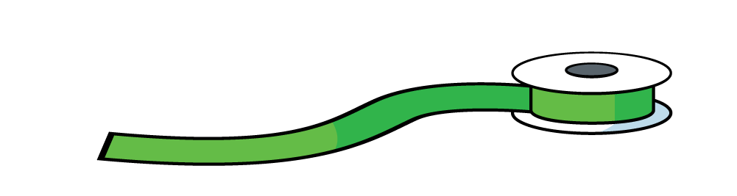
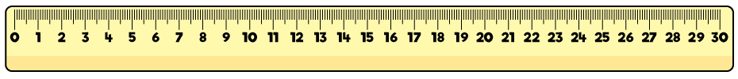
Perimeter is the total length around the edge
of a 2-D shape.
The perimeter of the rectangle is 22 cm.

Slide 7
Have a go at questions 1 and 2 on the worksheet

Slide 8
9 cm
13 cm
13 cm
9 cm
9 cm + 13 cm + 9 cm + 13 cm =
44 cm
22 cm
22 cm

Slide 9
Have a go at questions 3 and 4 on the worksheet

Slide 10
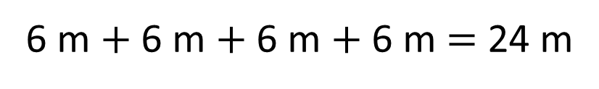
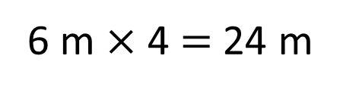
Can you work out the perimeter of the square?
6 m
6 m
6 m
6 m
6 m $×$ 4 $=$ 24 m
6 m $+$ 6 m $+$ 6 m $+$ 6 m $=$ 24 m

Slide 11



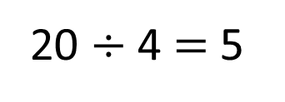
Draw a square with a perimeter of 20 cm.
20 $÷$ 4 $=$ 5
A square has 4 sides, all the same length.
Have a think
How many different rectangles can you draw with a perimeter of 20 cm?

Slide 12
How many different rectangles can you draw with a perimeter of 20 cm?
1 cm
6 cm
3 cm
7 cm
4 cm
9 cm
8 cm
2 cm
width $+$ length $=$ $\frac{1}{2}$of the perimeter of a rectangle

Slide 13
Have a go at the rest of the worksheet

