Slide 1

Sustainable Cities

Slide 2
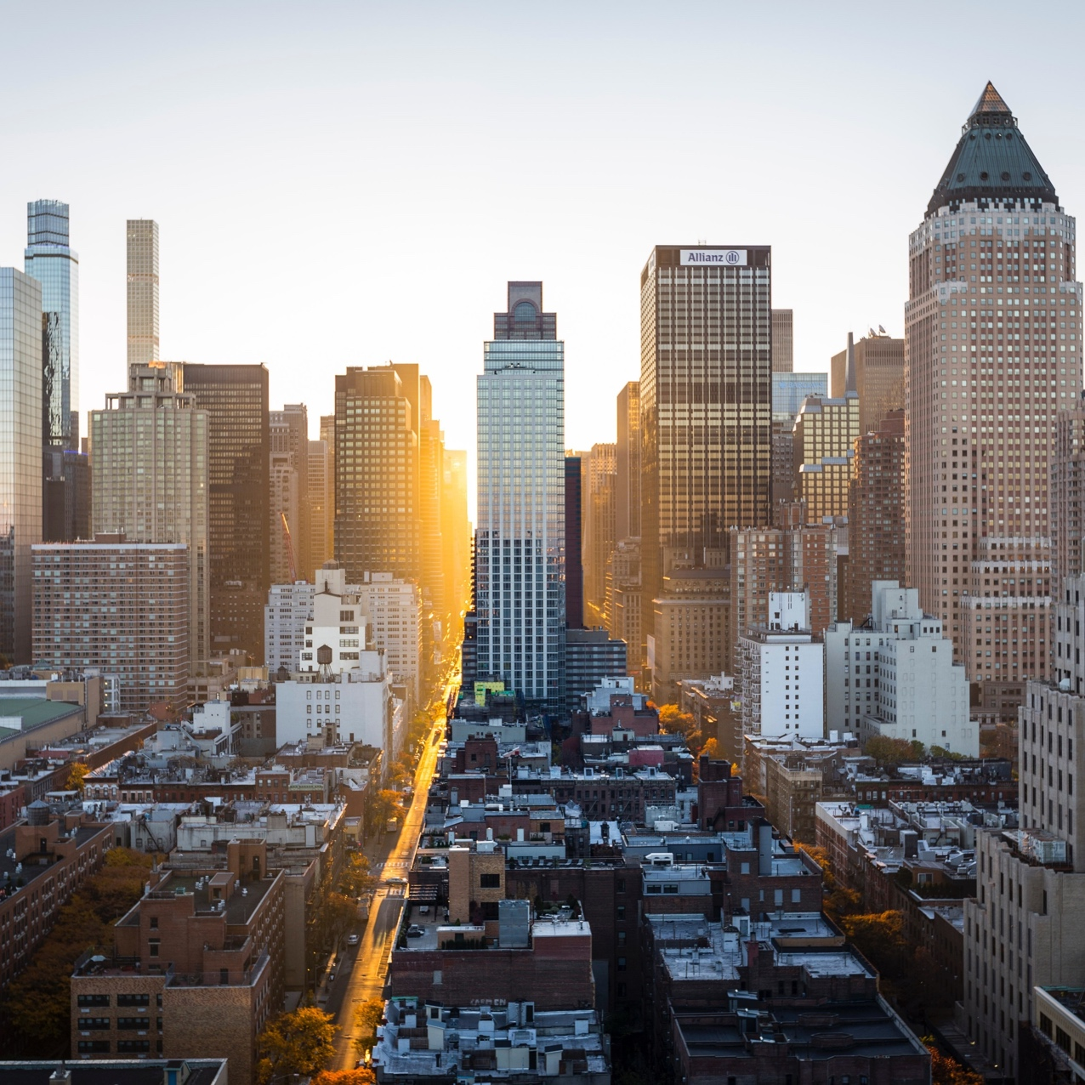
What makes a city sustainable?
It is estimated that 50% of the world’s population now live in cities. With this migration into large urban centres, the difficulty of meeting the basic needs of millions has become an ever-increasing problem. Overpopulation, excessive consumption, pollution, and depletion (running out) of resources have presented environmental and health challenges in major cities. The need has never been greater to find solutions and redesign urban landscapes. In 1994, the Aalborg Charter for sustainable cities and towns was created, and since then cities around the world have been leading the way in innovative and integrated approaches to sustainable living.

Slide 3
Let’s look at the lyrics to our PAC song. What do they mean? Why am I highlighting them today?
They paved paradise
And put up a parking lot
With a pink hotel, a boutique
And a swinging hot spot
Don't it always seem to go
That you don't know what you've got til its gone
They paved paradise
And put up a parking lot
They took all the trees
And put 'em in a tree museum
And they charged the people
A dollar and a half to seem ‘em
No no no
Don't it always seem to go,
That you don't know what you've got
Til its gone
They paved paradise
And put up a parking lot
Hey farmer farmer
Put away the DDT
I don't care about spots on my apples
Leave me the birds and the bees
Please!
What do they mean? Discuss.

Slide 4
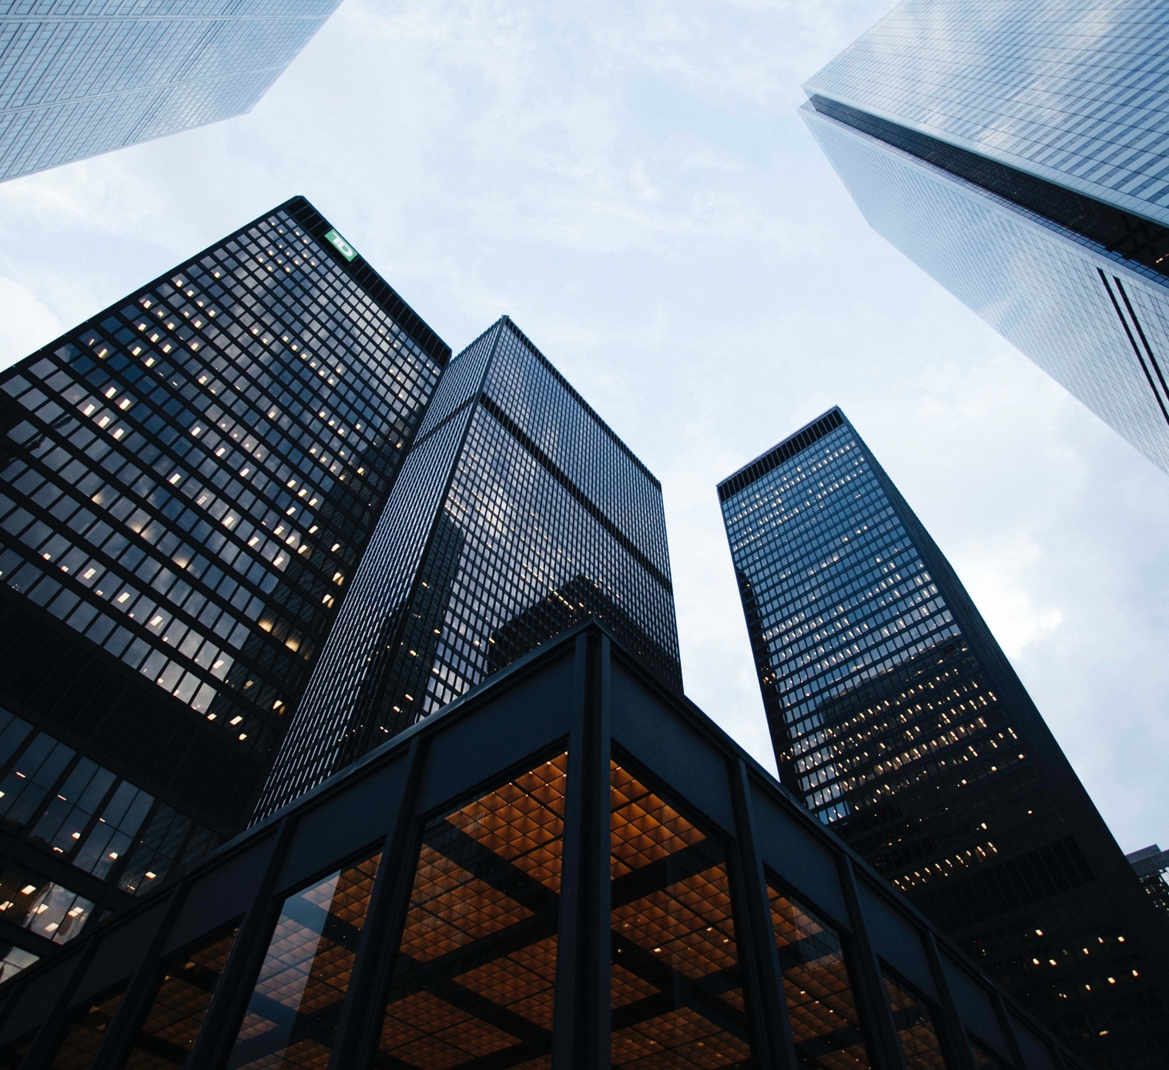
Sustainable cities, sometimes known as ecological or ‘eco’ cities, are settlements designed to have as little impact on the environment as possible. Some of the techniques through which the aims of an eco-city can be achieved are:
Sustainable or eco cities can be pre-existing cities that feature management of and towards:
reducing the inputs of energy, water and food and
reducing the outputs of heat, water and air pollution
They can also cities designed from scratch with these concerns in mind.

Slide 5

Renewable energy
Popular techniques, such as solar, wind, bio-gas (from organic matter) and bio-mass power are all achievable in existing cities willing to invest in the technologies.
Barcelona requires solar panels to be fitted to every large building in order to try and heat 60% of the city’s water through renewable energy.

Slide 6
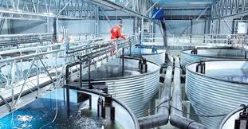
Urban agriculture
Producing food within or near a city reduces the distance the food has to travel before it reaches the consumer.
New York City is now home to indoor fish farms and rooftop gardens, and vegetables are grown in every available flowerbed and plot of land in the town of Todmorden, West Yorkshire.

Slide 7

No air-con!
Air conditioning uses lots of energy, but it's used because urban areas are artificially warmer.
Instead, taking steps to reduce the temperature of a settlement by planting trees and lightening the colours of buildings can counter the "urban heat island" effect.

Slide 8
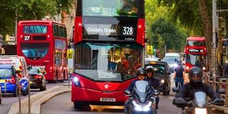
Public transport
Improving the standard and availability of public transport reduces car emissions, but requires a fully integrated approach to town planning to reduce the impact on businesses to keep the scheme viable. Can you think of eco-friendly ways to travel around the city?

Slide 9
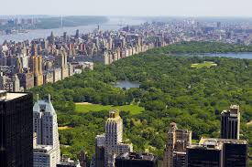
Access to public resources
The wellbeing of residents is critical in sustainable cities, which means guaranteed access to quality education, safe health centres, easy to access public transportation, garbage collection services, safety and good air quality, among other modern living necessities. As populations and challenges change within cities, so to does the need for adaptive solutions to resources. For example, New York City created a post-Sandy action plan consisting of 250 ambitious infrastructure resilience initiatives including transportation, telecommunications, parks, insurance, and buildings.

Slide 10
Urban renewal actions
The renovation of public spaces is another fundamental characteristic of sustainable cities. Public streets, squares, parks, urban spaces as well as modern irrigation and waste management practices are vital aspects of sustainable living. They help preserve the cultural heritage and identity of a city through renovation and restoration.
Ideally, urban renewal in a city is done in a completely integrated way. For example, in Melbourne, there are rebates (money back) designed to encourage property owners to adopt sustainable practices resulting in the efficient use of energy and water whilst reducing their waste to a minimum.

Slide 11
Reduction of CO2 emissions
The reduction of CO2 and other poisonous gases harmful to the ozone layer is perhaps the most significant measure of a cities environmental commitment. Lowering CO2 levels can be achieved through the long-term shift towards using renewable energies, vertical gardens, a good supply of alternative means of transport (e.g. bicycles, trains and electric buses) and household commitment to water and energy saving. One surprising city leading the way is Shenzhen, China, where in December 2013 a new fleet of more than 6,000 units of eco-friendly vehicles were introduced, becoming the largest zero emissions service fleet in the world.

Slide 12
Favouring ethical consumption
It is now well understood that over-consumption leads to excessive depletion of natural resources, greater waste and harmful by-products associated in the manufacturing process. Therefore it is critical that sustainable cities must promote and encourage ethical consumption, local food production and fair trade that both supports local supply chains and are environmentally friendly.

Slide 13
Reduce, reuse and recycle
Managers of a sustainable city must raise awareness about the importance of recycling and responsible consumption, and create infrastructure that allows for minimal waste. And change is possible in a short space of time if cities show leadership. San Francisco has implemented an 11-year-old zero waste program, which now sees 80% of all trash diverted from landfills. By 2020, the city hopes to bring that up to 100%.

Slide 14
Do you think London is sustainable?
Discuss with your partner and decide whether you think London has any of these initiatives (ideas) in place?
Remember to include your evidence to support your ideas!(bicycle hire, trains, buses etc).
Now, draw a poster bringing all your ideas together.

