Slide 1

French
Today we will be learning the names of different shops.

Slide 2
Talk and Share…
Think about where you live…
What shops do we have around our locality?

Slide 3
What shops do we have around our locality?
Supermarkets – Tesco, Aldi, Lidl, Sainsbury’s, Smaller shops – One stop, Nisa, Co-op
Markets
Post Office
Butchers
Bakery
Bank
Pharmacy

Slide 4
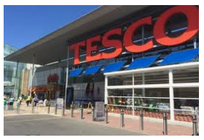
Le Supermarché – Supermarket

Slide 5
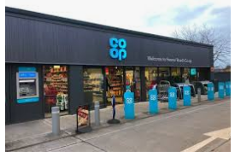
Une epicerié – Small Grocery Shop

Slide 6
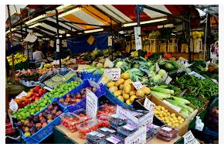
Le marché – Farmers Market

Slide 7
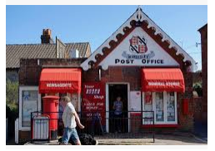
La Poste – Post Office

Slide 8
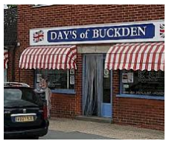
La Boucherie – Butchers

Slide 9
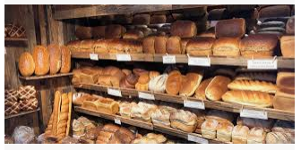
La Boulangerie – Bakery

Slide 10
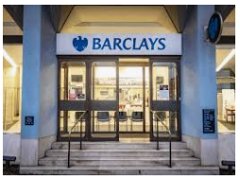
La Banque – Bank

Slide 11
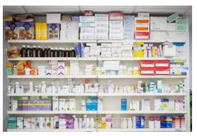
La Pharmacie – Pharmacy

Slide 12
Le S_p_rm_rché

Slide 13
Une e_ice_ié

Slide 14
Le m_r__é

Slide 15
La P_st_

Slide 16
La B_u__eri_

Slide 17
La Bo_l_ng_ri_

Slide 18
La B_n_ue

Slide 19
La Ph_rm_c_e

Slide 20
La Banque – Bank

Slide 21
Le marché – Farmers Market

Slide 22
La Poste – Post Office

Slide 23
Activity
Draw your own village/town, including a range of the shops we have learned today.
Can you label your picture with three different shops, in French?

Slide 24
Can you copy the words and fill in the blanks?
Le S_p_rm_rché
Une e_ice_ié
Le m_r__é
La P_st_
La B_u__eri_
La Bo_l_ng_ri_
La B_n_ue
La Ph_rm_c_e

