Slide 1
Varmints

Slide 2

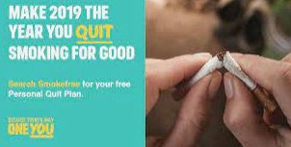



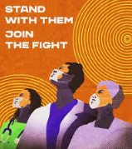


How do you think we should communicate this information to the public? Discuss. What is the important information that needs to be conveyed.

Slide 3
Model text:
Public health campaign.docx

Slide 4
You are going to create a poster, drawing from the discussions, notes and drawings you have produced.
Non – negotiables:
Presentation/handwriting
Punctuation – capital letters, full stops, exclamation marks, question marks
Finger spaces
Use the sentence constructor to help you check your work.

Slide 5
Finished

Slide 6
Thursday
Look at the poem below and on your desk:
The Ocean’s Blanket – Carol Ann Duffy
The ocean’s blanket is made of dark green seaweed
And golden mermaid’s hair.
We see a thousand starfish there.
The ocean’s blanket is made of crashing waves
And frothy, creamy foam.
It keeps us warm.
The ocean’s blanket is made of smiling dolphins
And lonely, singing whales.
We see the silver of the fishes’ scales.
The ocean’s blanket is made of waltzing octopuses
and dancing, inky squid.
It keeps us hid.
The ocean’s blanket is made of hidden pearls
And spicy, salty smells.
We see the jewels of a million shells.
The ocean’s blanket is made of sunken ships
And we are drowned, are drowned.
Beneath the ocean’s blanket we will not be found.

Slide 7
What are your initial responses?
What do you like? Dislike? Do you have any questions? What connections can you make with it?
Now as I read it again, think about the poet’s intention.
What has the poet done to create this?
How does the language affect you as a reader? Pick out effective language or imagery. How has the poet achieved the desired effect?

Slide 8
Finished

