Slide 1

Parent Maths session

Slide 2
No Pressure…but how would you work this out? Write your methods in the chat box.
38 + 8 =
Notes:
Review some of the answers. Everyone should get 46. How many people counted on (put 38 in your head, count on 8)? How many people added the 8s and “carried” the 1, adding it to the 3, getting 4? How many people added 2 to the 38, then 6 to the 40 and got 46? All these methods are correct, but which is the most efficient? We are teaching your 4 and 5 year olds to be efficient mathematicians. And you can help.

Slide 3
Statutory framework for the early years foundation stage
Developing a strong grounding in number is essential so that all children develop the necessary building blocks to excel mathematically. Children should be able to count confidently, develop a deep understanding of the numbers to 10, the relationships between them and the patterns within those numbers. By providing frequent and varied opportunities to build and apply this understanding – such as using manipulatives, including small pebbles and tens frames for organizing counting – children will develop a secure base of knowledge and vocabulary from with mastery of mathematics is built. In addition, it is important that the curriculum includes rich opportunities for children to develop their spatial reasoning skills across all areas of mathematics including shape, space and measures. It is important that children develop positive attitudes and interests in mathematics, look for patterns and relationships, sport connections, ‘have a go’, talk to adults and peers about what they notice and not be afraid to make mistakes.
Notes:
This is what the Statutory Framework requires for us to teach in the Early Years. This was updated in 2021. Children are expected to count, but they are also expected to develop a deep understanding of numbers to 10, relationship between numbers and the patterns within the numbers. So many of you may have children who can count to 100. But do they know that 80 and 20 equal 100, or 18 and 82 equal 100, or that 100 is an even number…by developing a deep understanding of numbers to 10, they can then begin to understand the patterns of numbers greater than 10 because our number system is base ten. Knowledge and vocabulary is also emphasised in the framework and the ultimate goal is mastery – understanding deeply. Creating pathways in their brains to solve problems with understanding, not memorisation.

Slide 4
How Can I Help my child learn Maths?
Currently, teaching covers the following areas of maths:
Subitising
Cardinality, ordinality and counting
Composition
Comparision
Shapes, Space and Measure
We are using the NCETM Mastering Number Programme.
Notes:
Subitising – looking at a objects or a pattern and knowing how many without counting. Perceptual subitising is seeing the whole instantly, conceptual subitising seeing the parts
Cardinality is when a number tells us how many or how much and ordinality refers to the position of the number (3rd in the queue). And counting is … well, counting. By ones, 2s, 5s, etc.
Composition is the idea that all numbers are composed of other numbers. 5 is the same as 2 and 3 or 4 and 1.
Comparision is more and fewer, taller, shorter, longer, wider, etc.
Shapes, Space and Measure is understanding the properties of shapes and measure is time, capacity, weight, etc.
We are using the NCETM (National Centre for Excellence in the Teaching of Maths) Mastering Number Programme, which has just launched this school year. The NCETM are the people behind Numberblocks on CeBeebies.

Slide 5
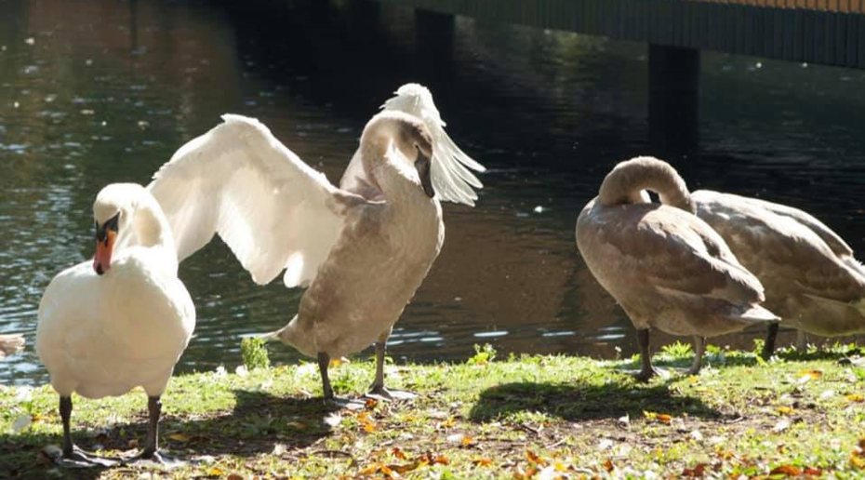
What does subitising look and sound like?
I see three swans!
Notes:
No need to count. We can all see three swans. How do you know it’s 3? You may see a 2 and a 1. Maybe you think there are 4 swans there, but I didn’t see it at first. That’s ok. The child may say, “Wait I see one more! There are 4 swans!”

Slide 6
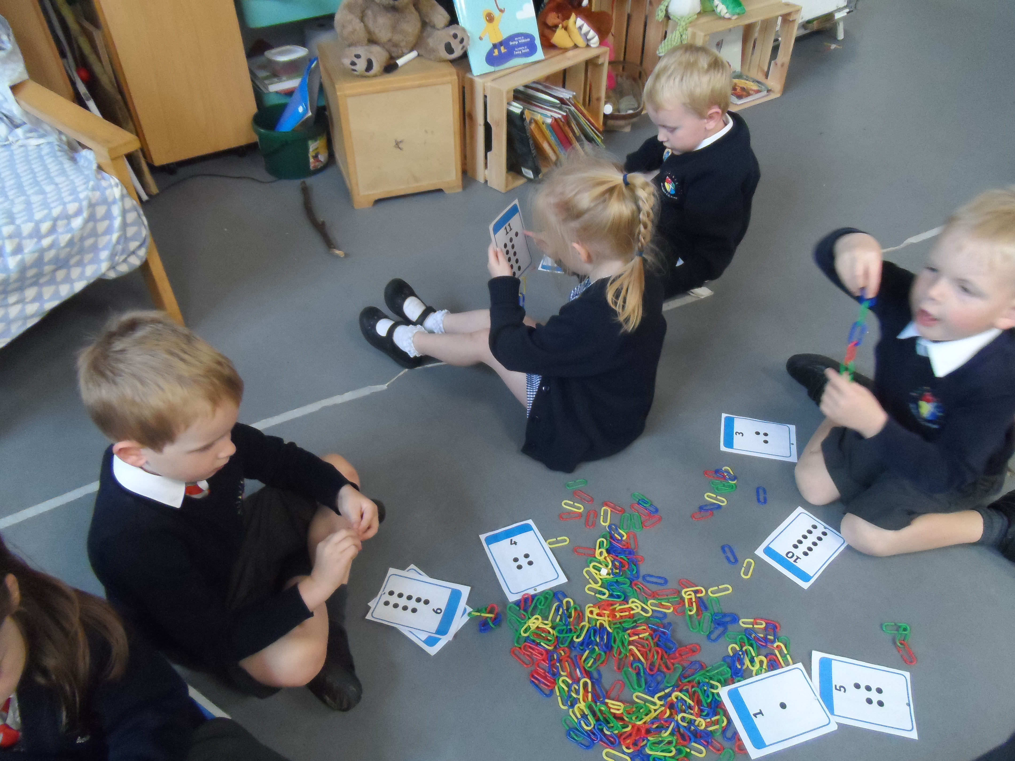
What does cardinality, ordinality and counting look and sound like?
I have 11. How many do you have?
I finished first! You’re last. Who finished second?
Notes:
Cardinality is the concept, counting is the tool. Ordinality is the order.

Slide 7
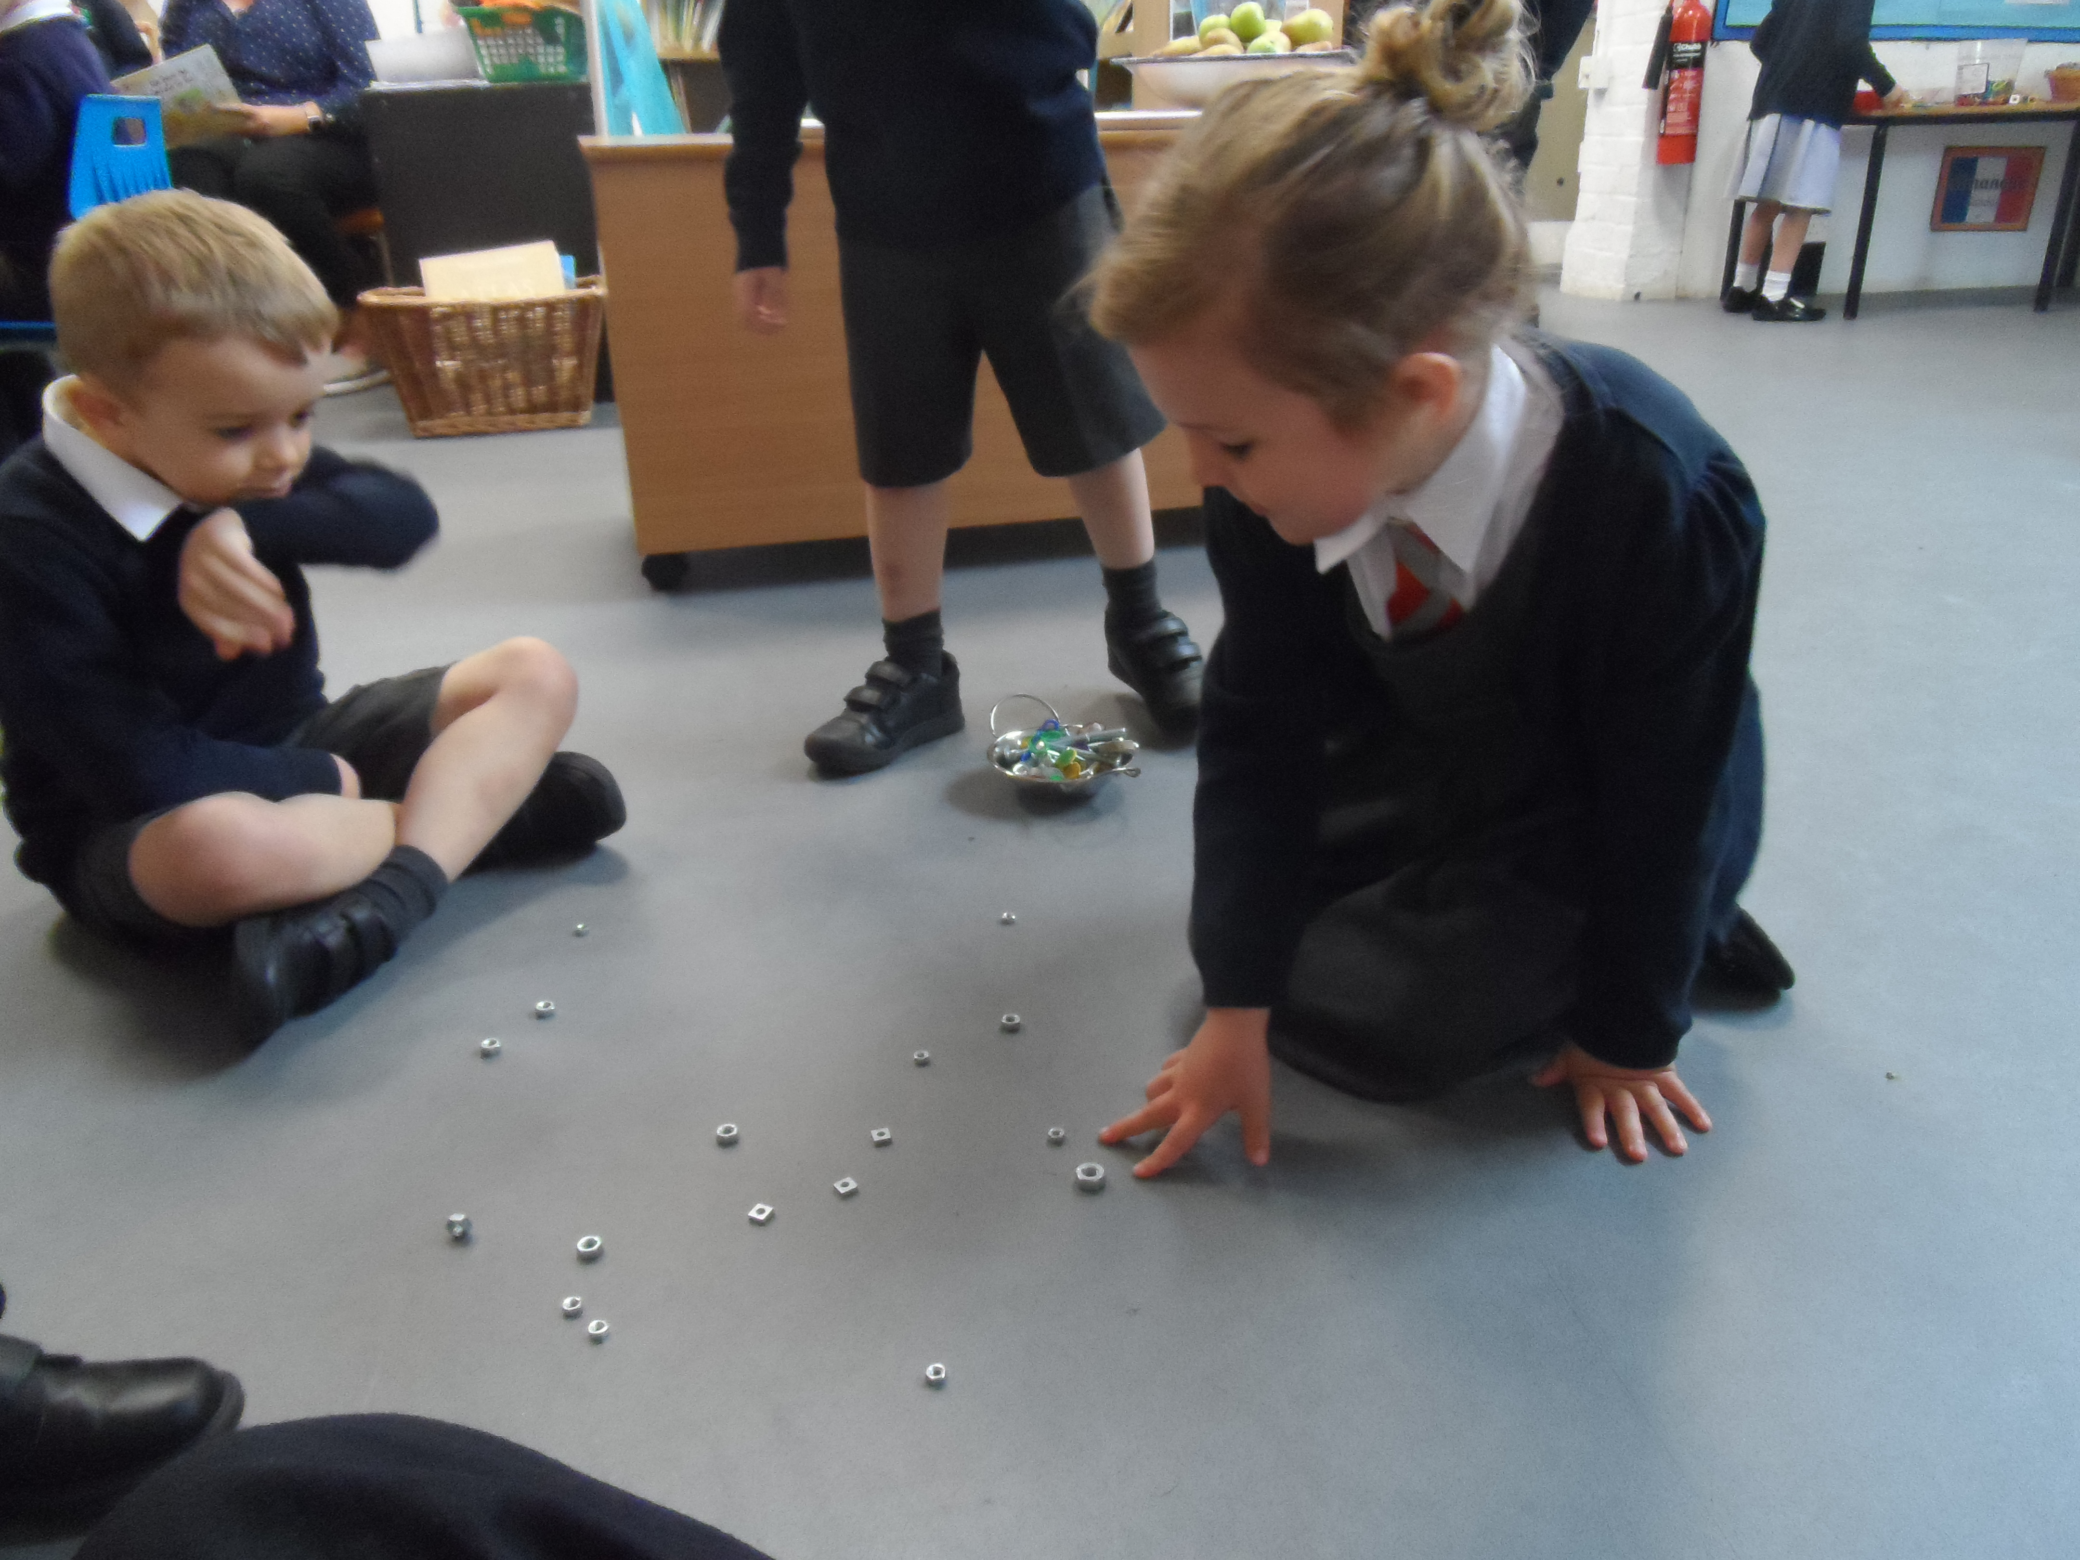
What does composition look and sound like?
I see a 2 and a 2. That equals 4!
I see 5. A three here and a 2 here.

Slide 8
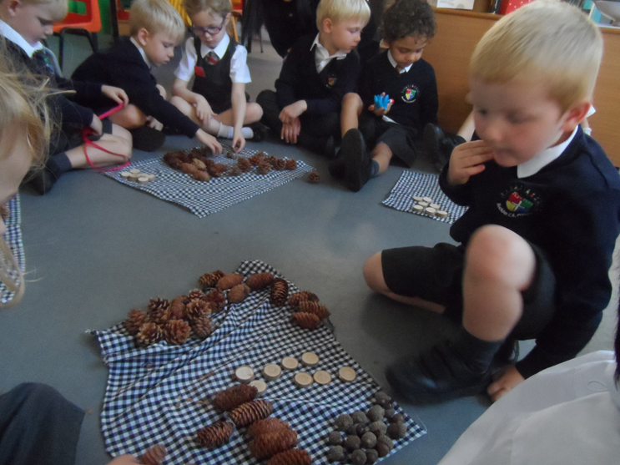
What does comparison look and sound like?
I have more acorns than pinecones. I have fewer wood pieces than acorns.
Notes:
This can easily become a discussion of, “How can we have equal amounts?”

Slide 9
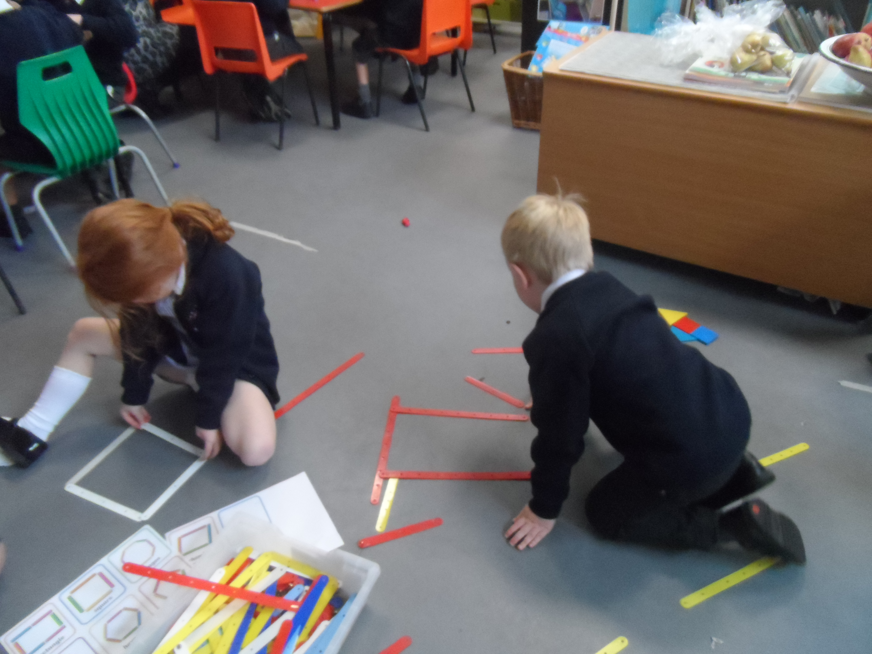
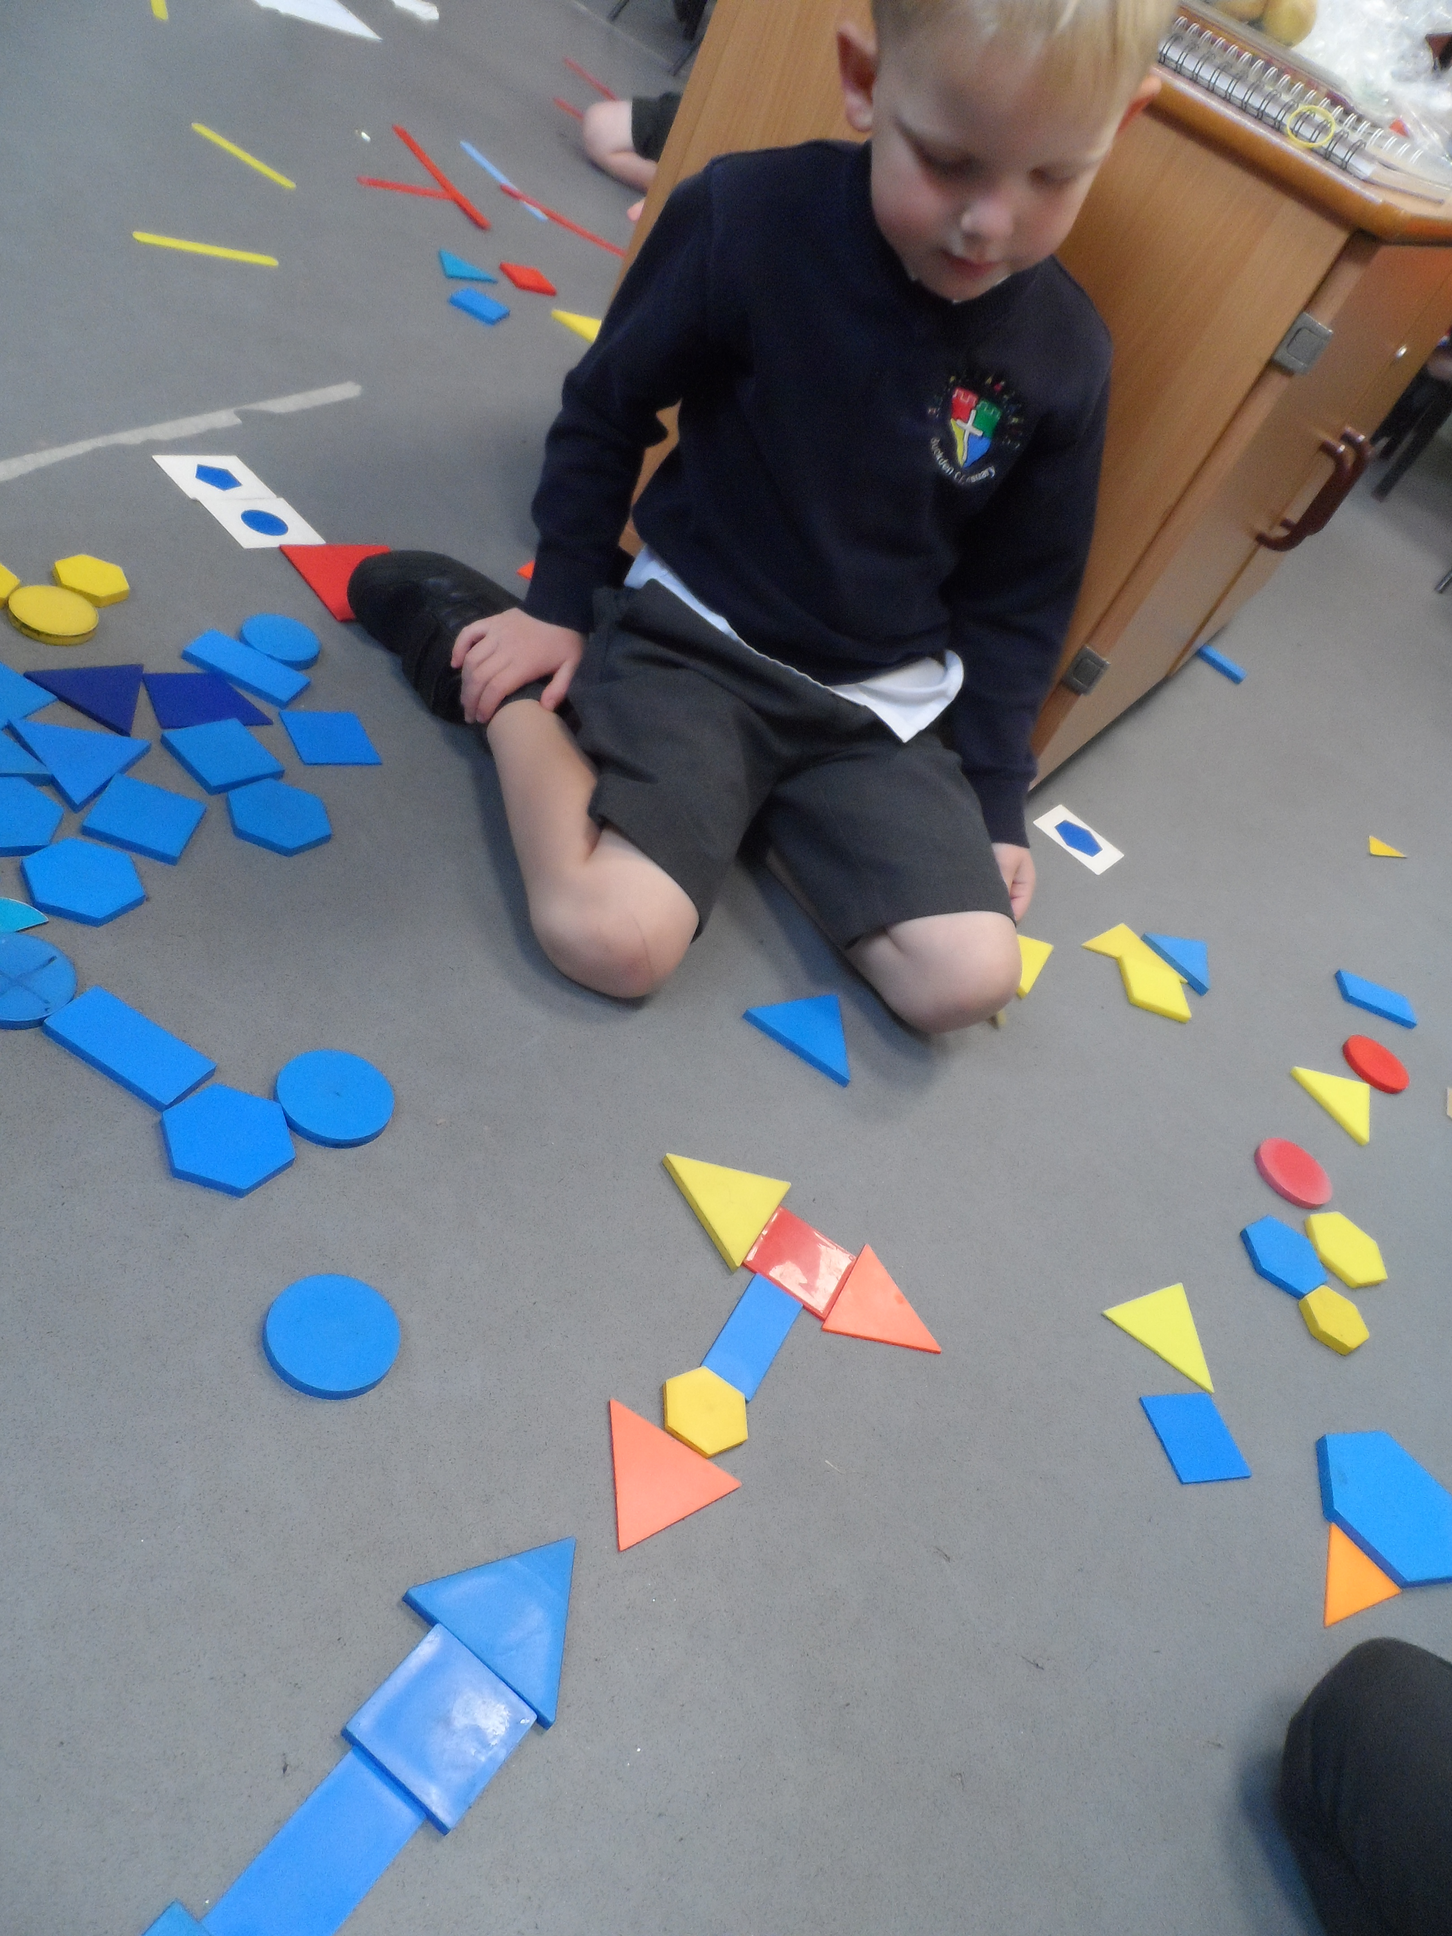
What do shapes, space and measure look and sound like?
Exploring the properties (straight, flat, roll, bend, etc.) of shapes and how to classify them
Measure = time, weight, distance, height, capacity and length

Slide 10
Myth-busting!
Mathematical mastery is not just about counting or writing equations.
Your child is using mathematical language every day…
“I’m 5 years old!” (Holding up 5 fingers.)
“Why does my brother have more biscuits than me? I want more!”
“When will we be there?”
“How many sleeps till my birthday?”
“I’m taller than you when I stand up here.”
“Daddy’s the tallest of all.”
“Look! Two birds!”
Notes:
Keep it fun and appreciate your child’s inbuilt interest in maths! But Mrs Woodward will now give some more specific activities…

Slide 11
How can you support maths at home?
Count everything- stairs, steps, toys, food. Children often find bridging 10 hard and may say 20 10 instead of 30. This is normal and logical. Also, 11 and 12 can be confusion as they don’t follow the ?teen pattern like 13 and beyond.
Look at numbers everywhere, door numbers, price tags, puzzle pieces,
Get your child involved in tasks like making packed lunches- eg. how many slices of bread do we need to make 4 sandwiches? (problem solving and addition/ doubling) Is there going to be enough left in the loaf? (subitising and estimating)
Cooking and baking is excellent for maths- includes number and shape space and measure.
Maths in nature- making shapes with sticks, subitising how many daisies in a patch of grass, patterns
Have real coins for playing with as shop role play. Try to use coins in a shop for your child to buy items on occasion rather than using a card. Have you got enough money?
Notes:
Whilst we do teach reading every day through phonics lessons with your children and hear your child read at least once a week, what we cannot do is offer the 1:1 daily reading needed for overlearning and embedding of reading skills over time.

Slide 12
How can you support maths at home?
Play board games initially use spot dice, then digit dice and eventually two dice for addition.
Playing cards- higher/ lower game, snap
Dominoes
Stories, songs and rhymes with number- YouTube have some excellent counting songs
Numberblocks- created by maths teaching specialists- links to our teaching
Ask your child to help by diallling numbers on the telephone
Scoring in outdoor sports- skittles, football, counting number of throws. Who has more? How many more to equal?
Referring to the time- o’clock, morning, evening, days of the week, using a calendar
Notes:
Whilst we do teach reading every day through phonics lessons with your children and hear your child read at least once a week, what we cannot do is offer the 1:1 daily reading needed for overlearning and embedding of reading skills over time.

Slide 13

Best playdough recipe
Playdough can be used for so much maths- making it and using measurements, creating 3D and 2D shapes, counting, size, can you make the longest worm, playdough splat to show subtraction
Ingredients
1 cup of plain flour.
1 cup of water.
1 tablespoon cooking oil.
2 teaspoons cream of tartar.
half a cup of salt.
food colouring (optional)
Method 2 - Microwave
Method 1 - Saucepan
Place all the ingredients in a saucepan at a low heat. Stir continously until the mixture thickens to a firm dough texture.
Place all the ingredients in a plastic container and cook for one and a half minutes in a microwave. Stir the mixture and microwave again for one minute.

Slide 14
Useful links
https://www.learningtrajectories.org/early-math/birth-to-grade-3 An American site with excellent resources and games to help support your child’s number sense.
www.topmarks.co.uk Several counting, number, shape and digit recognition games for your child to play.
https://www.bbc.co.uk/bitesize/articles/zks4kmn selection of games and activities
https://www.maths4mumsanddads.co.uk/ Lots of advice on how to engage your child with maths and how to support
https://www.bbc.co.uk/cbeebies/topics/numeracy Selection of online games and songs
https://www.ictgames.com/mobilePage/index.html Some games here are suitable for younger children- Duck Shoot, Whack a Mole, Counting Caterpillar, Post a Letter, Home Time Ladybird, Mucky Monsters, Bee More or Less

Slide 15
Feedback
https://forms.office.com/Pages/ResponsePage.aspx?id=DQSIkWdsW0yxEjajBLZtrQAAAAAAAAAAAAZAAJVwjehUQ0kyNk05STJFVkVINE1HV0JDSVBFUEMxSi4u
Share any other ideas from parents as to what you find works for your child.
Notes:
Any reading is good reading. Magazines, road signs, whilst shopping, menus, games.

