Slide 1
Non-Chronological Reports

Slide 2
To Design a Sea Creature

Slide 3
What is a non-chronological report?
A non-chronological report is a text which isn't written in time order.
They are normally non-fiction texts which give information on a particular subject or event, without referring to the order in which things happen.

Slide 4
Different types of Non-Chronlogical reports
Formal Letter
Non-Fiction book
Information leaflet
Instructions
Newspaper report or magazine article
Fact File

Slide 5
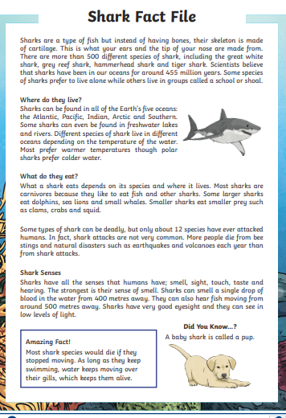
What type of information is included in both Fact Files?

Slide 6
What type of information is included in both Fact Files?
Appearance of animal- size, weight, colour, features etc.
What type of animal they are eg- fish or mammal.
How they behave.
Diet/what they eat
Habitat/ Where they live-Pictures
Amazing Fact Box
Other Scientific Information, such as offspring, what senses they have.
Skeletal Type and how this is a positive/negative for them.

Slide 7
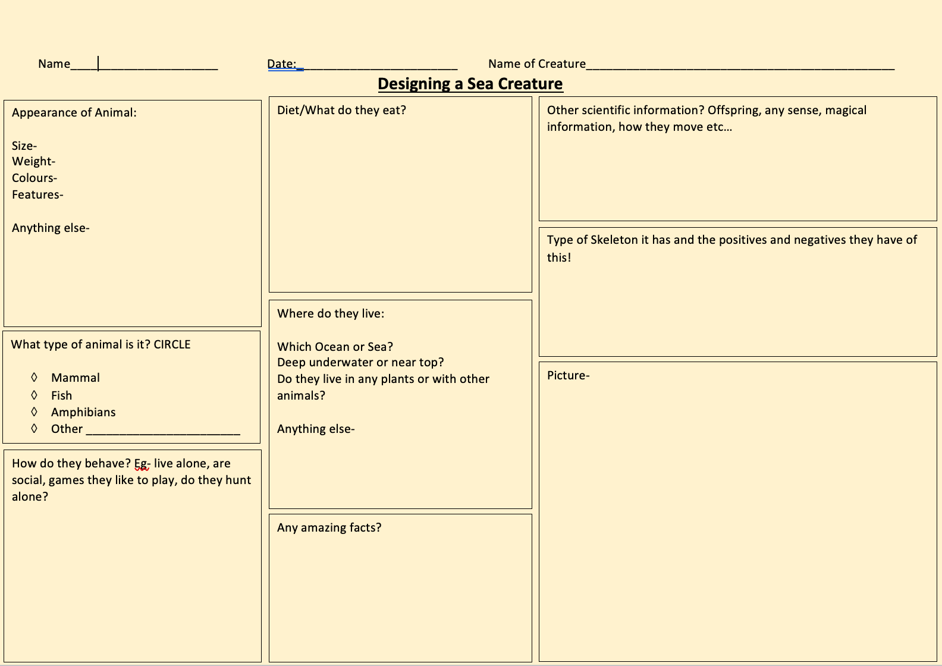

Slide 8
Features of a Non-Chronological Report

Slide 9
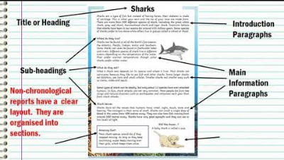

Slide 10
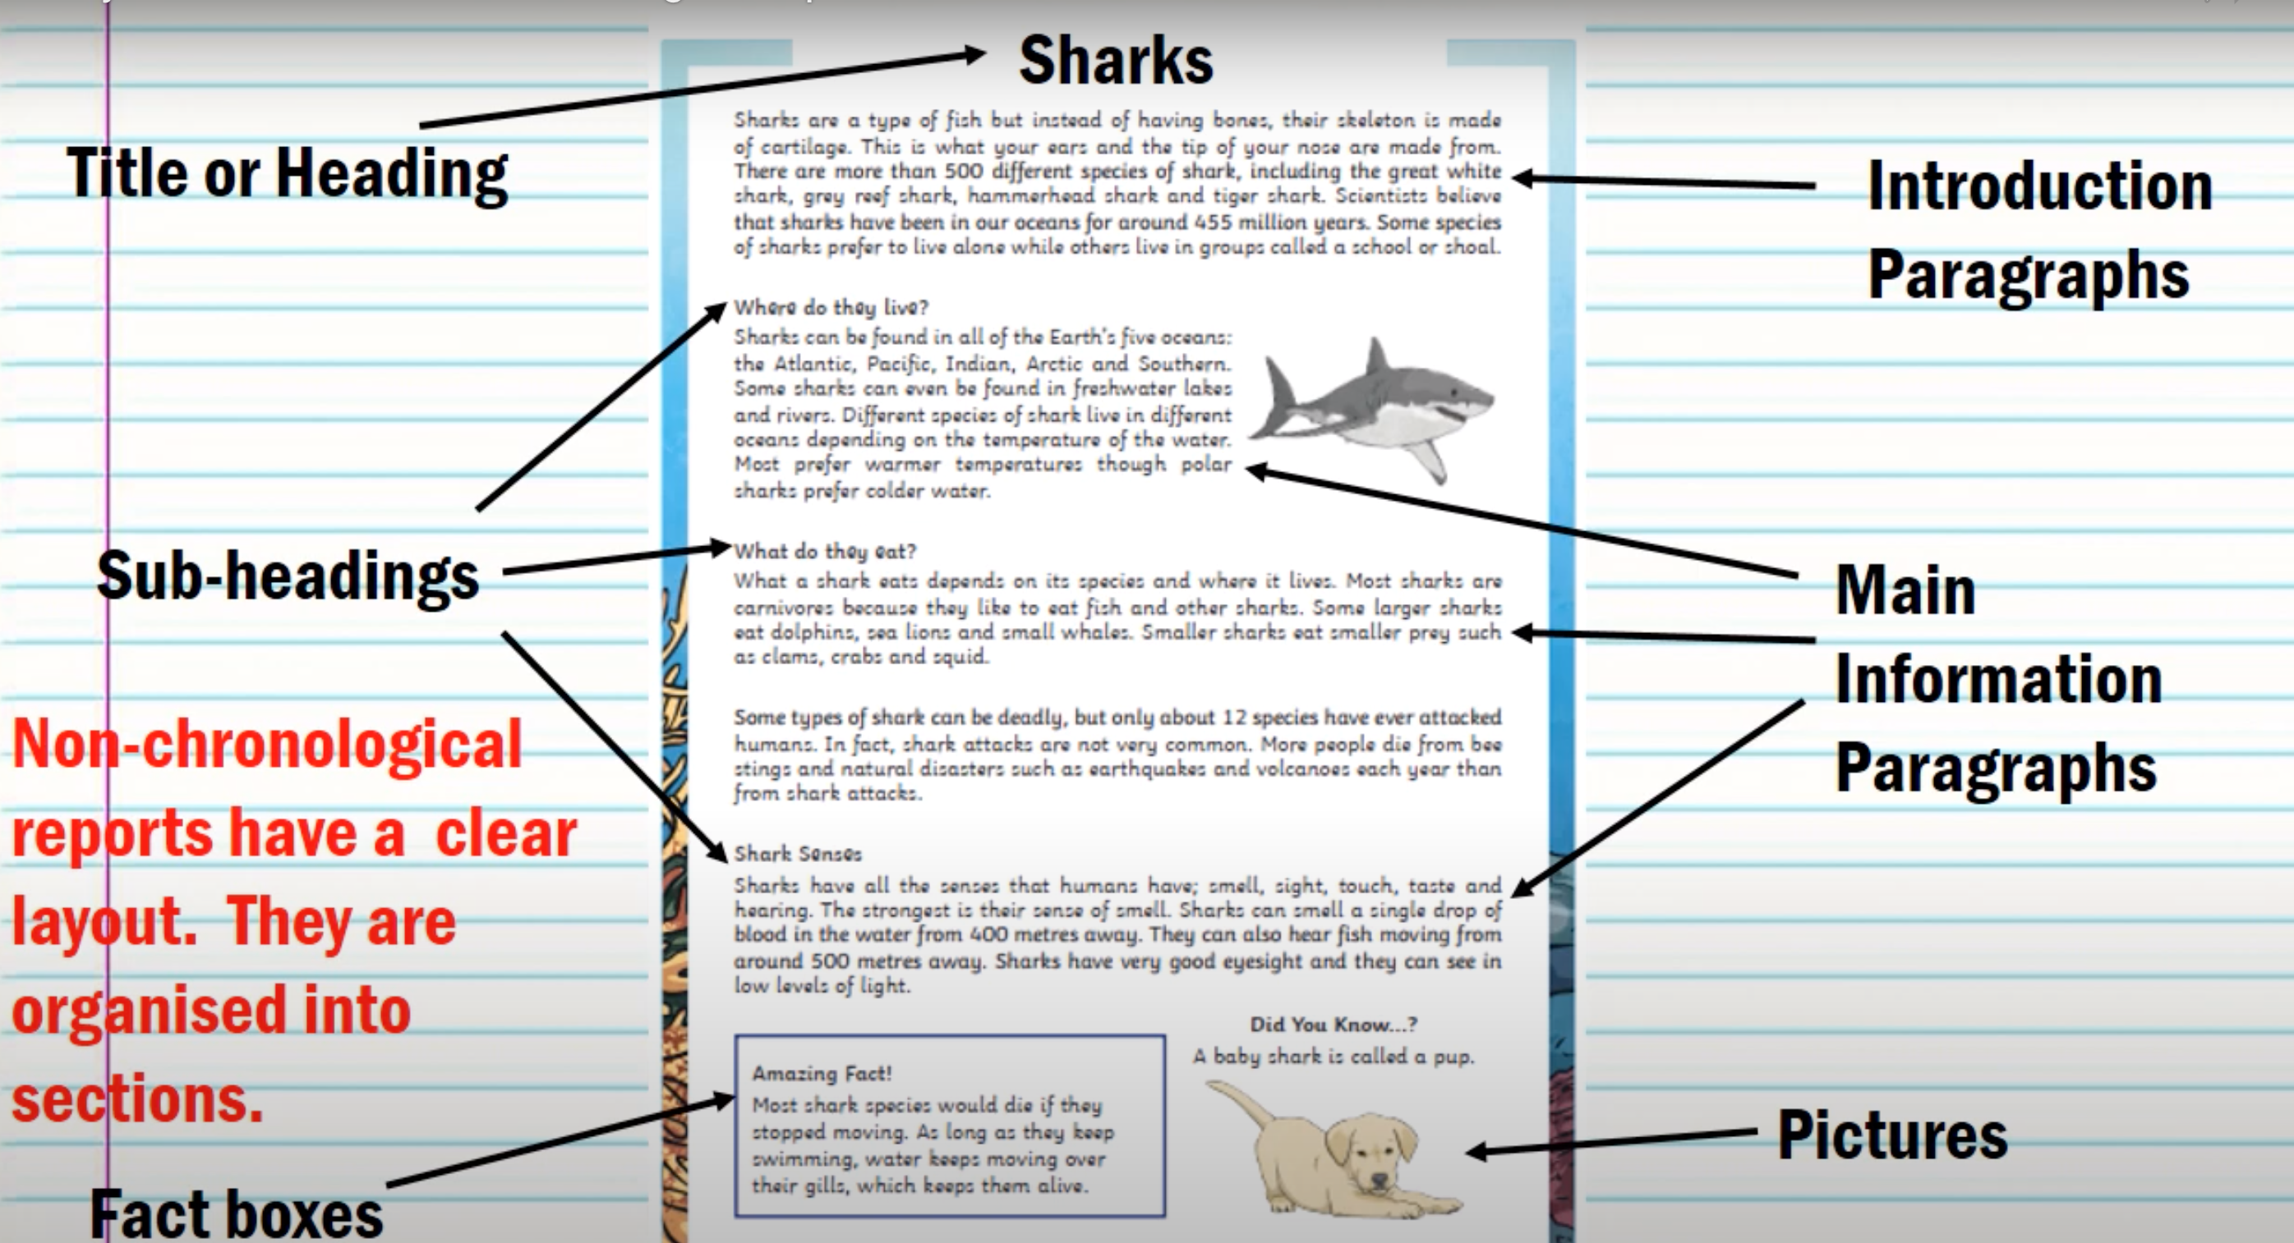

Slide 12
To Plan a Non-Chronological Report

Slide 13
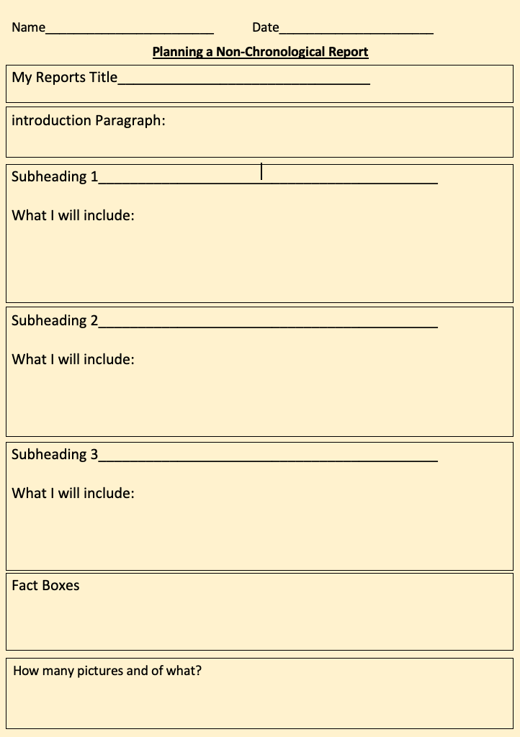

Slide 14
To Write a Non-Chronological Report

Slide 15
Non-Chronological Report Tick Sheet
Title
Introduction Paragraph
Sub-headings
Paragraphs
Fact Boxes
Pictures
Checked I have included my whole plan.

