Slide 1
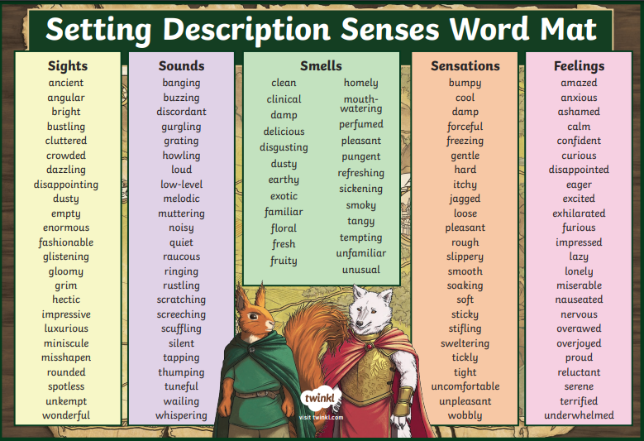
Monday:
Setting descriptions
This week we are going to be learning how to write a setting description. We have already identified interesting words from the chapter on Samson Island.
Share some with your adult. Explain why you chose certain words and when you could use them.

Slide 2
Watch the following clip that highlights key things to think about when writing a setting description.
https://www.bbc.co.uk/bitesize/articles/zcxnm39

Slide 3
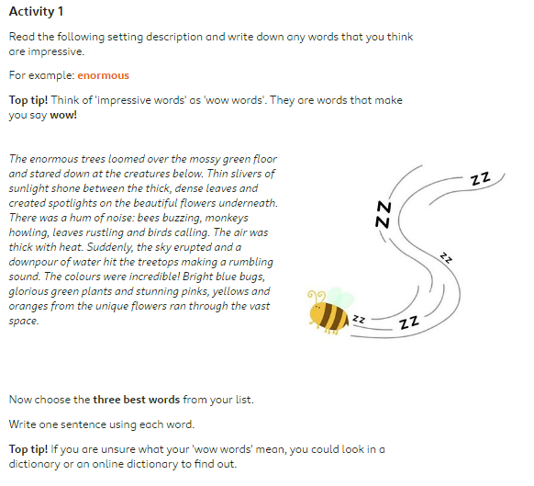

Slide 4
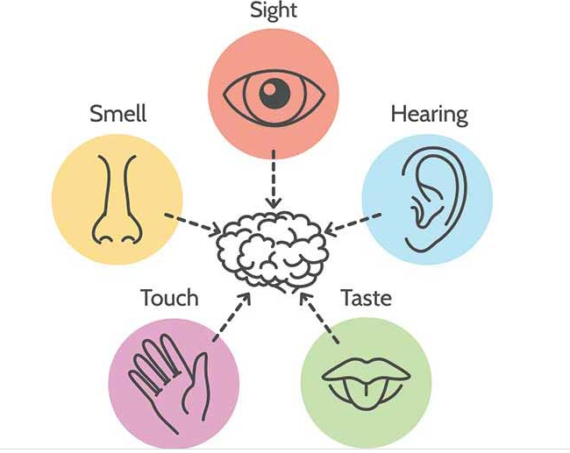
Tuesday:
Recap what we learned yesterday.
Now watch the following animation. Remember, we are focussing on the setting :
https://www.literacyshed.com/a-shed-full-of-animations.html
What can you see all around you?
Mountains, woodland, rock, trees, birds, undergrowth – describe them. Use all your senses. Think, pair, share your ideas with your partner. Write 5 sentences to describe the setting. Use a different sense for each one.

Slide 5
Let’s look at an example and discuss. Think about the tone of the text. What is easiest to remember/write?
Stone mountains stood like waves frozen in time, surrounding the abundant woodland. The grey rock was full of hidden, muted colours, visible to those who cared to notice it.
Trees peppered the landscape below these vast rocky giants. Sometimes their branches reached out to one another forming maze-like pathways for the tree top birds and creating large patches of shaded undergrowth for the insects and fungi.
The forest floor, though seemingly carpeted with grass, was made from a hundred different species of wildflower; green in their tender youth. Where the sun dappled its light and warmth for most of the day, flowers were in full bloom. They whispered their perfume into the air and rolled their delicate heads in the breeze.
Fallen rocks had been reclaimed by the forest’s plants to become mossy bridges and platforms. Vines and creepers circled them, cuddling tight and popping open their purple flowers. They were welcome.

Slide 6
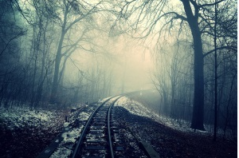
Wednesday
Let’s look at the image below:
What do you notice?
What do you see?
What time of day is it?
Notice the difference between:
The morning fog shrouded the deserted track in a cloak of dense fog.
I see fog all around me on the track.
What sounds can you hear? A stream? Howling wind? Birds? Wolves?
What is the weather like?
What is beyond the fog?
Are you walking along the track? On a train? Where is the train going?
Pick out the main features you see and write phrases to describe them.

Slide 7
Let’s share your ideas:

Slide 8
Now let’s improve:
Trees towered, like sentries, guarding a dark secret beyond the gloomy horizon. A cloak of dense fog shrouded the deserted track. Eerie chills invaded Gracie’s body, piercing her heart right to its core.
Trembling with anticipation, they marched onwards – a mix of fear and curiosity. Gracie’s pace quickened as she trudged through the crumbling train tracks. Whatever lay ahead could not be as dreadful as what lay behind. The relief of shore had just begun to wash over her.
The shriek of an owl caused her pulse to throb like a beating drum. An acrid taste hung in the air. The wind howled with increasing force – there would be no respite tonight.
In the dim distance, a streak of light caught her eye. Gracie and Daniel froze. Rooted to the spot, she noticed a shadow in the folds of the branches ahead. Could this be the fabled ghost of Samson island? Could some poor soul still be wandering aimlessly in search of peace that would never come? As quickly as it appeared, it swiftly disappeared, leaving Gracie in no doubt that they were on the cursed island.

Slide 9
Thursday:
Your task for today is to stick in your picture and write your setting description.
Remember to link it to Samson, Gracie and Daniel, if you find it easier.
Use powerful adjectives to describe the mood.
Use your 5 senses.

Slide 10
Friday:
Edit your work.
Remember non-negotiables – handwriting, presentation, punctuation.
Use a word mat to see if you can improve your sentences with more ambitious vocabulary.

