Slide 2
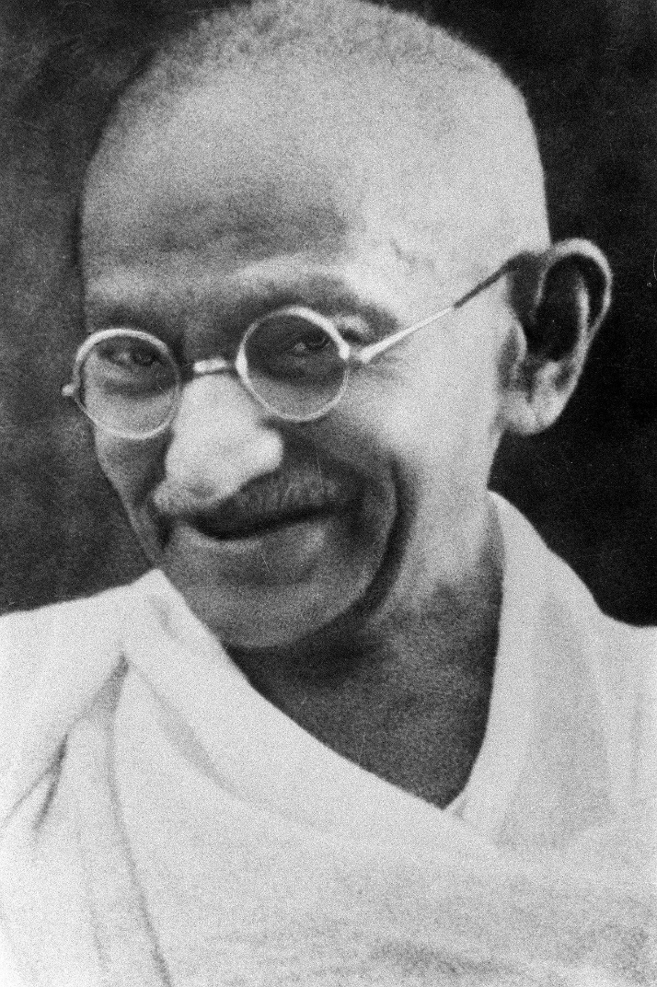
Family Life
Mohandas Karamchand Gandhi was born on 2nd October 1869. He was born in Porbander in Gujarat, north-west India.
Gandhi’s father was the chief minister of Porbander. His mother was highly religious. She worshipped the god Vishnu but also believed Jain teachings of mutual tolerance and not causing injury to living things.
Gandhi was born into a privileged caste and therefore received a good education.
caste – The classes that people in India were divided into.
“Title of Image Used” by [Author] is licensed under CC BY 2.0

Slide 3
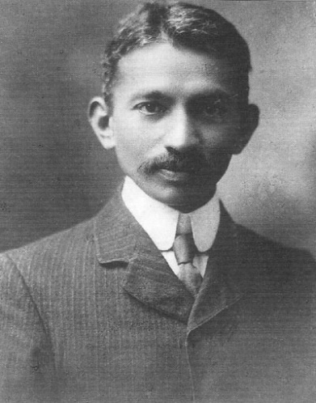
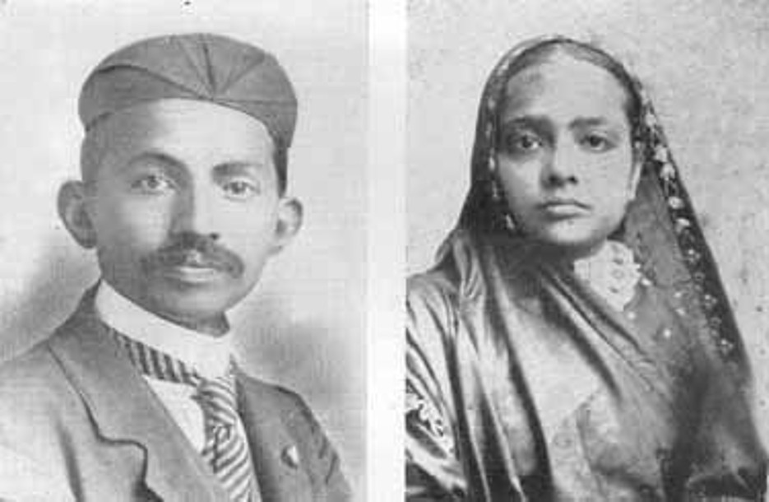
Married Life
At the age of 13, Gandhi had an arranged marriage to a girl, who was also 13, called Kasturbai Makhanji.
His first son was born in 1888 when Gandhi was 18 years old and a student at Samaldas College.
arranged marriage – A marriage between two people that is arranged by their families.
“Title of Image Used” by [Author] is licensed under CC BY 2.0

Slide 4

Studying
Gandhi was not very happy at college so when he was offered the chance to study law in London, he took it.
He worked hard and began to study all religions. Until this time, he had never really been interested in religion.
When he returned to India, he found it hard to find work so eventually took a job in South Africa for a year.
“Title of Image Used” by [Author] is licensed under CC BY 2.0

Slide 5

South Africa
Racism was prevalent in South Africa. Black and Asian people were not given the same rights as White people. During his time in South Africa, Gandhi experienced racism.
On one occasion, Gandhi was removed from a train purely because he was not a White person.
Another time, he was asked to remove his turban by a European magistrate. He refused and left the courtroom.
“Title of Image Used” by [Author] is licensed under CC BY 2.0

Slide 6
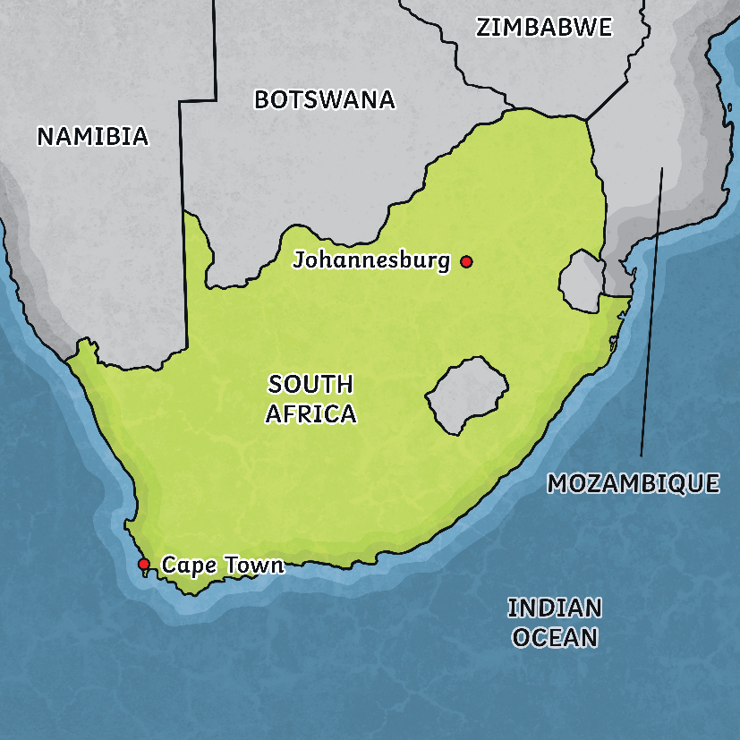
Contradictions
Although Gandhi was himself a victim of racism, letters he wrote at the time suggest that he didn’t support Black people’s rights. He didn’t approve of Black people living alongside Indian people, saying he felt ‘most strongly’ about it. In 1905, the city of Durban was struck by plague. Gandhi wrote that the illness would continue to spread as long as Indian people had to go to the same hospital as Black people.
Talk About It
Given that Gandhi had experienced racism, why do you think he wrote what he did about Black people?
“Title of Image Used” by [Author] is licensed under CC BY 2.0

Slide 7
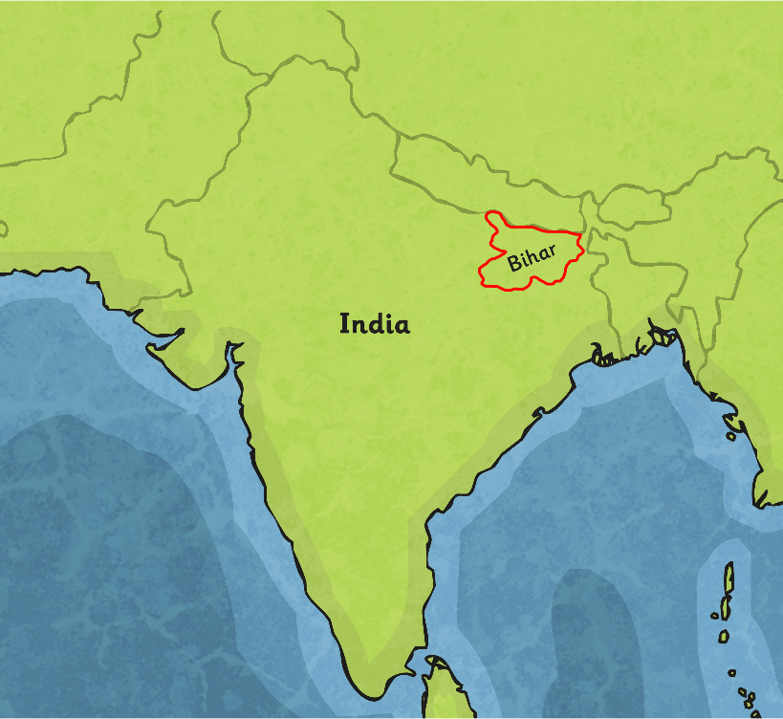
Gandhi and Politics
Gandhi started a political movement called the Natal Indian Congress. He believed in non-violent political protests.
He returned to India in 1915 and saw how oppressed the Indian people of Bihar were by the White British masters.
He began to encourage people to stand up for themselves and their rights in peaceful protests and strikes.
The people were grateful that somebody was interested in their situation and he became known as Mahatma, meaning ‘Great Soul’.
“Title of Image Used” by [Author] is licensed under CC BY 2.0

Slide 8
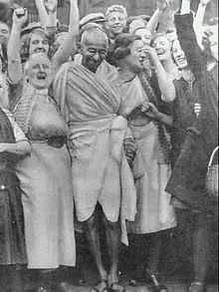
A Famous Leader
Gandhi’s fame began to spread. Indian people saw him as their voice for freedom and fairness. He started a boycott of buying British goods. This meant that he encouraged people not to buy things made in Britain. This led to his first arrest and, on 2nd March 1922, he was sent to prison for two years. Gandhi went on many hunger strikes to bring attention to the unfair treatment of Indian people at the hands of the British.
“Title of Image Used” by [Author] is licensed under CC BY 2.0

Slide 9
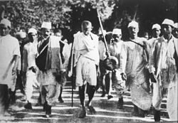
The Salt March
When Gandhi was released, he began a campaign to end the British rule over Indian people.
In 1930, the British introduced a tax on salt. This hit the poorest people the most. In protest, Gandhi marched 250 miles to the sea to get his own salt.
Thousands of people joined him on his march and 60,000 people were arrested, including Gandhi.
“Title of Image Used” by [Author] is licensed under CC BY 2.0

Slide 10
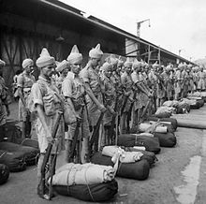
Civil Unrest
When the Second World War broke out, Indian people fought for the British. Gandhi did not see why they should when they were being treated so unfairly at home. He was arrested for encouraging people to rise up against Indian men fighting for the British and spent two years in prison at the Aga Khan Palace in Puna.
Sadly, his wife was also held there but she died in prison not long before Gandhi was released.
Not everyone agreed with his beliefs and, because he was so well known, there were six attempts to assassinate (kill) him.
“Title of Image Used” by [Author] is licensed under CC BY 2.0

Slide 11
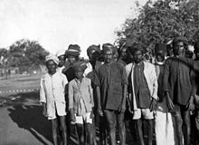
People Power
The British began to realise that Gandhi had many followers and a lot of influence on those people. As a result, they had to:
ease poverty;
grant status and recognition to the people classed as ‘the untouchables’;
give women more rights;
eventually allow India to have political independence from Britain.
“Title of Image Used” by [Author] is licensed under CC BY 2.0

Slide 12
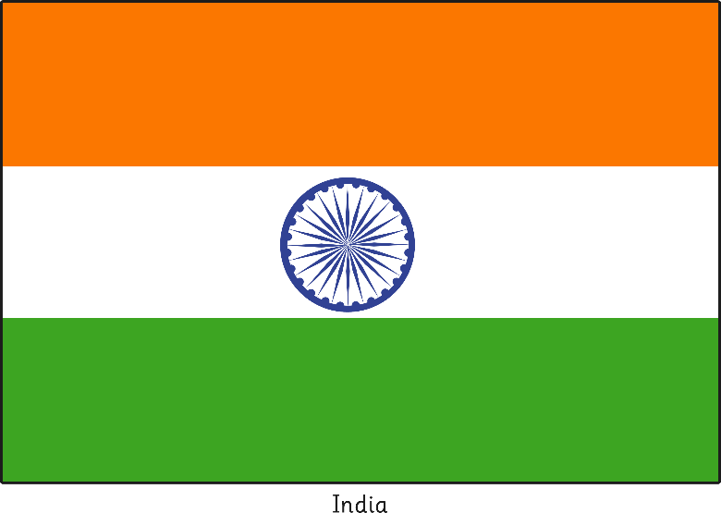

India is Split
The Congress Party decided that it would be better if they split India into two halves, one being Hindu India and the other Muslim Pakistan. This was called partition and it happened in 1947. Gandhi was unhappy about partition and was worried that the two sides could end up at war with each other.
Indian Flag
Pakistan Flag
“Title of Image Used” by [Author] is licensed under CC BY 2.0

Slide 13
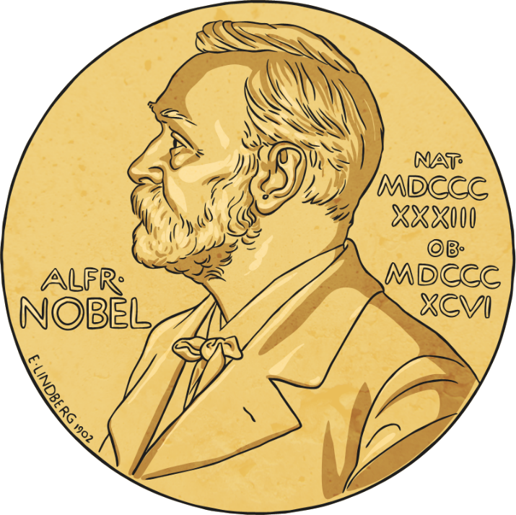
Death
On 30th January 1948, Gandhi was on his way to a prayer meeting at Birla House in Delhi. He was shot three times in the chest.
Gandhi’s body was cremated. His ashes are kept in the Aga Khan’s Palace in Pune, where he was once kept prisoner.
Gandhi had been nominated for the Nobel Peace Prize five times but was never awarded it. In the year of his death, the prize was not awarded to anyone. The reason given was ‘there was no suitable living candidate’.
His birthday is now a national holiday in India.
Photo courtesy of Fowler&fowler - granted under creative commons licence – attribution
“Title of Image Used” by [Author] is licensed under CC BY 2.0

Slide 14
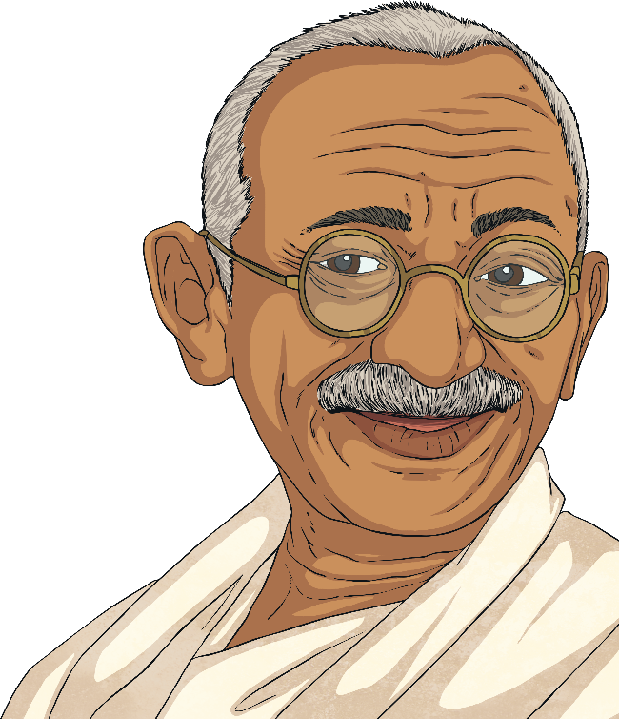
Gandhi’s Quotes
‘Live as if you were to die tomorrow. Learn as if you were to live forever.’
‘An eye for an eye only ends up leaving the whole world blind.’
‘Be the change you want to see in the world.’
‘In a gentle way, you can shake the world.’
‘The best way to find yourself is to lose yourself in the service of others.’
“Title of Image Used” by [Author] is licensed under CC BY 2.0

