Slide 1
HINDUISM
RELIGION AND THE INDIVIDUAL
BIG QUESTION
Why does a Hindu want to collect good Karma?

Slide 2
HINDUISM - KARMA
These resources have been produced by the Diocese of Ely Education Team and are based upon the Diocese of St. Edmundsbury and Ipswich’s ‘Emmanuel Project’.
Use of these resources is restricted to those schools, which have purchased the ‘Emmanuel Project’ and whose purchase details have been shared with the Diocese of Ely.
Sharing these resources, without having purchased the full scheme of work contravenes copyright for the ‘Emmanuel Project’ with the Diocese of St Edmundsbury and Ipswich.
All images used within these resources are within the creative commons.
Please read the introduction to this unit first, in order to set the scene for your teaching and to understand the major concept being studied. Please also ensure that you have decided upon your method of assessment with your RE leader before commencing the unit of learning.
Please send all feedback about this resource to education@elydiocese.org
Notes:
PHOTO CREDITS
Clothing – in the creative commons
Moksha Patamu board - This Photo by Unknown Author is licensed under CC BY-SA
Bedtime story - This Photo by Unknown Author is licensed under CC BY-SA

Slide 3
BIG QUESTION – ENQUIRY CYCLE
Why does a Hindu want to collect good Karma?
1 – ENGAGE
2 – ENQUIRE
3a – EXPLORE STORY
3b – EXPLORE COMMUNITY
3c – EXPLORE RELIGIOUS LIFE
4 – EVALUATE
5 – EXPRESS

Slide 4
Resources / prep for this section
Read the SOW intro carefully for context.
Work out what your assessment will be first.
You will need multiple snakes and ladders boards (at least 6 for this session)
PRINT
One quotation to display
One quotation to put in envelope
RESOURCES
Sports bag with different styles of clothes in it (smart / sports / casual / seaside) plus envelope with printed quotation in it
VIDEO SET UP

Slide 5
HINDUISM
RELIGION AND THE INDIVIDUAL
BIG QUESTION
Why does a Hindu want to collect good Karma?

Slide 6
BIG QUESTION - MORE QUESTIONS
Why does a Hindu want to collect good Karma?
What are your questions?
Notes:
Ask the children what they would like to know from the big question?
What is Karma? Is Karma collectible? Is it an object?
What is a Hindu?

Slide 7
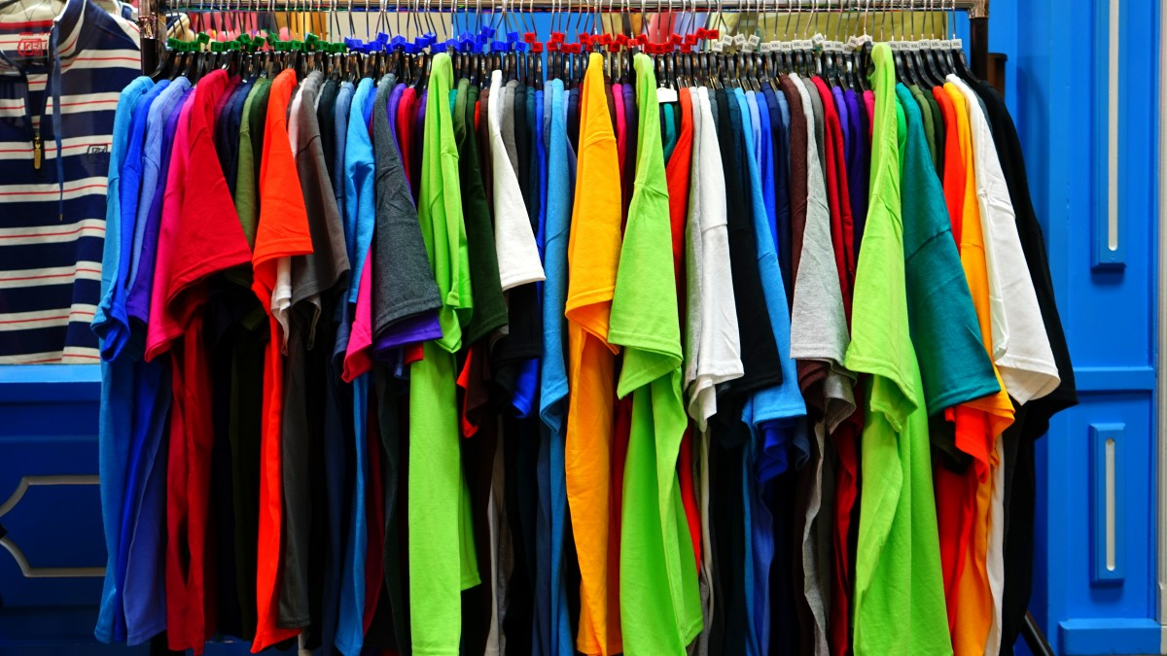
As a man casts off his worn-out clothes and takes on other new ones in their place, so does the embodied soul cast off his worn-out bodies and enters other new’ – words from Bhagavad Gita

Slide 8
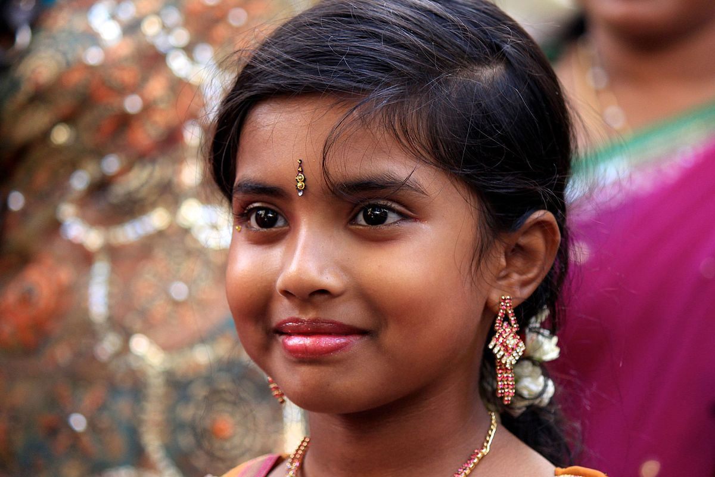
How does Karma affect an individual’s daily life?
Notes:
You need money to buy new clothes; some are more expensive than others.
Hindus believe that a bit like buying new clothes, when you leave this life, you ‘buy’ a new life and it is paid for with good karma – the good actions you have done in this life. When you return to earth, you become a better person / being.

Slide 9
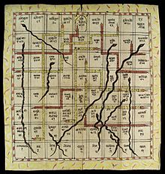
Hindus have holy books and stories to teach them about the ‘snakes and ladders’ of life and how to achieve a better life.
Notes:
Show children the snake and ladder symbol on the front of the unit.
Hindus have holy books and stories which teach them more about the ‘snakes and ladders’ of life and how to achieve a good re-birth into a better life.

Slide 10

How do Hindu parents help their children learn about good actions (KARMA).
Why do they think this is important?
Read the story.
Think about the actions.
Are they snakes or are they ladders?
Notes:
Four stories in resources.

Slide 11
Think about your story…
What would a Hindu child learn about good actions (KARMA)?

Slide 12
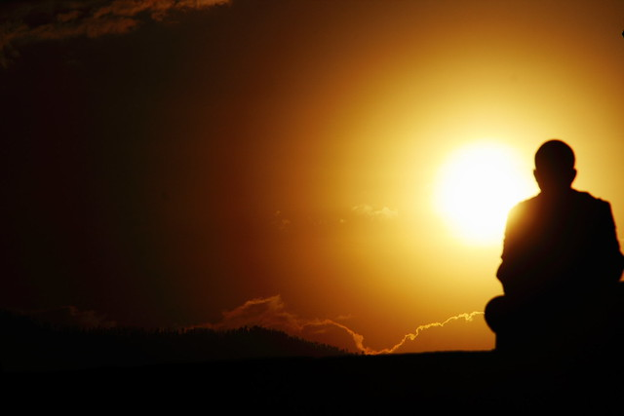
I WONDER…
Notes:
I wonder:
I wonder how the stories make children think about good actions and bad actions?
I wonder how Hindu parents explain the morals and the lessons to be learnt in these stories?
I wonder if we know any fairy stories with morals?
I wonder how we learn about good and bad actions?
I wonder how important it is to me to be wise and choose good actions?

