Slide 1
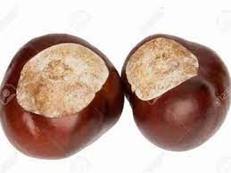
I have 12 conkers and Sam gave me 4 more. How many do I have now?

Slide 2
I have 16 conkers and Dave gave me 6 more. How many do I have now?

Slide 3
Now make your own addition calculations.

