Slide 1
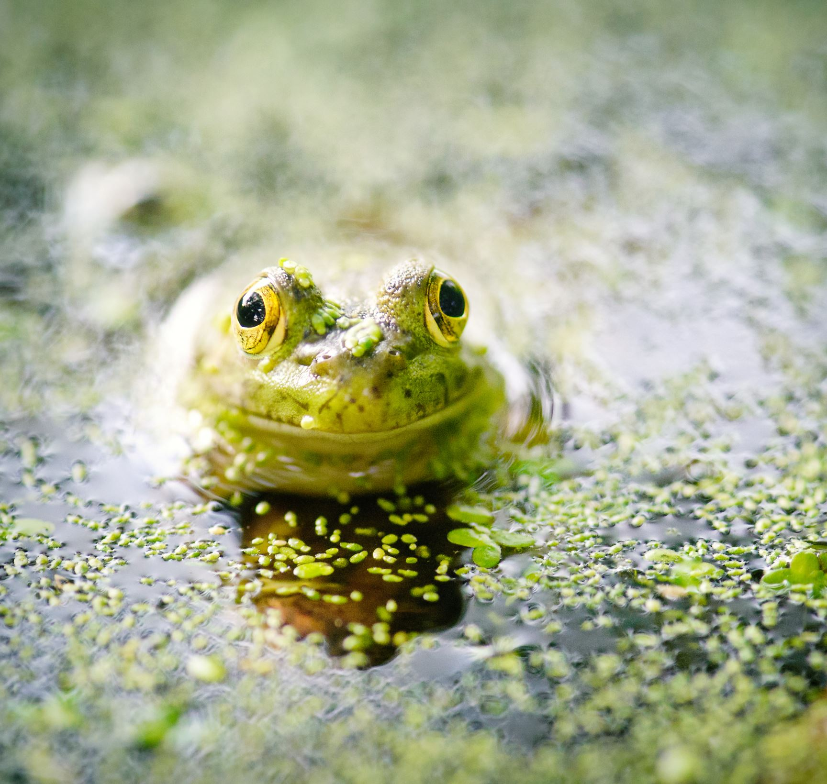
Food chains in a pond

Slide 2
What do these words mean?
Predator
A predator is an animal that eats other animals
Prey
Prey are the animals that the predator eats

Slide 3
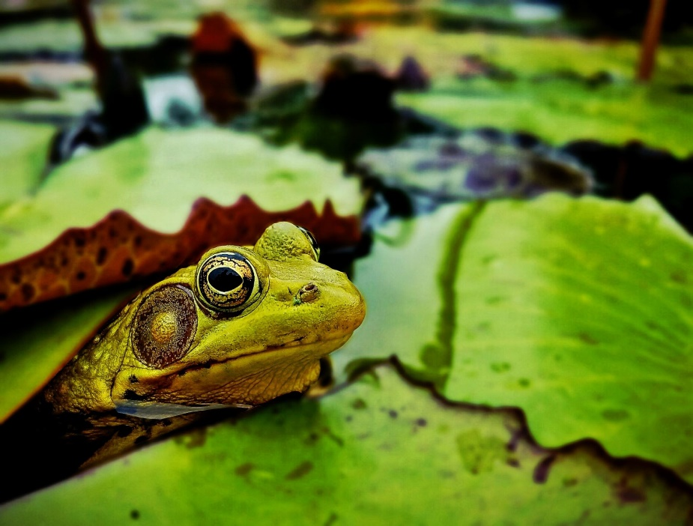
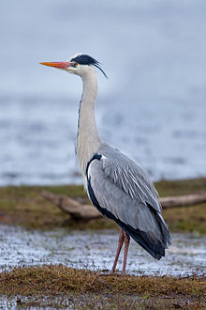
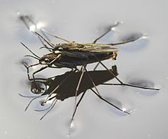
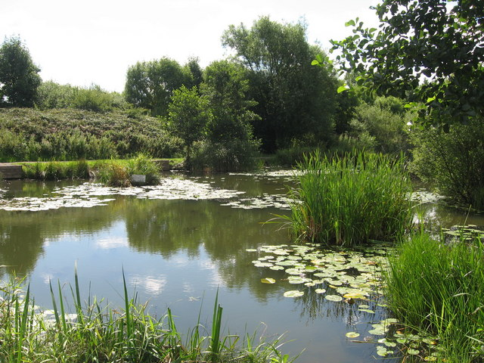
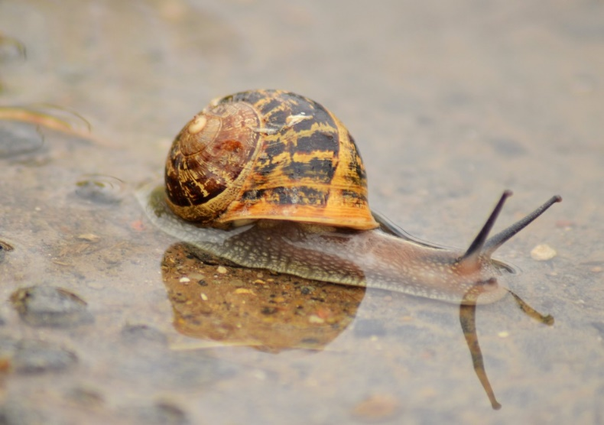
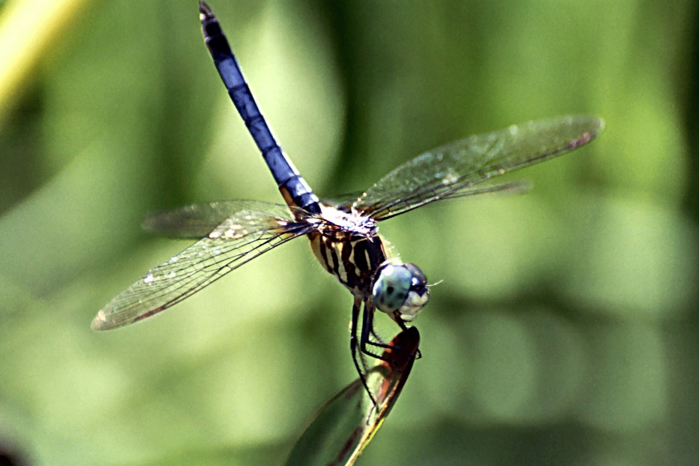
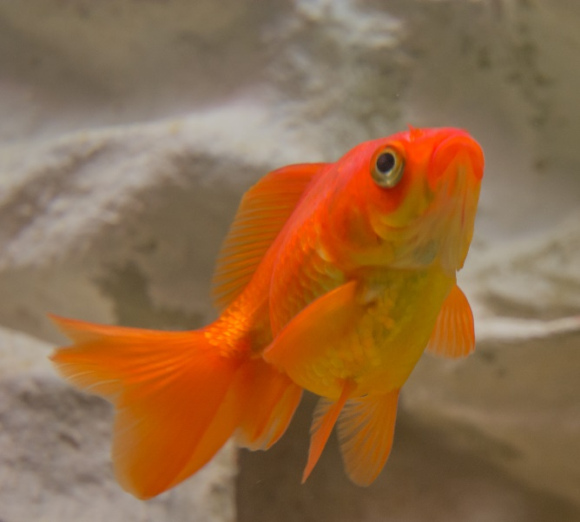
Can you think of some animals that live in a pond?
What do they eat?

Slide 4
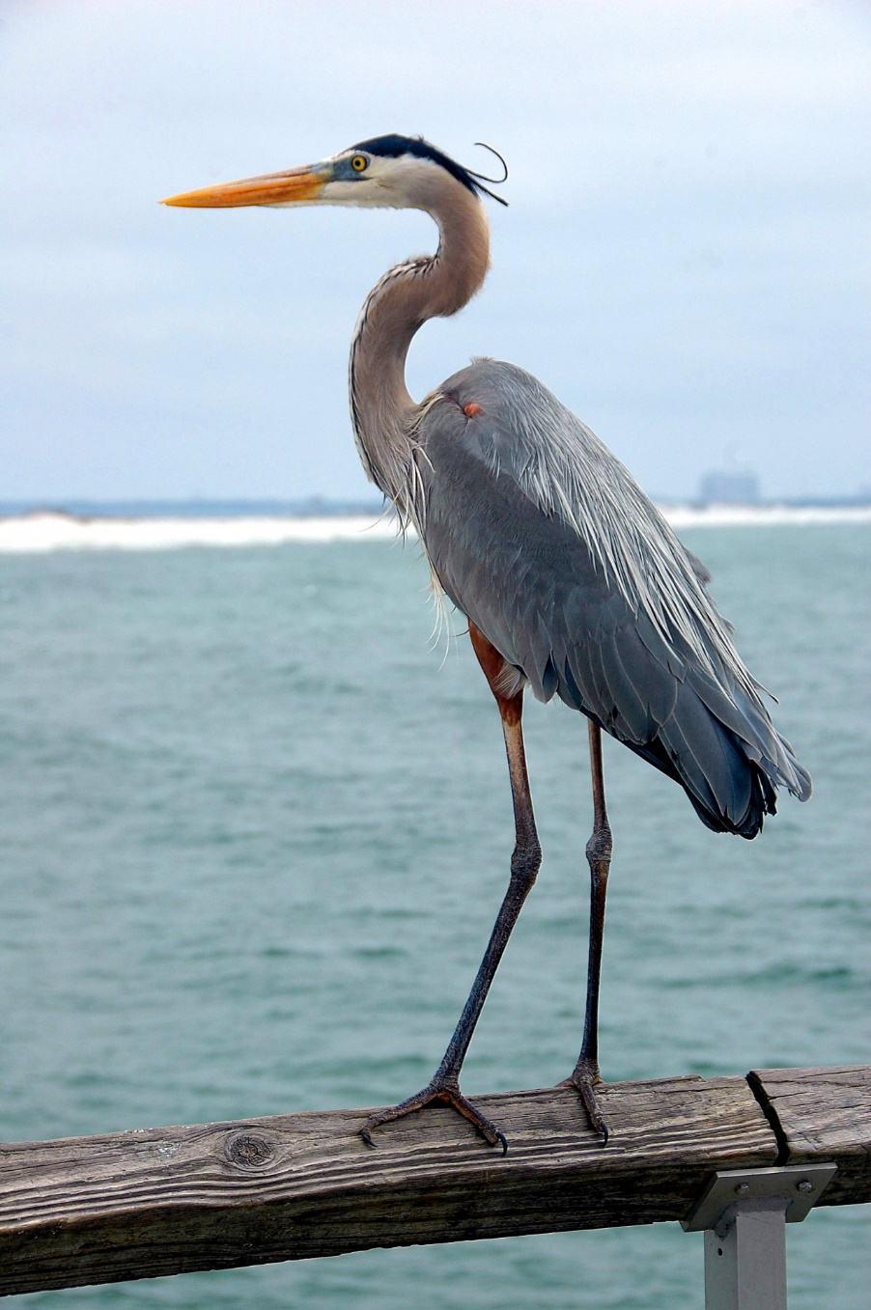
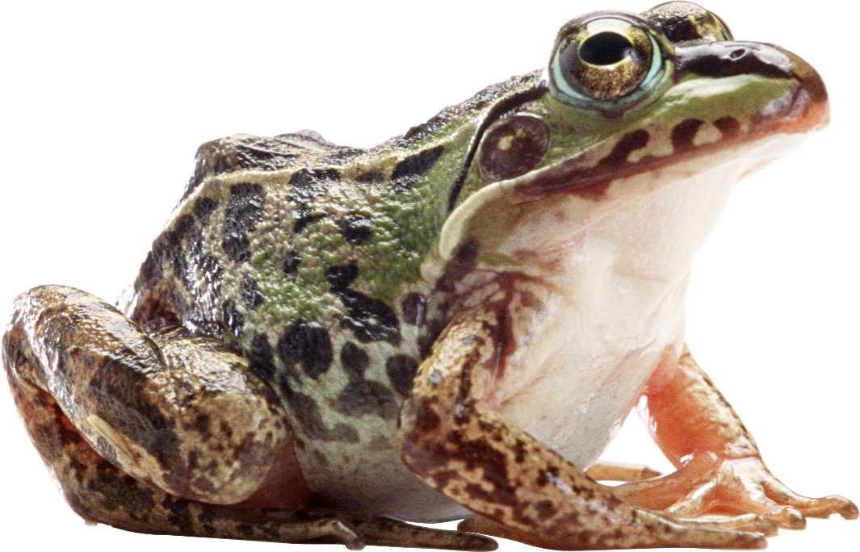
Let’s make a food chain!
What does a heron eat?
They eat fish and frogs!

Slide 5


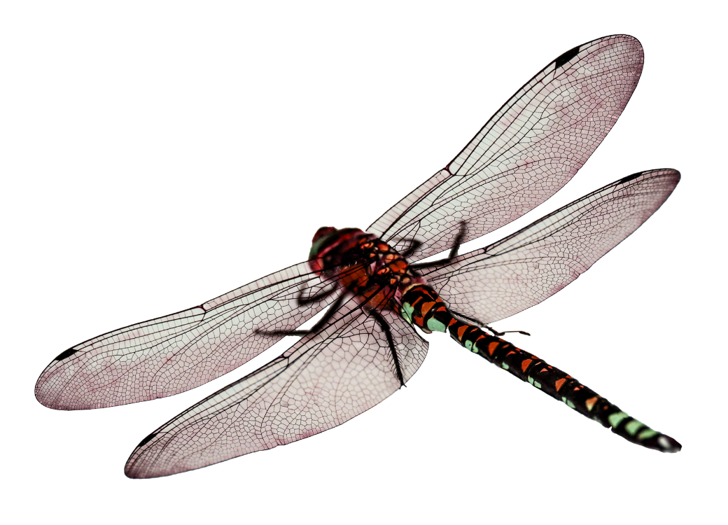
Let’s make a food chain!
What does a frog eat?
Heron
Frog
They eat insects like dragonflies!

Slide 6

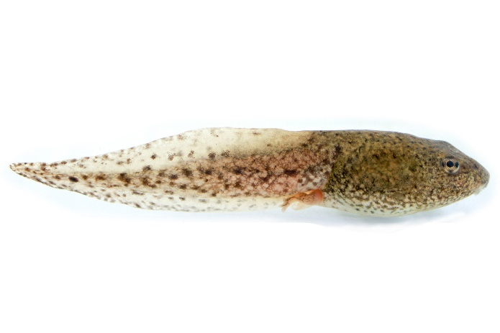
Let’s make a food chain!
What does a dragonfly eat?
Heron
Frog
Dragonfly
They eat insects and tadpoles!

Slide 7


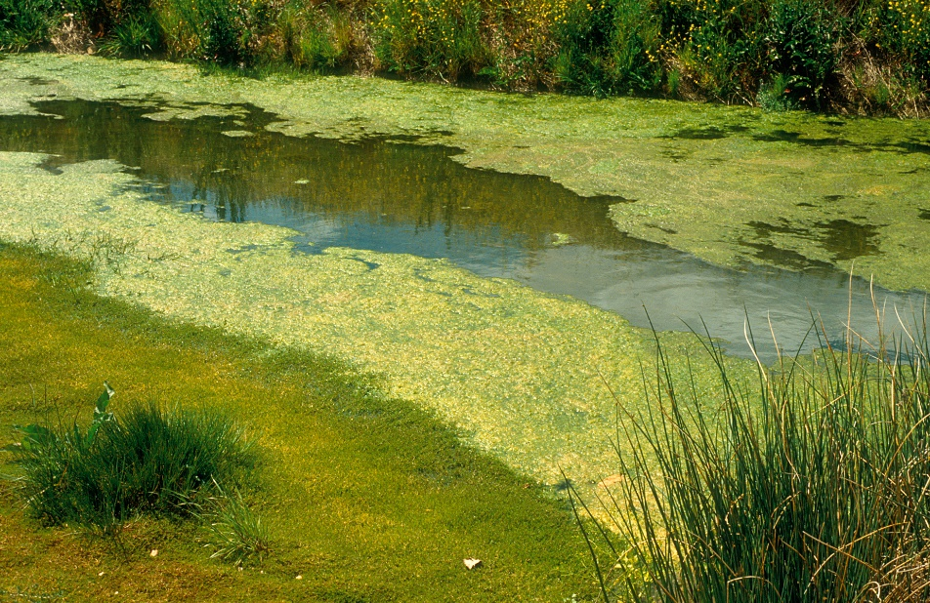



Let’s make a food chain!
Heron
Frog
Dragonfly
Tadpole
Algae (plant)
What does a tadpole eat?
They eat algae and other plants!

Slide 8
Two new words…
A producer makes their own food, like how plants get their energy from the sun.
A consumer needs to eat plants or other animals to get their food.

Slide 9
Can you find a producer and a consumer?
Heron
Frog
Dragonfly
Tadpole
Algae (plant)
Consumers
Producer

Slide 10
Today’s activity:
Represent a food chain from a pond in any format.
This could be:
            a list
            a drawing
            photos
            a model
            something else
Label the producer and consumers.

