Slide 1
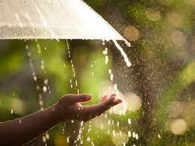
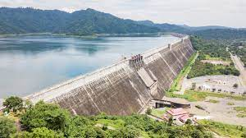
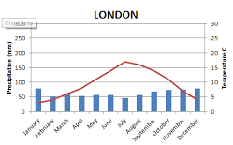
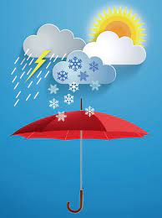
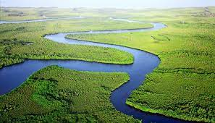
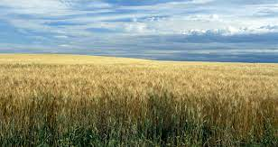
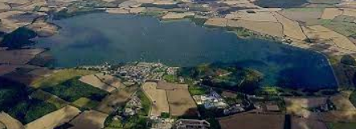
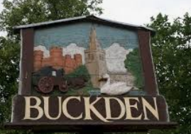
Vocabulary
Like the weather, but over a long time.
The way the air and the atmosphere feels. It includes: temperature, wind, rain, sun, snow, fog, or cloud.
An area near you or your neighbourhood.
The quantity of rain falling within a given area in a given time.
A large lake used as a source of water supply.
A large natural stream of water flowing in a channel to the sea, a lake, or another river.
An area of open land, planted with crops, bounded by hedges or fences.
A barrier constructed to hold back water and raise its level, forming a reservoir used to generate electricity or as a water supply.
field
dam
local
weather
climate
reservoir
rainfall
river

Slide 2
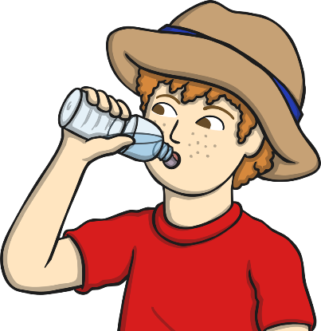
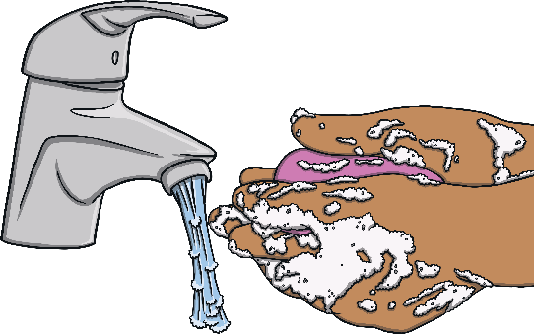

Why Is Water Important?
Water is essential to all life. All living plants and animals need water to survive.
Each day, try to drink around five glasses of water to keep your body healthy.
We also need water to clean our bodies, teeth, clothes, plates and cups.
Plants need water to grow. Without plants, humans and other animals would not have anything to eat.

Slide 3
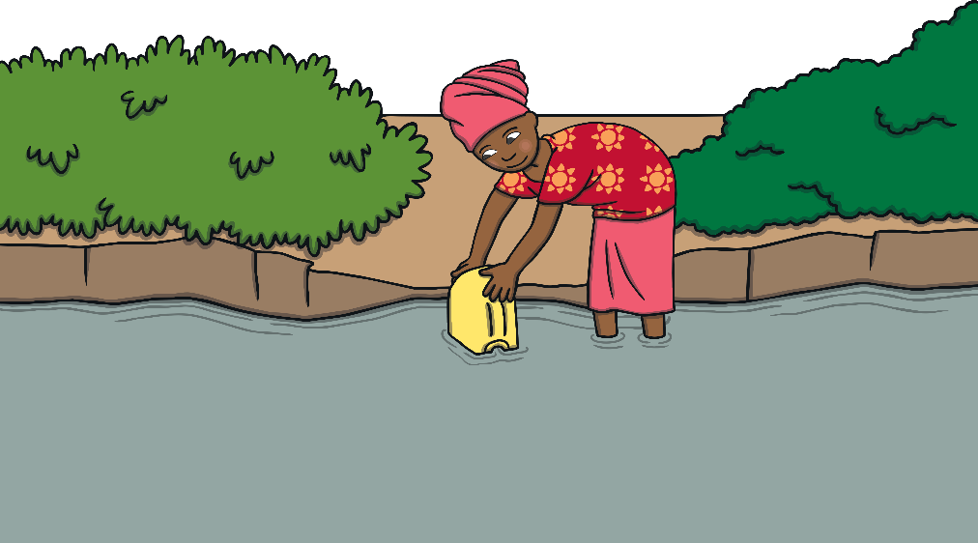

Clean Water
When we turn on our taps, the water that comes out is clean and safe to drink. In some parts of the world, water can have lots of germs in it that might make people poorly when they drink it.
Although the water is dirty, people have no choice but to drink it and use it to cook food.
In the world, 844 million people have to drink dirty water.
844 million looks like this:
844,000,000

Slide 4
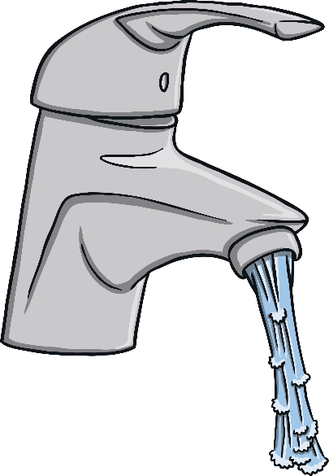
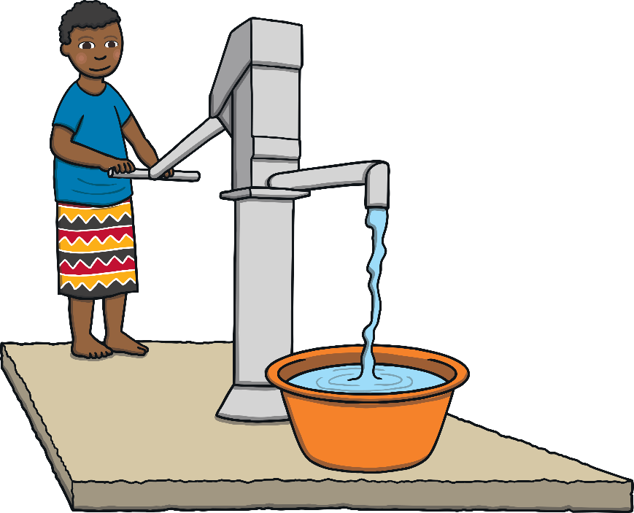
Where Do We Get Water From?
When you want water, how do you get it? We are lucky that in our country, we can get water from a tap whenever we want it.
The water we have is fresh and clean.
In some countries, people don’t have taps in their houses. They have to walk for many miles to fill up buckets from
a river. Then, they have to carry the heavy buckets back home again. Fetching water takes such a long time that some children cannot go to school.

Slide 5
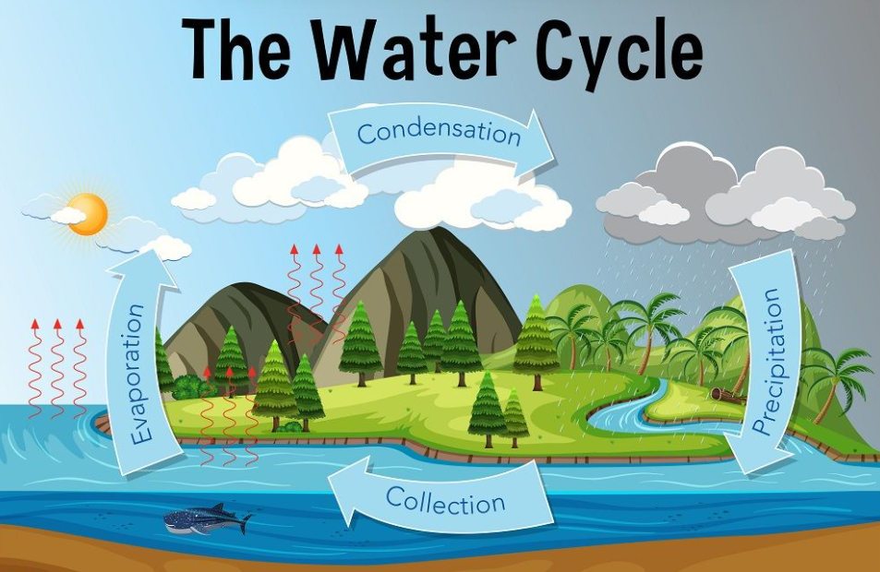
https://www.youtube.com/watch?v=y5gFI3pMvoI

Slide 6
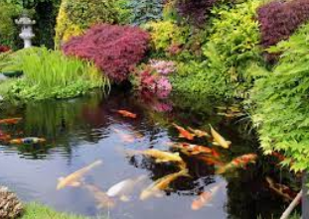
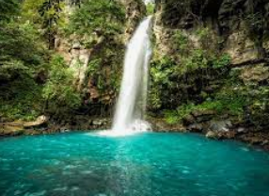
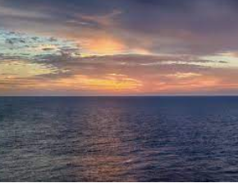
https://www.youtube.com/watch?v=bNWuQD7QHBc
What is a body of water?
Can you name any bodies of water?
As you watch the video, make notes on different bodies of water.
Draw and label these in your book.

Slide 7
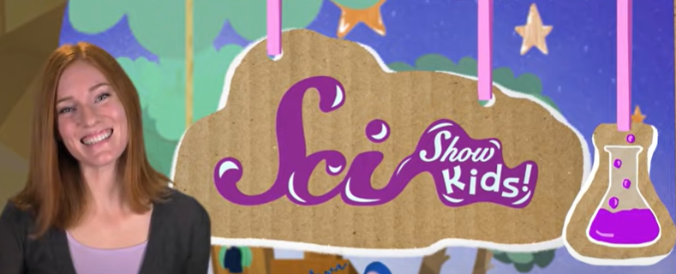
From source to tap!
https://www.youtube.com/watch?v=cGi4PugN4qY

Slide 8
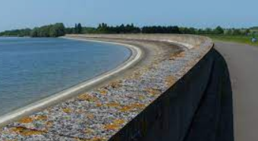
Where do we get our water from?
What is a reservoir and what is its purpose?
A reservoir is an artificial lake created in a river valley by the construction of a dam. The most critical purpose of reservoirs is flood risk management. Reservoirs collect water during times of high rainfall, reducing flood risk, and then release the water slowly over the following weeks and months.
Our local reservoir is Grafham Water.
It supplies many local people with clean water.

Slide 9
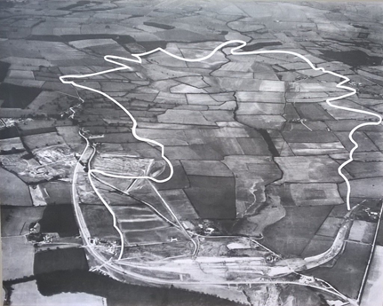
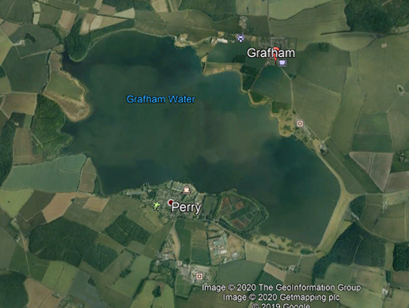
Then Vs Now
1950
2020
What do you notice about these two pictures?
Why do you think a reservoir needed to be built?
I think that…
I know that…
I believe that…

Slide 10
1950
2020
2020
1950
2020
1950
1950
2020

Slide 11
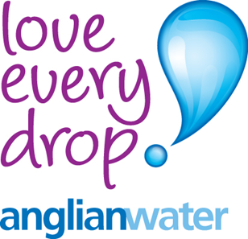
Back in the 1950’s the local authorities in the area realised that, as so many houses were being built and the new town of Milton Keynes being planned, the demand for water in the area would soon be too high for the amount being cleaned. So they made plans to build a new reservoir.

Slide 12
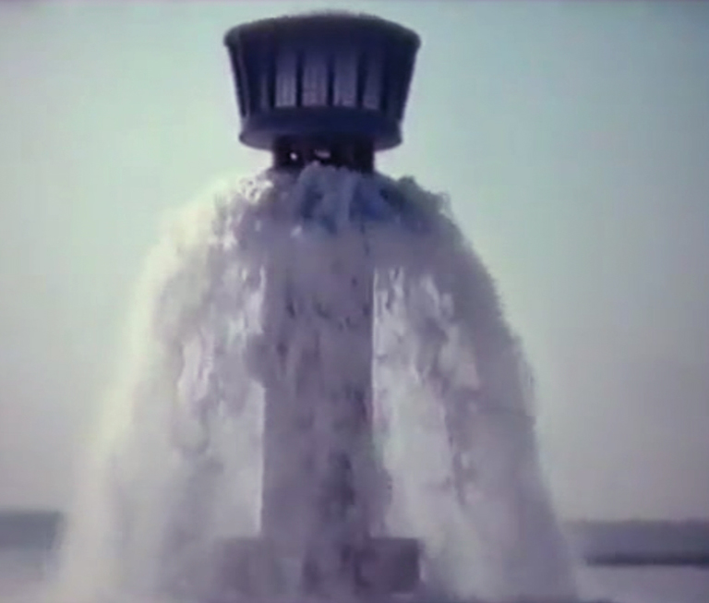
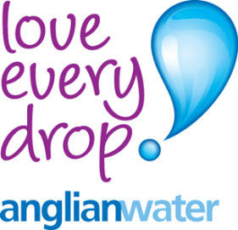
An area of just over 6 square km was chosen in the valley of Diddington Brook. A dam was constructed and in Dec 1964 water began being pumped from the Great Ouse at Offord Cluny through a huge underground pipe into the new reservoir.
It took over a year for
it to be filled.
it

Slide 13
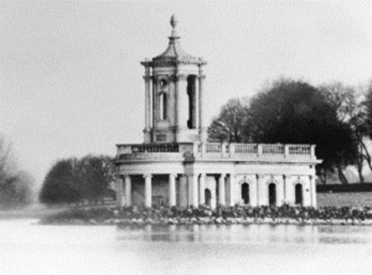

Much of the land flooded was farm land but the small village of Diddington had to be flooded. There was a church in the centre of the village that can still be seen today if the water levels drop.

Slide 14
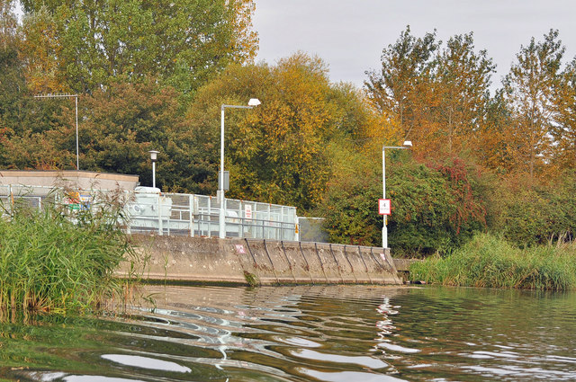

The water is pumped into the reservoir from the River Ouse (Offord Cluny)

Slide 15
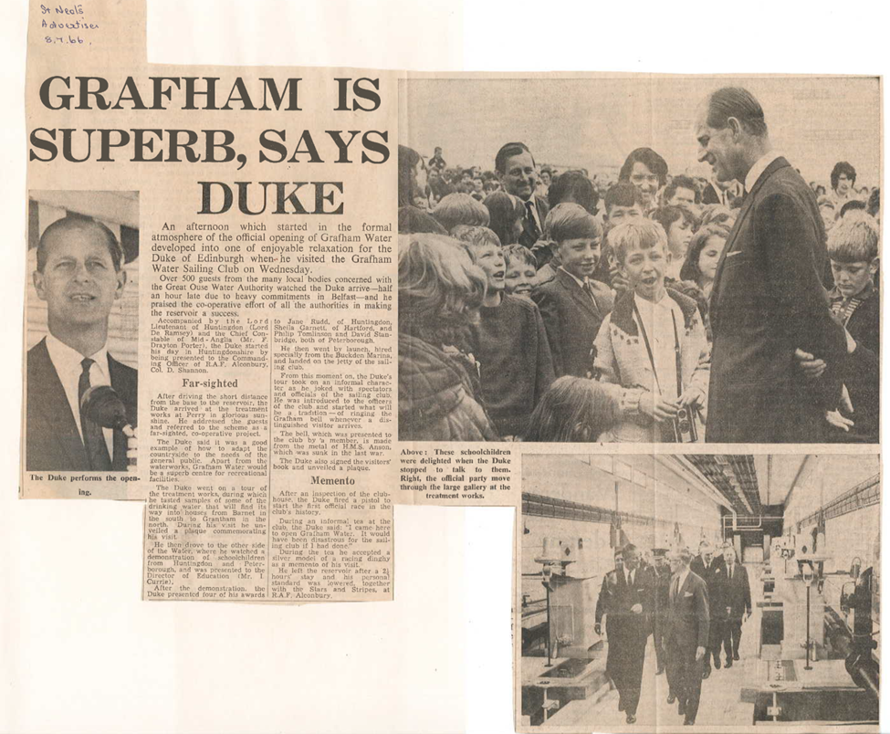
The reservoir was officially opened on the 6th July 1966 by the Duke of Edinburgh.

Slide 16
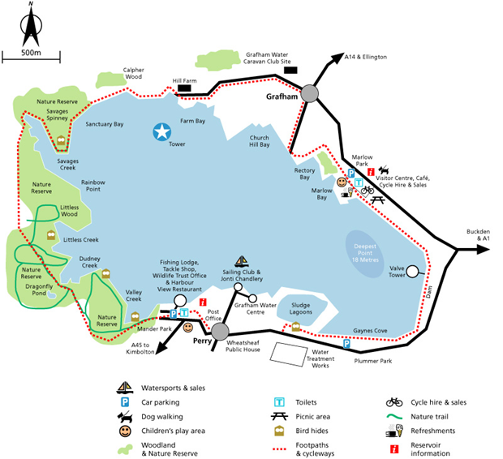

Lots of leisure activities can be found around the reservoir.
The original design included a sailing club, a trout fishery and education centre.
Over the past 20 years other things have been added
Bird hides.

Slide 17
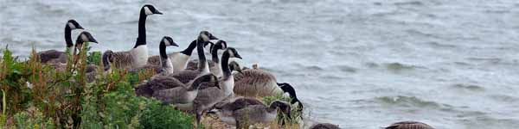

Much of Grafham has been given a special status – a site of special scientific interest (SSSI).
That is because it has become a habitat for a wide range of birds, animals and insects.
Anglian Water works in partnership with many organisations like the Wildlife Trust to ensure that the whole area is protected and improved.

Slide 18
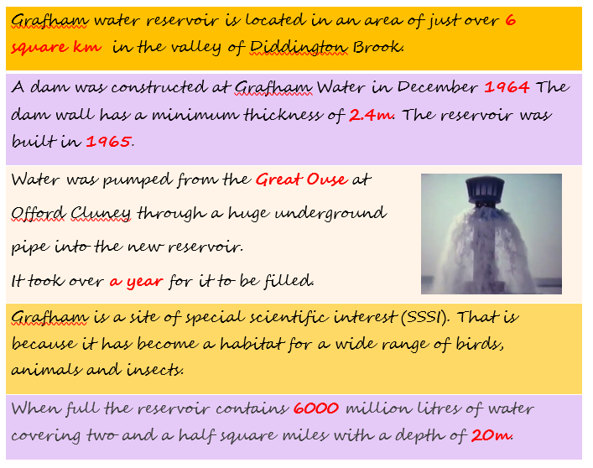
What key facts can you remember about Grafham Water?

Slide 19
What key facts can you remember about Grafham Water?

Slide 20
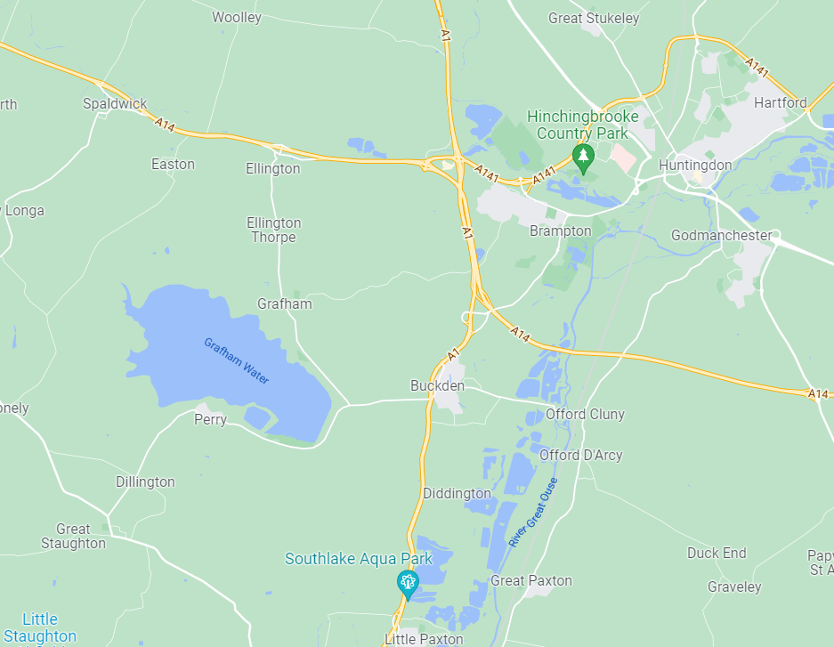
Google Maps
Can you find the following places on the map?
Circle the village of Buckden
Circle the village of Grafham
Draw a line around Grafham Reservoir
Draw an arrow to the A14
Can you find where you live?
In small groups, you will go on Google Earth to see if you can find these places on the digital map!

Slide 22
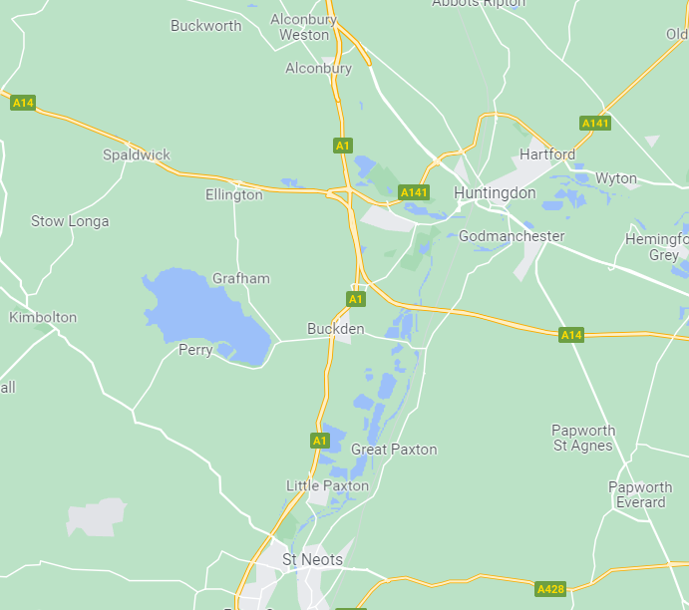

Slide 23
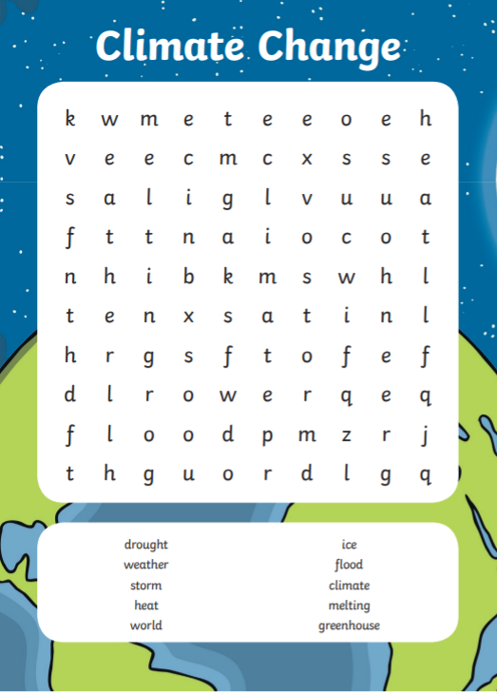

Slide 24
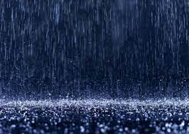
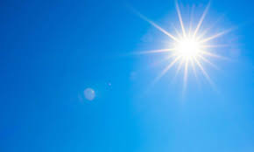
Climate and Water Supply
https://www.youtube.com/watch?v=Y3gqoDUtmt4
Climate change has a severe impact on water resources. Climate change affects more than temperature. Warmer water changes the patterns of ocean currents, affecting global weather patterns. Some places will receive more rainfall, which could lead to flooding, while other places will get less, which might mean drought.
Why do you think this might be a bad thing for the world’s water supply?

Slide 25
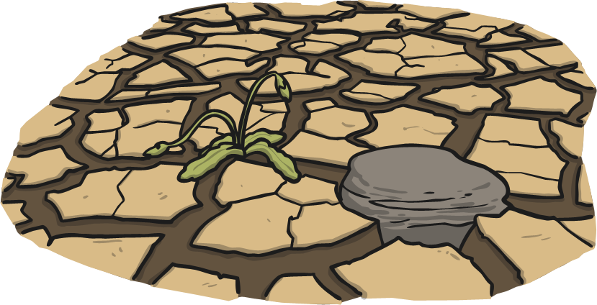
Droughts
Do you ever get bored when it rains lots and you can’t go outside to play? We have a lot of rain in our country and sometimes we can get fed up of it.
In some countries, they would love to have our rain. These countries have droughts. Droughts are when there isn’t rain, sometimes for
many months. When there is no rain, plants can’t grow properly and then there isn’t enough food for humans and other animals to eat.
1.9 billion people live in areas where there are droughts.

Slide 26
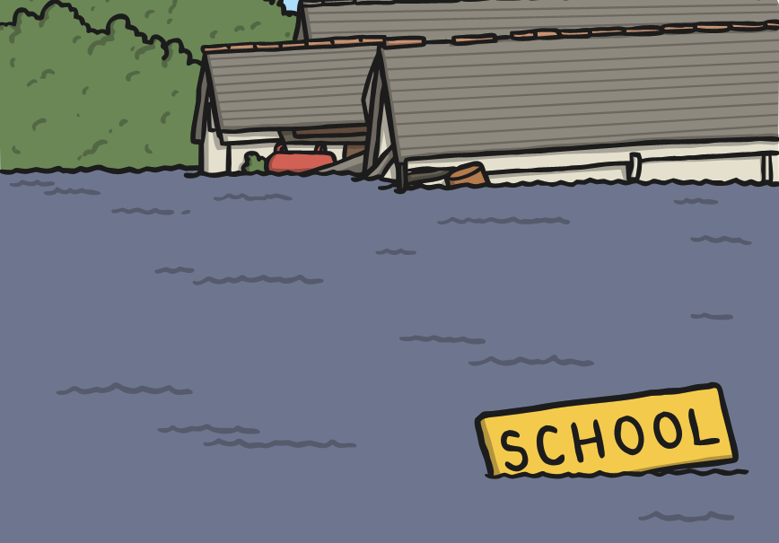
Floods
Other areas of the world have the opposite problem: floods. A flood is where there is too much water in an area and there is nowhere for it to go.
Floods can destroy crops, damage buildings and put people in danger.
1.2 billion people live in areas that are in danger of being flooded and that number is getting bigger every year!

