Slide 2
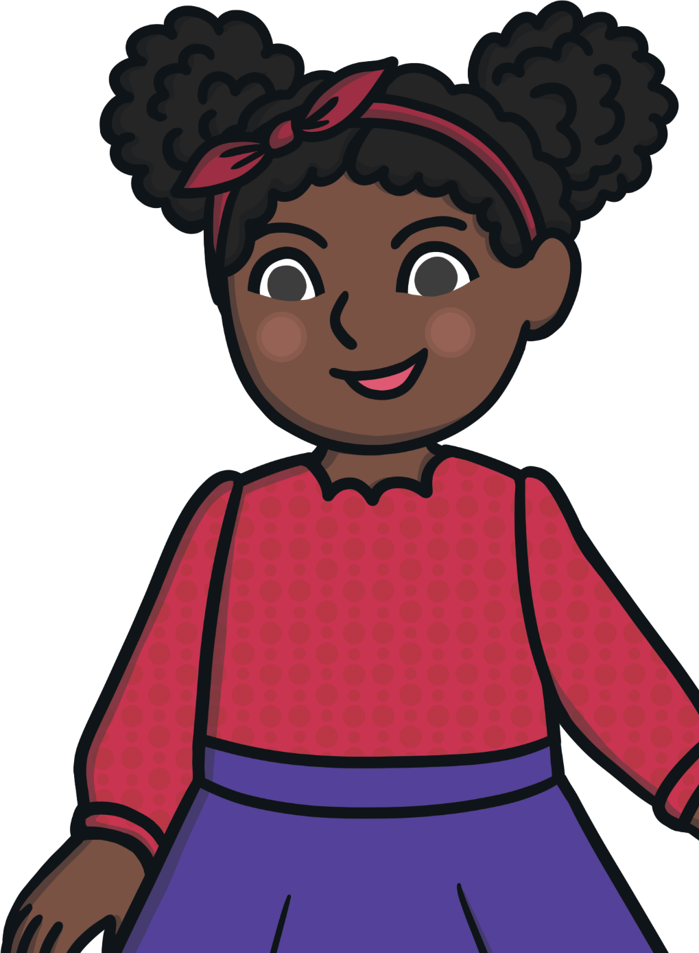
An adjective is a describing word.

Slide 3
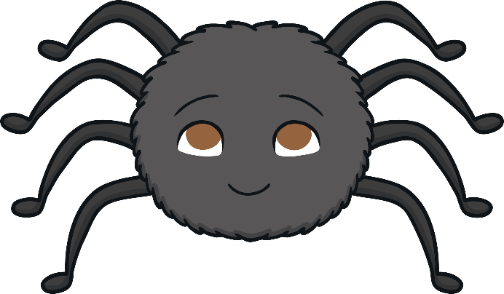
There was a spider in the bathroom.
+ adjectives =
There was a huge, hairy spider in the bathroom.

Slide 4

A slug was in my kitchen.
+ adjectives =
A slimy, sticky slug was in my kitchen.

Slide 5
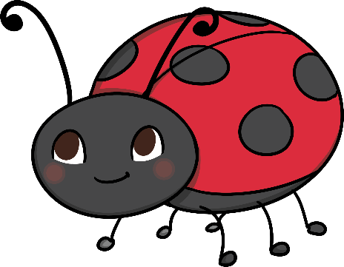

I found a ladybird on a leaf.
+ adjectives =
I found a tiny ladybird on a big leaf.

Slide 6
A butterfly flew into my house.
+ adjectives =
A brown and orange butterfly flew into my house.

Slide 7
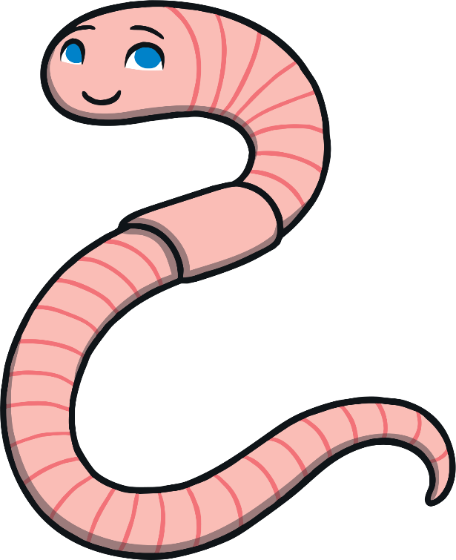
The worm dug through the soil.
+ adjectives =
The wiggly, pink worm dug through the soil.

