Slide 1
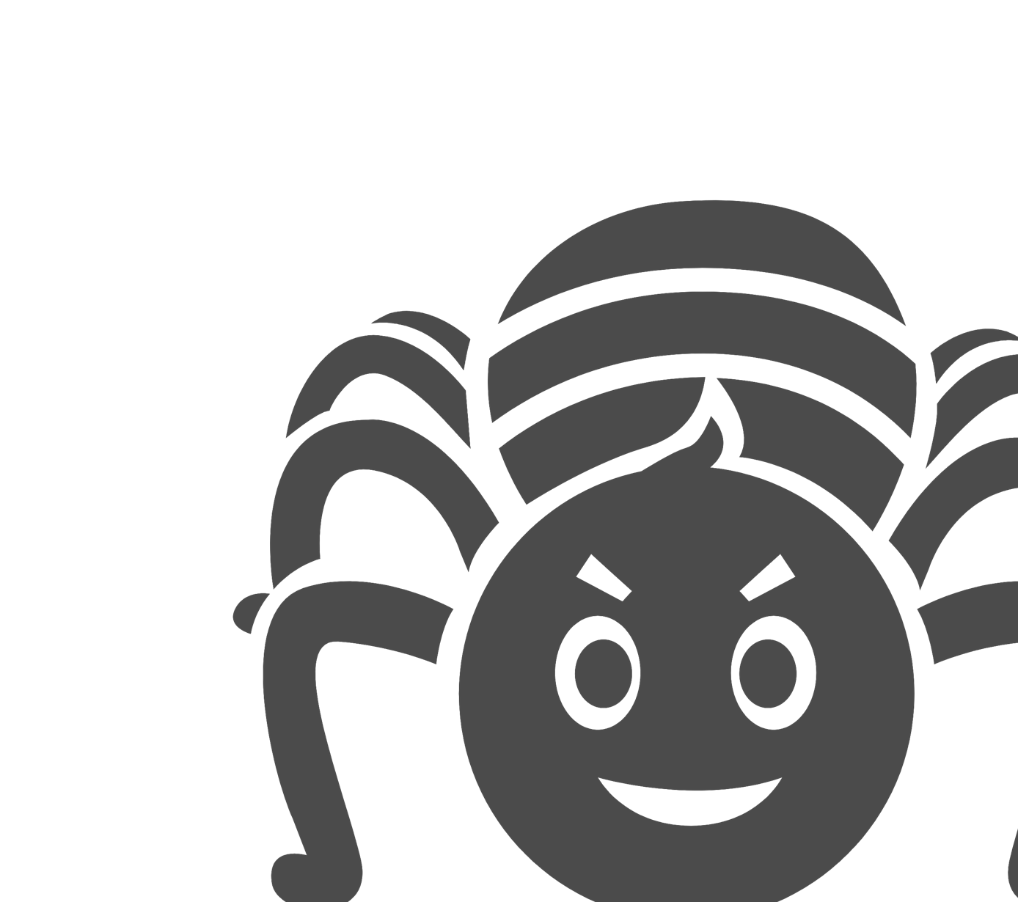

Story of Spikey the Spider
I can describe appropriate ways to behave towards other people online and why this is important.
I can give examples of how bullying behaviour could appear online and how someone can get support.

Slide 2
Who is Spikey the Spider?
Spikey the Spider is not a very nice spider. He makes his web, laying a trap and other animals get all tangled up in it.
Spikey the Spider bullies the other animals. The other animals get upset about what Spikey says and does. He won’t stop when they ask him to.
Notes:
Read out the scenario

Slide 3
How might Spikey bully others online?
In a game, he says horrible things about the other animals in the chat.
He makes rude videos about the other animals and posts them online for everyone to see.
He stole a password and pretended to be another animal, being rude to others.
He draws mean pictures which he shares with the other animals

Slide 4





What could Spikey be using?
Notes:
Ask the children what kind of technology could Spikey be using to be mean to the other animals. Present each technology one at a time, explaining Spikey could use a mobile phone, computer games, social media, and consoles etc.

Slide 5
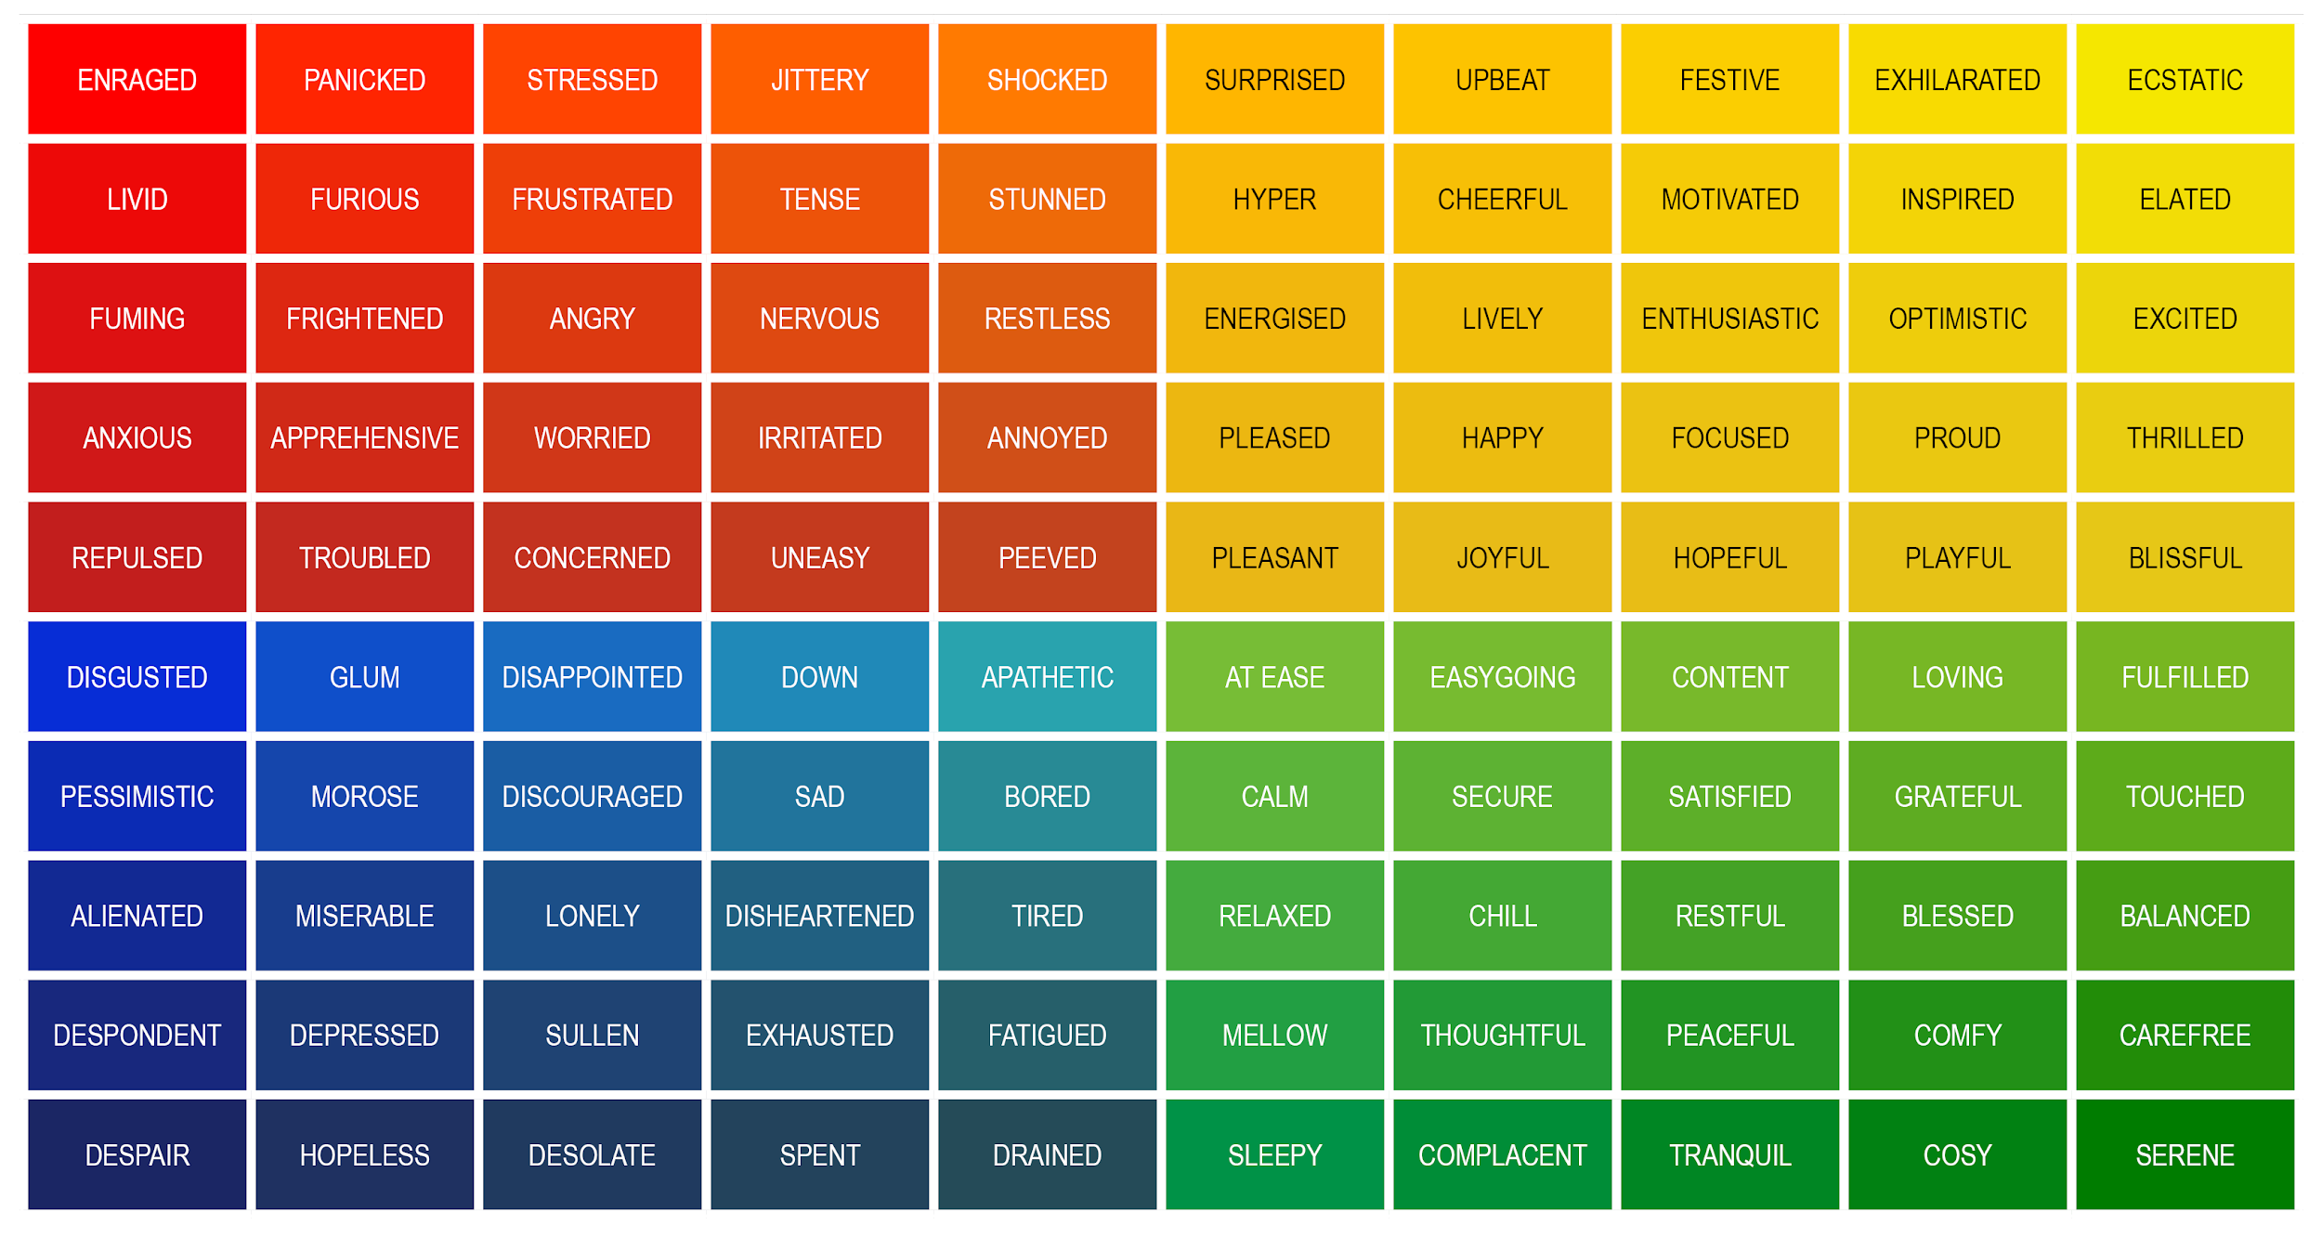
How might the other animals feel about Spikey’s behaviour?

Slide 6

This resource was created with
The Diana Award
For more details of The Diana Award Anti-Bullying Programme, please visit antibullyingpro.com

