Slide 1
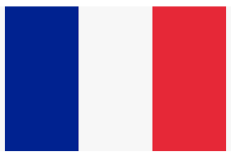
French
Lesson 1
Revisit – Numbers
Can you count out loud from 1 to 20 in French?
You have 2 minutes to practise!
Challenge: Can you count to 31?
Notes:
Give the children 2 minutes to practise counting from 1-20/1-31 to themselves/their adults at home.

Slide 2
French
Lesson 1
Revisit - Numbers
Put up your little yellow hand if you’re feeling brave enough to have a go!
Notes:
Ask a number of children who may be more confident in doing this to count to 20/31 out loud to the remote learners.

Slide 3
Numbers 1-31
How many can flags you see?
Can you say the number in French?
Notes:
Can the children say the number out loud in French?

Slide 4
Numbers 1-31
How many can flags you see?
Can you say the number in French?
Notes:
Can the children say the number out loud in French?

Slide 5
Numbers 1-31
How many can flags you see?
Can you say the number in French?
Notes:
Can the children say the number out loud in French?

Slide 6
Numbers 1-31
What number comes after 11?
Can you say the number in French?
Notes:
Can the children say the number 14 aloud in French? Deuze.

Slide 7
Numbers 1-31
What number comes after 13?
Can you say the number in French?
Notes:
Can the children say the number 14 aloud in French? Quatorze.

Slide 8
Numbers 1-31
What number comes after 15?
Can you say the number in French?
Notes:
Can the children say the number 16 aloud in French? Seize.

Slide 9
Numbers 1-31
What number comes after 18?
Can you say the number in French?
Notes:
Can the children say the number 19 aloud in French? Dix-neuf.

Slide 10
Numbers 1-31
CHALLENGE:
What number comes after 21?
Can you say the number in French?
Notes:
Can the children say the number 22 aloud in French? Vingt-deux.

Slide 11
Numbers 1-31
CHALLENGE:
What number comes after 25?
Can you say the number in French?
Notes:
Can the children say the number 26 aloud in French? Vingt-six.

Slide 12
Numbers 1-31
CHALLENGE:
What number comes after 29?
Can you say the number in French?
Notes:
Can the children say the number 30 aloud in French? Trente.

Slide 13
Numbers 1-31
Watch the video below to practise counting and singing the numbers from 1 – 31 in French.
https://www.youtube.com/watch?v=PkUfSHEdGQs
Notes:
Children to go away and watch the link on the slide to practise saying/singing numbers 1-31.

Slide 14
French
Lesson 2
Revisit – Months of the Year
Can you remember any of the months of the year?
Talk to your adult about any month names you can remember.
Challenge: Can you remember them in order?

Slide 15
French
Lesson 2
Revisit – Months of the Year
Put up your little yellow hand if you can think of a month of the year!

Slide 16
French
Lesson 2
January July
February August
March September
April October
May November
June December
Notes:
Write down any month names that the children can remember, then move onto the next slide to show them all of the months of the year altogether.

Slide 17
French
Lesson 2
January Janvier July Juillet
February Fevrier August Aout
March Mars September Septembre
April Avril October Octobre
May Mai November Novembre
June Juin December Decembre
Notes:
Encourage the children to say the months of the year aloud, in order. My turn, your turn style recall.

Slide 18
French
Lesson 2
January Janvier July Juillet
February Fevrier August Aout
March Mars September Septembre
April Avril October Octobre
May Mai November Novembre
June Juin December Decembre
Practise saying the months of the year with your adult at home.

Slide 19
French
Lesson 2
Watch this video to practise the months of the year in French.
https://www.youtube.com/watch?v=7_u2SigckNQ

Slide 20
French
Lesson 3
Revisit – When is your Birthday?
Can you count out loud from 1 to 31 in French?
Can you remember the months of the year?
You have 2 minutes to practise!
Notes:
Give the children 2 minutes to practise counting from 1-20/1-31 to themselves/their adults at home as well as recalling the months of the year.

Slide 21
French
Lesson 3
Counting together
Unmute your microphone and count aloud with me!
Notes:
Count aloud from 1-31.

Slide 22
French
Lesson 3
January Janvier July Juillet
February Fevrier August Aout
March Mars September Septembre
April Avril October Octobre
May Mai November Novembre
June Juin December Decembre
Unmute your microphone and say them aloud with me!
Notes:
Encourage the children to say the months of the year aloud, in order. My turn, your turn style recall.

Slide 23
French
Lesson 3
When is your Birthday?
My birthday is on the …. of …
My birthday is on the 10th of April.
Notes:
Ask the children to say their birthday to their adult in English.

Slide 24
French
Lesson 3
When is your Birthday?
Quelle est la date de ton anniversaire?
My birthday is on … of …
Mon anniversaire est le…
My birthday is on the 10th of April.
Mon anniversaire est le 10 Avril.
Notes:
Explain that to ask someone when their birthday is in French, we say ‘Quelle est la date de ton anniversaire?’
To reply, we say ‘Mon anniversaire es le…’ and then say the number of the date we were born followed by the month.
So to say ‘My birthday is on the 10th of April, we would say, Mon anniversaire es le 10 Avril’.

Slide 25
French
Lesson 3
Quelle est la date de ton anniversaire?
Mon anniversaire est le…
1 2 3 4 5 6 7 8 9 10 Janvier Fevrier Mars
11 12 13 14 15 16 17 Avril Mai Juin Juillet
18 19 20 21 22 23 24 Aout Septembre Octobre
25 26 27 28 29 30 31 Novembre Decembre
2 minute challenge: Can you say your birthday in French? Use the blue writing as your sentence starter.
Notes:
Ask the children to have a go at saying their Birthday in French.

Slide 26
French
Lesson 3
Quelle est la date de ton anniversaire?
Mon anniversaire est le…
If you would like to share when your birthday is, put up your little yellow hand!
Notes:
Ask the children to have a go at saying their Birthday in French.

Slide 27
French
Lesson 4
Revisit – Days of the week
Can you remember the days of the week?
Share what you can remember with your adult.
Notes:
Give the children 2 minutes to recall the days of the week.

Slide 28
French
Lesson 4
Revisit – Days of the week
Which days can you remember? Put up your little yellow hand if you have any ideas.
Notes:
Write down any ideas the children have.

Slide 29
French
Lesson 4
Revisit – Days of the week
Monday Lundi
Tuesday Mardi
Wednesday Mercredi
Thursday Jeudi
Friday Vendredi
Saturday Samedi
Sunday Dimanche
Notes:
Say the days of the week aloud for the children to hear how they are pronounced. My turn, your turn style recall.

Slide 30
French
Lesson 4
Monday Lundi
Tuesday Mardi
Wednesday Mercredi
Thursday Jeudi
Friday Vendredi
Saturday Samedi
Sunday Dimanche
Practise saying the days of the week aloud.

Slide 31
French
Lesson 4
Watch the video link below to practise saying/singing the days of the week.
https://www.youtube.com/watch?v=PPGRMNYw8HE

Slide 32
French
Lesson 5
Revisit – What is the date?
You will need to remember:
Numbers 1-31
Days of the week
Months of the year.
Notes:
Give the children 2 minutes to recall the days of

Slide 33
French
Lesson 5
Revisit – What is the date?
3 minute challenge:
How far can you count in French?
What are the days of the week?
What are the months of the year?
Notes:
Give the children 2 minutes to recall numbers, days of the week and months of the year.

Slide 34
French
Lesson 5
Revisit – What is the date?
k
Lundi Janvier Juillet
Mardi Fevrier Aout
Mercredi Mars Septembre
Jeudi Avri l Octobre
Vendredi Mai Novembre
Samedi Juin Decembre
Dimanche
Notes:
My turn, your turn style recall of days of the week. Which is.... Tuesday? Which is…. Thursday? Which is…. March? Which is…. October? Which is…. July?

Slide 35
French
Lesson 5
What is the date?
Quelle est la date?
The date is... (day, number, month)
La date est…
The date is Monday 1st February
La date est Lundi 1 Fevrier
Notes:
To ask someone what the date is, we say ‘Quelle est la date?’. To respond to this, we use the sentence starter… ‘La date est…’ followed by the day, the number and the month we are on.

Slide 36
French
What is the date today?
La date est… day, number, month.
k
Lundi Janvier Juillet
Mardi Fevrier Aout
Mercredi Mars Septembre
Jeudi Avri l Octobre
Vendredi Mai Novembre
Samedi Juin Decembre
Dimanche Use these prompts to help you.
Lesson 5
Notes:
What is the date today? Ask the children to think about what the date is in English, using the prompts of days, months and recall of numbers 1-31.

Slide 37
What would these dates be in French?
Wednesday 12th May Thursday 15th April
Monday 23rd August Friday 28th June
Use these prompts to help you.
Lundi Janvier Juillet
Mardi Fevrier Aout
Mercredi Mars Septembre
Jeudi Avril Octobre
Vendredi Mai Novembre
Samedi Juin Decembre
Dimanche
La date est…
Notes:
Children to have a go at saying the date for the following dates in French.

Slide 38
French
Lesson 6
Revisit – Hobbies
2 minutes: What activities do you do outside of school?
Can you remember any of these activities in French?
Notes:
Ask children

Slide 39
French
Lesson 6
Revisit – Hobbies
What hobbies/activities do you like?
Can you remember any of these activities in French?
Put up your little yellow hand if you would like to share your ideas.
Notes:
Ask children if they can recall any hobbies they have, and if they can remember anything of them in French. Share ideas.

Slide 40
French
Lesson 6
Revisit – Hobbies
I like - J’aime
I don’t like - Je n’aime pas
Notes:
To say ‘I like’ we say ‘J’aime’
To say ‘I don’t like’ we say ‘Je n’aime pas’.

Slide 41
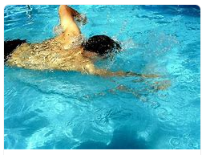
French
Lesson 6
Swimming – Natation
I like swimming - J’aime nager
I don’t like swimming – Je n’aime pas Nager

Slide 42
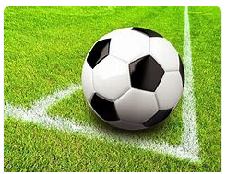
French
Lesson 6
Football – Football
I like football - J’aime le Football
I don’t like football – Je n’aime pas Football.

Slide 43
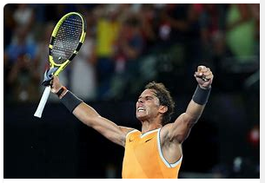
French
Lesson 6
Tennis – Tennis
I like Tennis - J’aime le Tennis.
I don’t like Tennis – Je n’aime pas le Tennis.
Notes:
Swimming

Slide 44
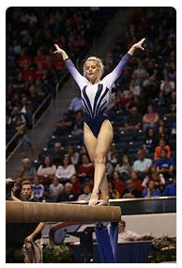
French
Lesson 6
Gymnastics – La Gymnastique
I like Gymnastics - J’aime la Gymnastique.
I don’t like Gymnastics – Je n’aime pas le Gymnastique.
Notes:
Swimming

Slide 45
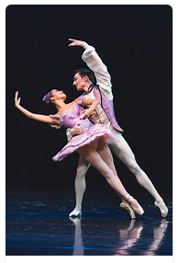
French
Lesson 6
Dancing – Danse
I like dancing - J’aime Danser
I don’t like dancing – Je n’aime pas le Danser.

Slide 46
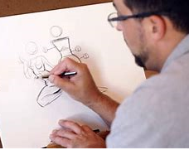
French
Lesson 6
Drawing - Dessin
I like drawing - J’aime Dessiner
I don’t like drawing – Je n’aime pas le dessiner.

Slide 47
Le Dessiner
Le Danse
Le Gymnastique
Le Football
La Natation
Le Tennis
J’aime…
Je n’aime pas…
Choose one activity you like and one activity you don’t like.
Can you say which activities you like/dislike in French?
Use the sentence starters to help you.
Notes:
Children to choose one activity they like and one they don’t like in French.

Slide 48
French
Lesson 7
Revisit – Shops
2 minutes: What shops are around our locality?
Can you remember any of the shops names in French?

Slide 49
French
Lesson 7
Revisit – Shops
Put your little yellow hand up if you can remember any shop names in French!

Slide 50

Le S_p_rm_rché

Slide 51
Le Supermarché – Supermarket

Slide 52
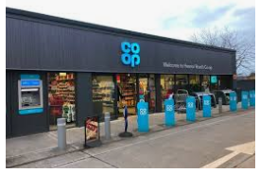
Une e_ice_ié

Slide 53
Une epicerié – Small Grocery Shop

Slide 54
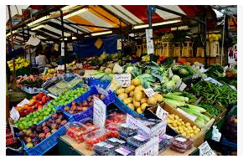
Le m_r__é

Slide 55
Le marché – Farmers Market

Slide 56
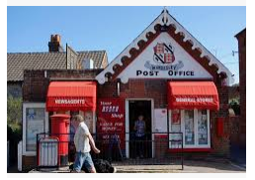
La P_st_

Slide 57
La Poste – Post Office

Slide 58
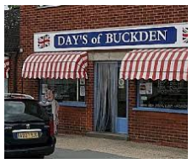
La B_u__eri_

Slide 59
La Boucherie – Butchers

Slide 60
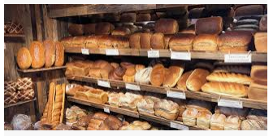
La Bo_l_ng_ri_

Slide 61
La Boulangerie – Bakery

Slide 62
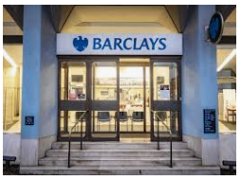
La B_n_ue

Slide 63
La Banque – Bank

Slide 64
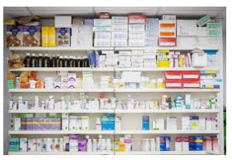
La Ph_rm_c_e

Slide 65
La Pharmacie – Pharmacy

Slide 66
French
Lesson 8
Where I live
What types of buildings do we have in Buckden and its surrounding villages?
Think about places other than shops!

Slide 67
French
Lesson 8
Where I live
What types of houses and buildings do we have in Buckden and its surrounding villages?

Slide 68
French
Lesson 8
Where I live
Houses
Flats
Castle (Buckden Towers)
Cottages
Farms

Slide 69
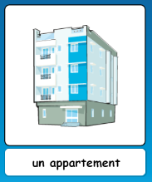
French
Where I live
Lesson 8

Slide 70
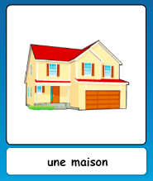
French
Where I live
Lesson 8

Slide 71
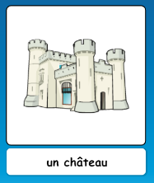
French
Where I live
Lesson 8

Slide 72
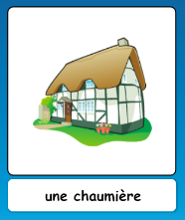
French
Where I live
Lesson 8

Slide 73
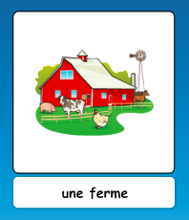
French
Where I live
Lesson 8

Slide 74
French
Where I live
Lesson 8

Slide 75
French
Where I live
Lesson 8
Can you remember what these buildings are called?

Slide 76
French
Lesson 8
Where do you live?
Où habitez-vous?

Slide 77
French
I live in a…
Je vis dans…
Lesson 8
I live in a house.
Je vis dans une maison.

Slide 78
French
Where do you live?
Lesson 8
I live in a…
Je vis dans…

Slide 79
French
Lesson 9
School Subjects
What learning do we do in School?
What subjects do we do every week?

Slide 80
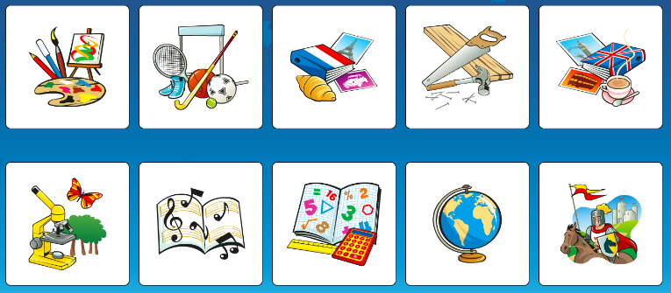
French
Lesson 9
School Subjects

Slide 81
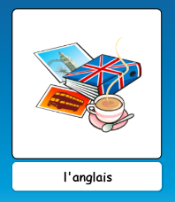
French
Lesson 9
School Subjects

Slide 82
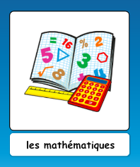
French
Lesson 9
School Subjects

Slide 83
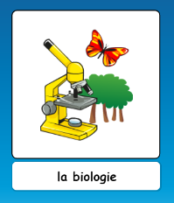
French
Lesson 9
School Subjects

Slide 84
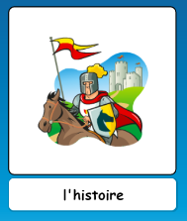
French
Lesson 9
School Subjects

Slide 85
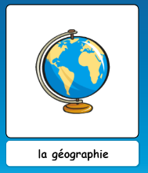
French
Lesson 9
School Subjects

Slide 86
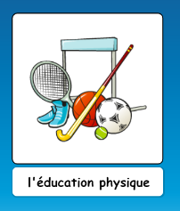
French
Lesson 9
School Subjects

Slide 87
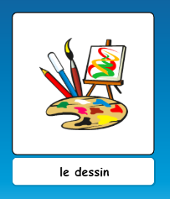
French
Lesson 9
School Subjects

Slide 88
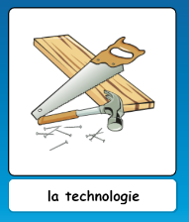
French
Lesson 9
School Subjects

Slide 89
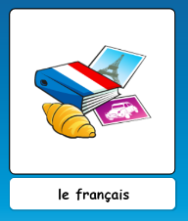
French
Lesson 9
School Subjects

Slide 90
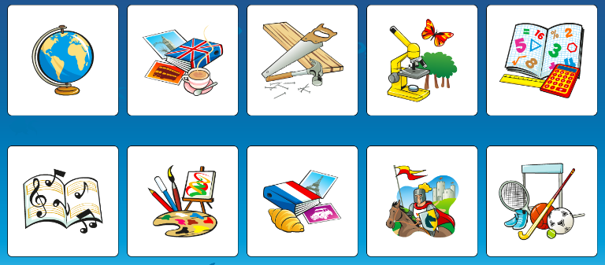
French
Lesson 9
School Subjects
Notes:
What is Geography?

Slide 91
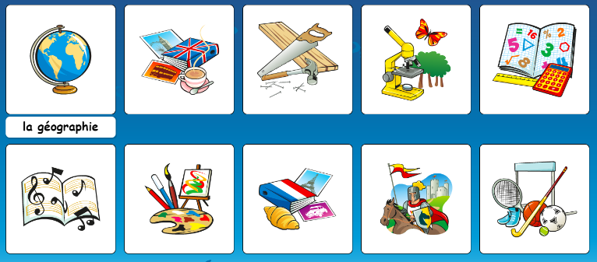
French
Lesson 9
School Subjects
Notes:
What is English?

Slide 92
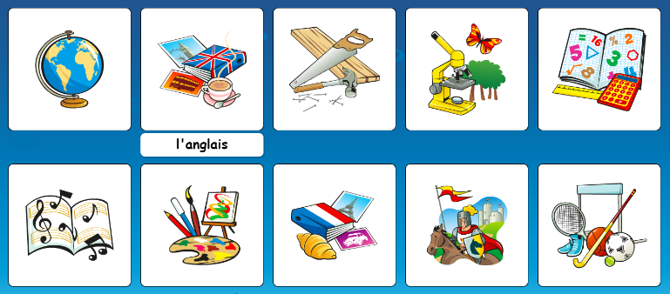
French
Lesson 9
School Subjects
Notes:
What is DT?

Slide 93
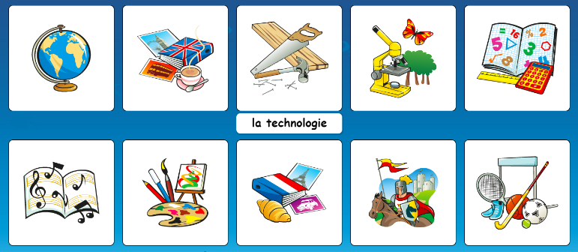
French
Lesson 9
School Subjects
Notes:
What is Science?

Slide 94
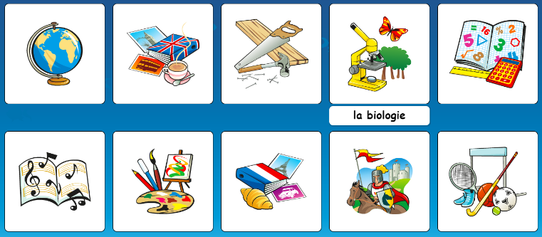
French
Lesson 9
School Subjects
Notes:
What is Maths?

Slide 95
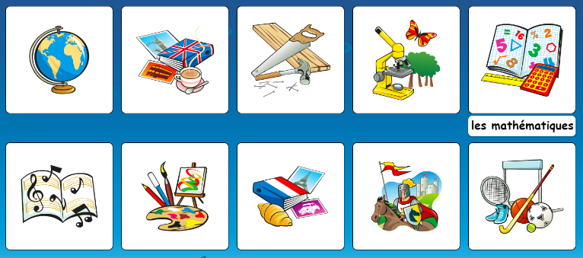
French
Lesson 9
School Subjects
Notes:
What is Music?

Slide 96
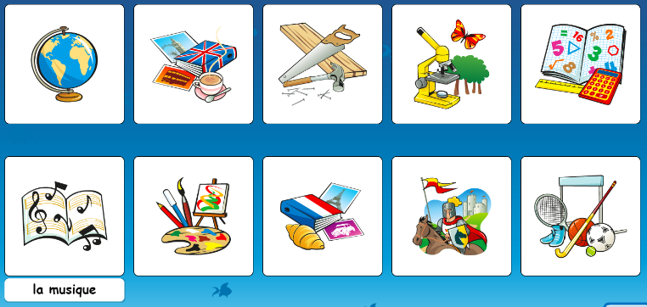
French
Lesson 9
School Subjects
Notes:
What is Art?

Slide 97
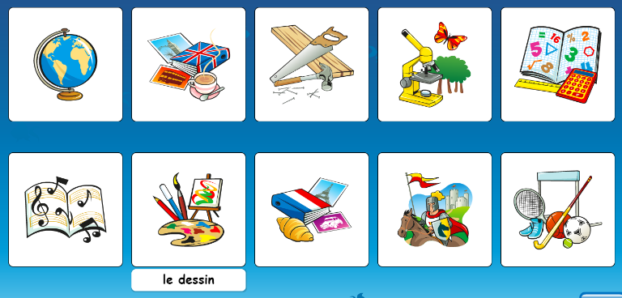
French
Lesson 9
School Subjects
Notes:
What is French?

Slide 98
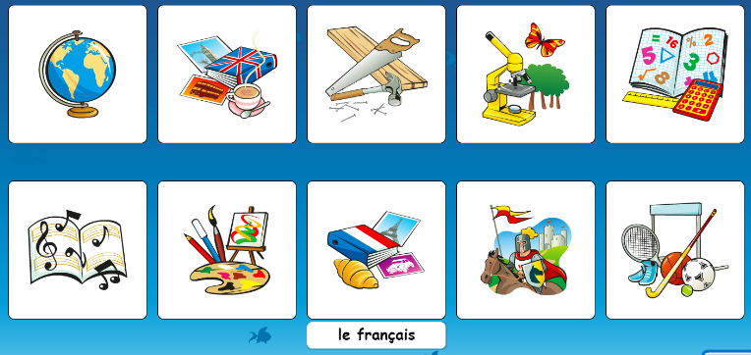
French
Lesson 9
School Subjects
Notes:
What is History?

Slide 99
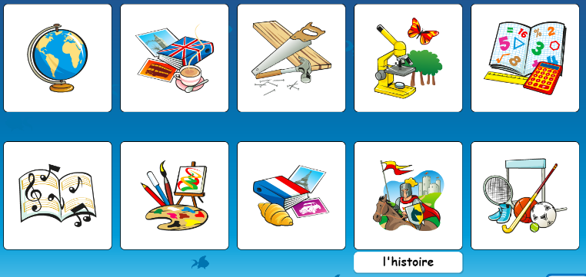
French
Lesson 9
School Subjects
Notes:
What is PE?

Slide 100
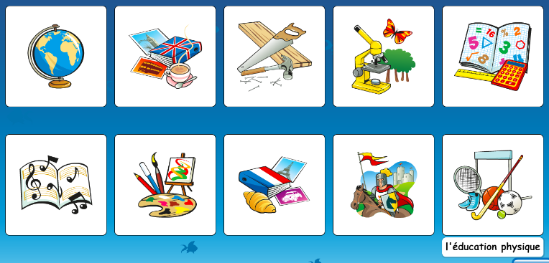
French
Lesson 9
School Subjects
Notes:
What is PE?

Slide 101
French
School Subjects
Lesson 9
Can you tell us your favourite school subject in French?

Slide 102
French
Lesson 10
School Stationary
What is in your school pencil case?
Draw/write what is in your pencil case on your whiteboard.

Slide 103
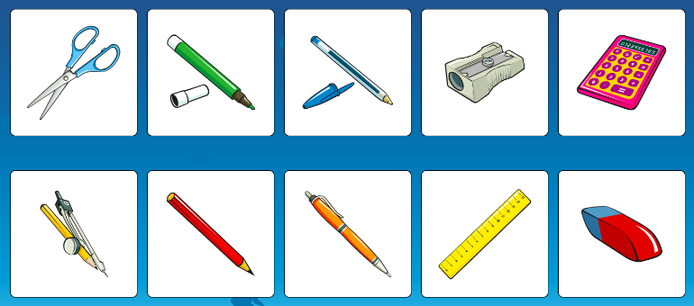
French
School Stationary
Lesson 10
What’s in your pencil case?

Slide 104
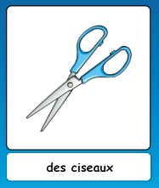
French
School Stationary
Lesson 10
What’s in your pencil case?

Slide 105
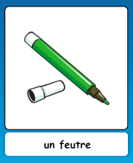
French
School Stationary
Lesson 10
What’s in your pencil case?

Slide 106
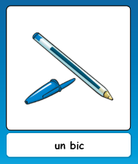
French
School Stationary
Lesson 10
What’s in your pencil case?

Slide 107
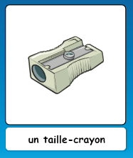
French
School Stationary
Lesson 10
What’s in your pencil case?

Slide 108
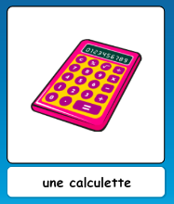
French
School Stationary
Lesson 10
What’s in your pencil case?

Slide 109
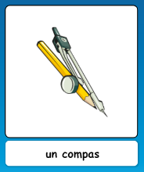
French
School Stationary
Lesson 10
What’s in your pencil case?

Slide 110
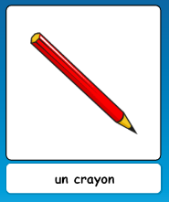
French
School Stationary
Lesson 10
What’s in your pencil case?

Slide 111
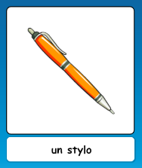
French
School Stationary
Lesson 10
What’s in your pencil case?

Slide 112
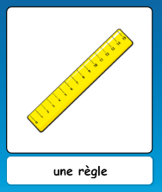
French
School Stationary
Lesson 10
What’s in your pencil case?

Slide 113

French
School Stationary
Lesson 10
What’s in your pencil case?

Slide 114

French
School Stationary
Lesson 10
What’s in your pencil case?
Notes:
How do you say ‘felt tip pen’?

Slide 115

French
School Stationary
Lesson 10
What’s in your pencil case?
Notes:
How do you say ‘biro’?

Slide 116

French
School Stationary
Lesson 10
What’s in your pencil case?
Notes:
How do you say ‘sharpener’?

Slide 117

French
School Stationary
Lesson 10
What’s in your pencil case?
Notes:
How do you say ‘calculator’?

Slide 118

French
School Stationary
Lesson 10
What’s in your pencil case?
Notes:
How do you say ‘compass’?

Slide 119

French
School Stationary
Lesson 10
What’s in your pencil case?
Notes:
How do you say ‘pencil’?

Slide 120

French
School Stationary
Lesson 10
What’s in your pencil case?
Notes:
How do you say ‘pen’?

Slide 121

French
School Stationary
Lesson 10
What’s in your pencil case?
Notes:
How do you say ‘ruler’?

Slide 122

French
School Stationary
Lesson 10
What’s in your pencil case?
Notes:
How do you say ‘rubber’?

Slide 123

French
School Stationary
Lesson 10
What’s in your pencil case?

Slide 124
French
School Stationary
Lesson 10
What’s in your pencil case?
Draw and label the items you have in your pencil case.
Challenge: Can you label them in French?

