Slide 1
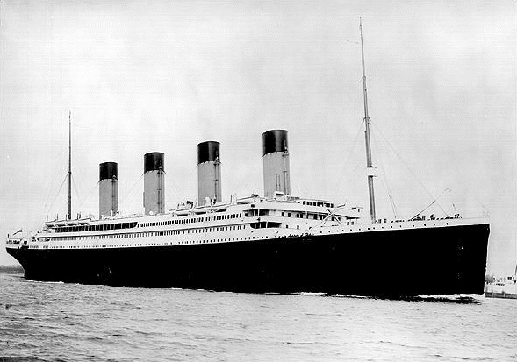
The Titanic’s
Journey

Slide 2
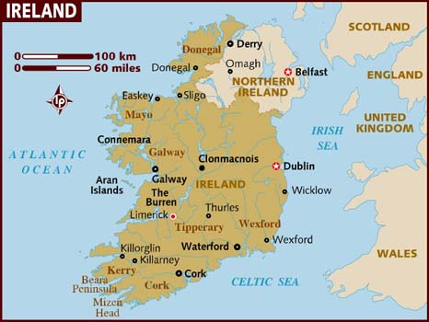
The Titanic was built in Belfast, Northern Ireland by the White Star Line Shipping Company.

Slide 3
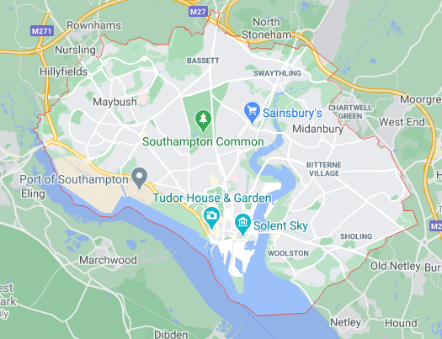
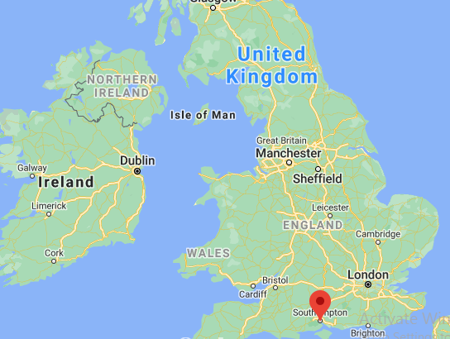
The Titanic sailed 660 miles to the Port of Southampton ready to load its passengers and crew.

Slide 4
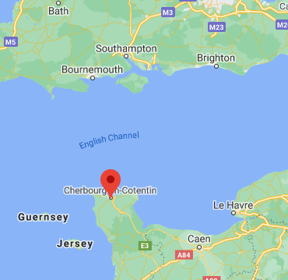
From Southampton, the Titanic crossed the English Channel and sailed to Cherbourg, France.
The ship was too large to dock so passengers were transported via tender boats.

Slide 5
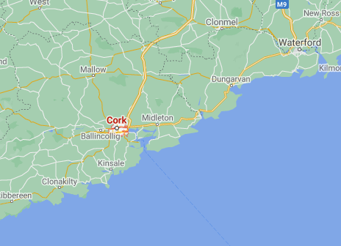
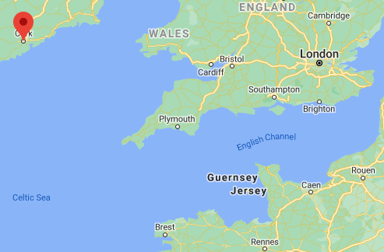
The Titanic then set sail to make its only stop in Queenstown, now known as Cork.
It collected its last passengers before setting off on its Maiden Voyage.

Slide 6
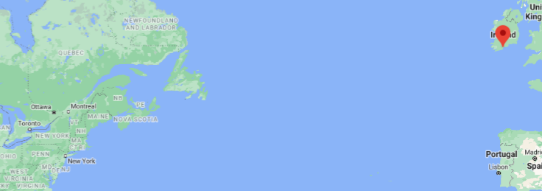
From Cork, the Titanic began it’s Maiden Voyage across the North Atlantic Ocean.
The intended journey of the Titanic was a 2,825 mile stretch towards New York, America.

Slide 7
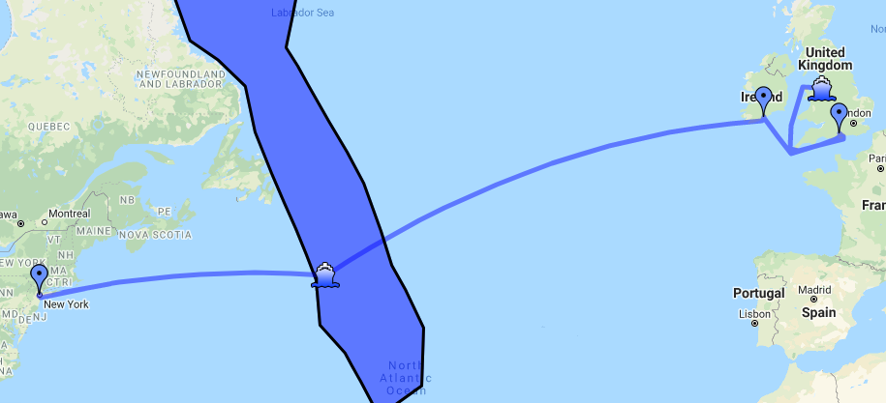
Unfortunately, the Titanic only travelled 400 miles before hitting an iceberg and sinking in the North Atlantic Ocean.
This is the crash site of the Titanic.

Slide 8
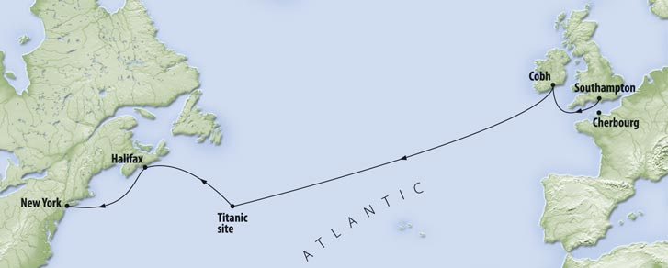
The journey
Can you talk about the journey of the Titanic including the different places it stopped, where it was due to go and where in the world it sank?

Slide 9
Follow up Activity
Use some different items around the house (clothes, toys, or you could draw your own map!) to represent the different places we have learnt about. You could make a big map on the floor!
Can you use a piece of string to map the intended journey of the Titanic?

