Slide 1
Religious Education
Lesson 2
Salvation
The Easter Story

Slide 2

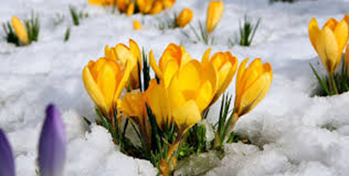
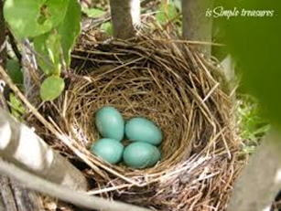
Recap – what can you remember?
Key words
Spring
Easter
God
Jesus
2 minute challenge:
Note down anything you can remember from last week on your whiteboard. You may choose to draw some pictures or write some words or sentences.

Slide 3
The Easter Story
https://www.bbc.co.uk/teach/class-clips-video/religious-studies-ks1-the-christian-story-of-easter/zhgv47h

Slide 4
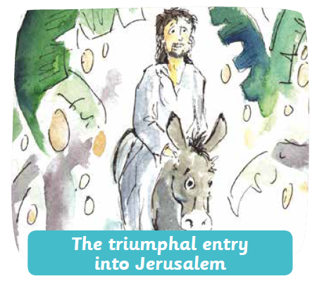
The Easter Story – Entry to Jerusalem
Jesus was loved by many, but others were jealous of him.
When Jesus arrived in Jerusalem as King, his followers greeted him waving Palm leaves.

Slide 5
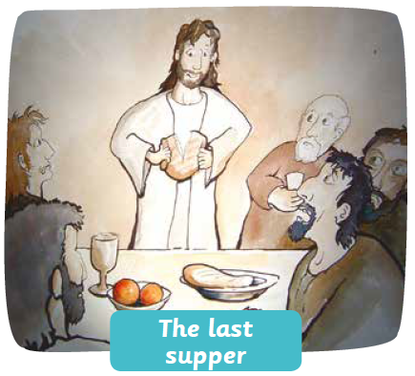
The Easter Story – Betrayal
Judas, one of Jesus’ disciples, betrayed Jesus at the Last Supper.

Slide 6
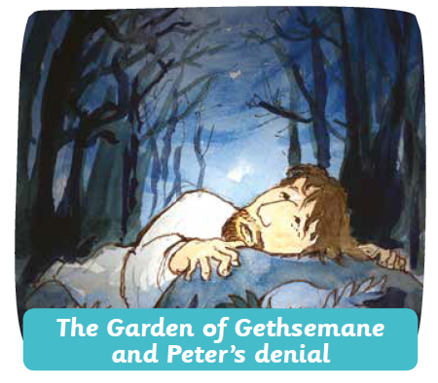
The Easter Story – Arrest
Jesus was arrested at the Garden of Gethsemane and put on trial.

Slide 7
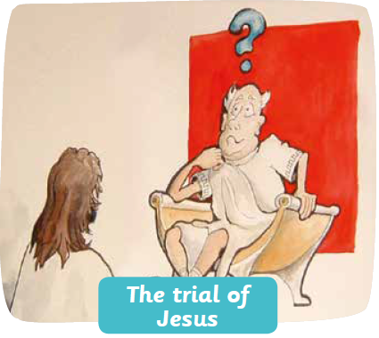
The Easter Story – The Trial of Jesus
Jesus was put on trial and was sentenced to death by crucifixion.

Slide 8
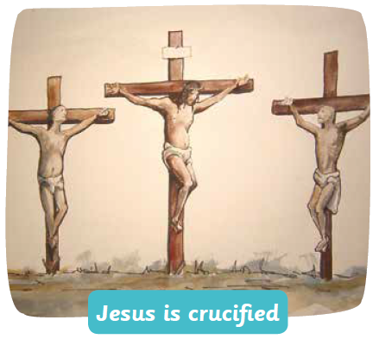
The Easter Story – The Crucifixion
Jesus dies on the cross. His body was then wrapped in cloth and placed in a tomb.

Slide 9
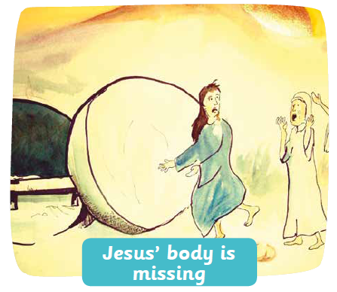
The Easter Story – The Empty Tomb
Three days later, on Easter Sunday, Mary Magdalene and her friends went to visit Jesus’ tomb.
They were shocked to find that the rock had been moved and Jesus’ body was gone!

Slide 10
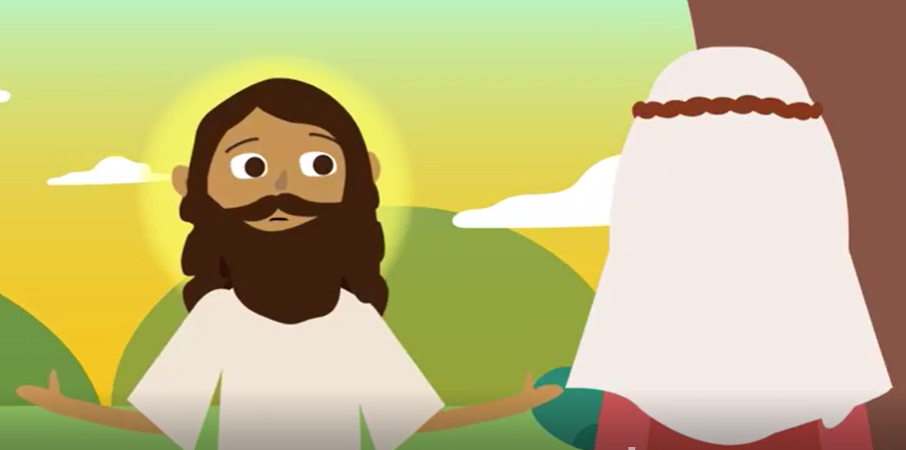
The Easter Story – Jesus Appears
Mary wept. A figure appeared and said ‘why are you crying?’.
It was Jesus! He told Mary to go and tell his disciples that he had Risen.

Slide 11
The Easter Story - Activity
Cut out and stick the Easter Story in the correct order.
Challenge: See if you can retell the story to a friend!

