Slide 1
Which one is the correct past tense?
1. I buyed a sandwich.
2. I buying a sandwich.
3. I bought a sandwich.
4. I buyded a sandwich.

Slide 2
Grammar – tenses
Recap
Past – when something has already happened.
Present – when something is happening now.
Future – when something is yet to happen.

Slide 3
What tense?
Rapunzel lived all alone in a tall, dark tower.
A. Past
B. Present
C. Future

Slide 4
What tense?
Rapunzel lived all alone in a tall, dark tower.
A. Past

Slide 5
Changing to present tense.
Rapunzel lived all alone in a tall, dark tower.
What would ‘lived’ change to, to make this sentence the present tense?

Slide 6
Changing to present tense.
lived → lives
Rapunzel lives all alone in a tall, dark tower.

Slide 7
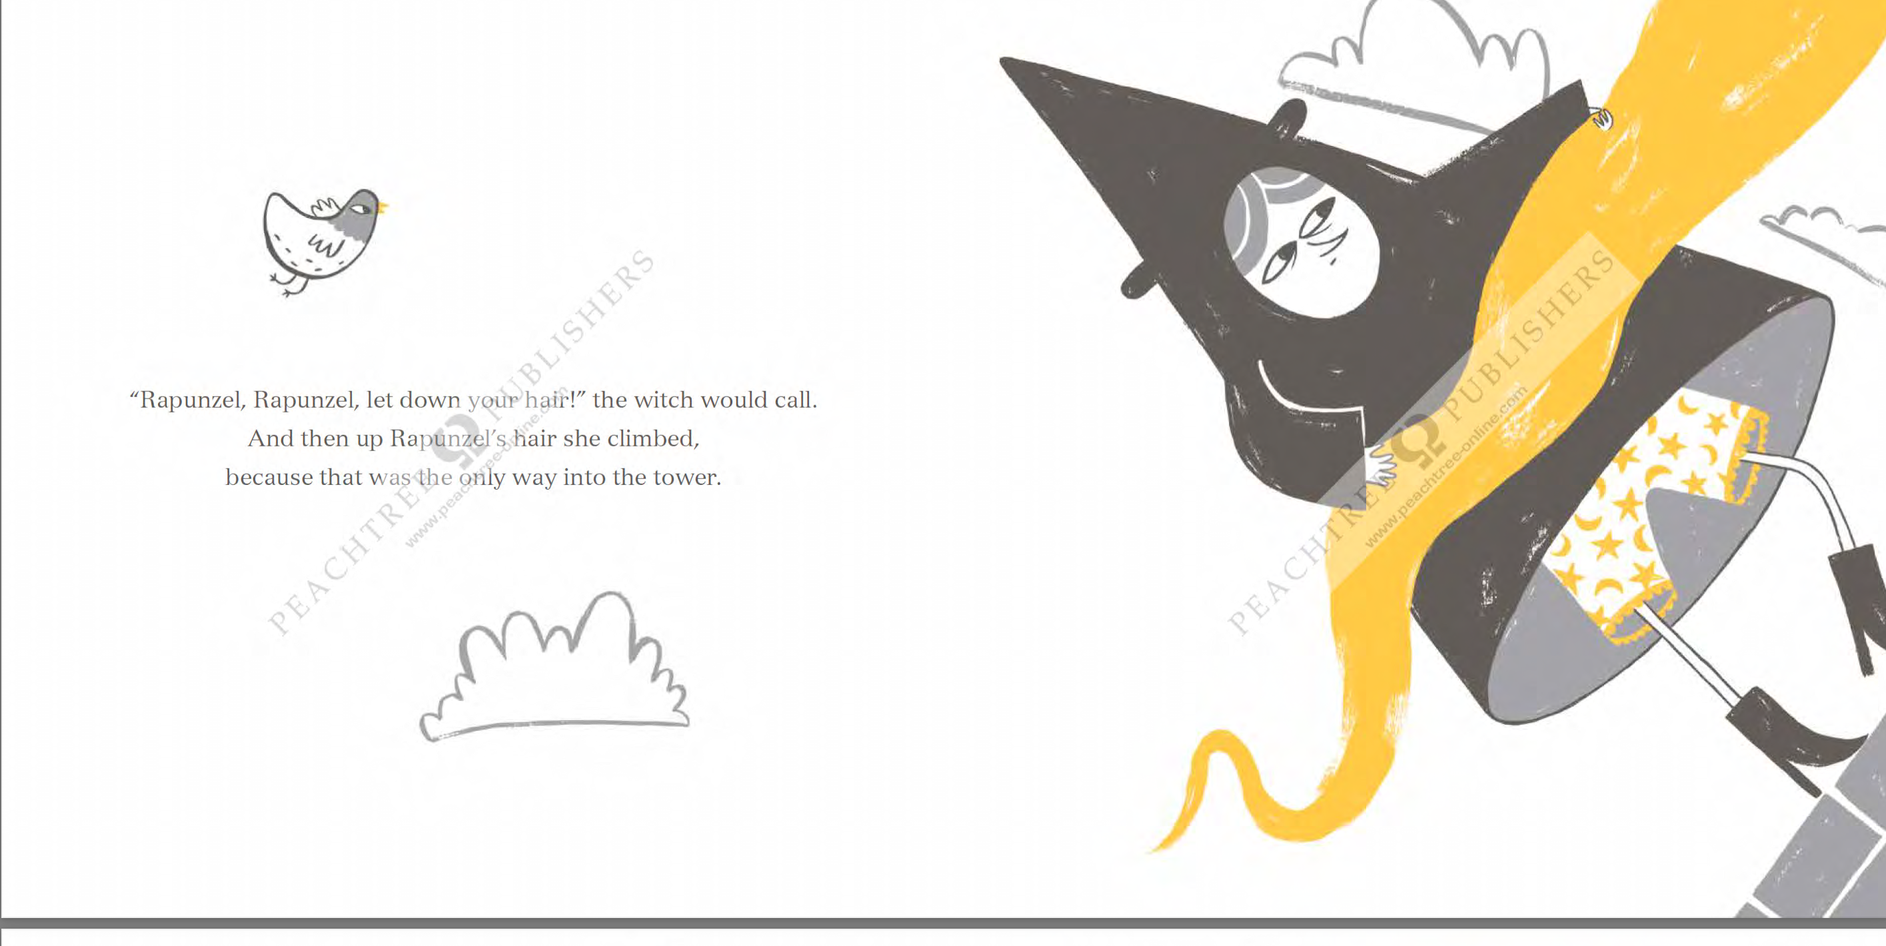
What tense?
Up she climbed, because that was the only way into the tower.
A. Past
B. Present
C. Future

Slide 8
What tense?
Up she climbed, because that was the only way into the tower.
A. Past

Slide 9
Changing to present tense.
Up she climbed, because that was the only way into the tower.

Slide 10
Up she climbs, because that is the only way into the tower.

Slide 11
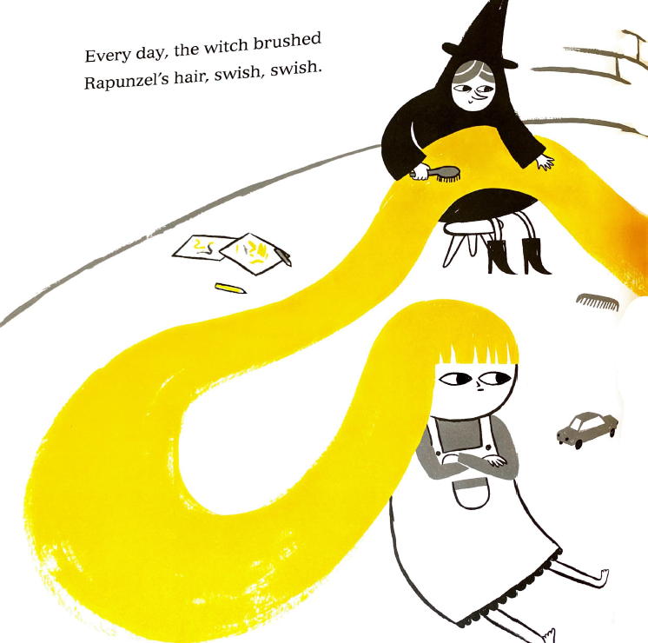
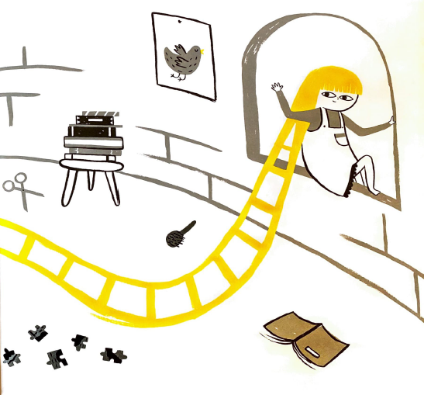
Your task…
Look at the pictures. What is happening?
1. Write a sentence to explain what is happening NOW, in the PRESENT tense.
2. Write the same sentence explaining what has happened, in the PAST tense.

