Slide 1

Where does soil come from?
Rocks and Soils

Slide 2

Steps to success
To understand what happens to rocks over time.
To know what soil is made from.
To create a storyboard showing how soil is created.

Slide 3
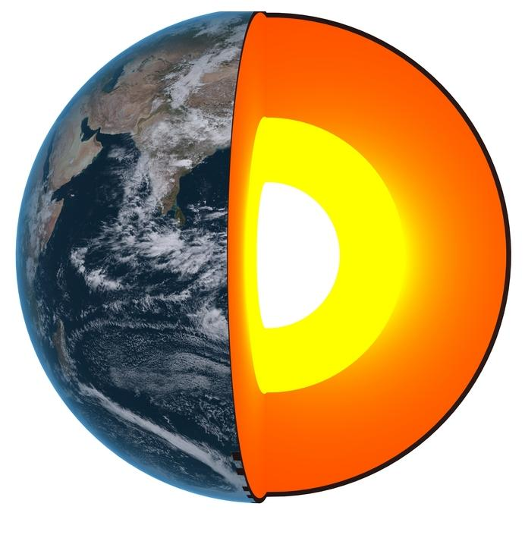
What types of rocks are made at each layer?
What can you remember?

Slide 4


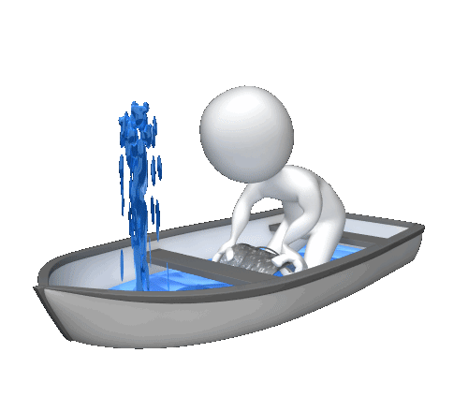
Out at sea!
Ah, the open sea! Nothing better than knowing you are on solid ground!
Can you explain what the captain means?
What? Solid Ground? You´re nuts!

Slide 5

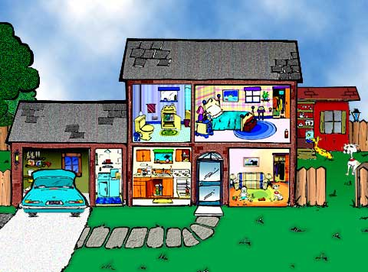
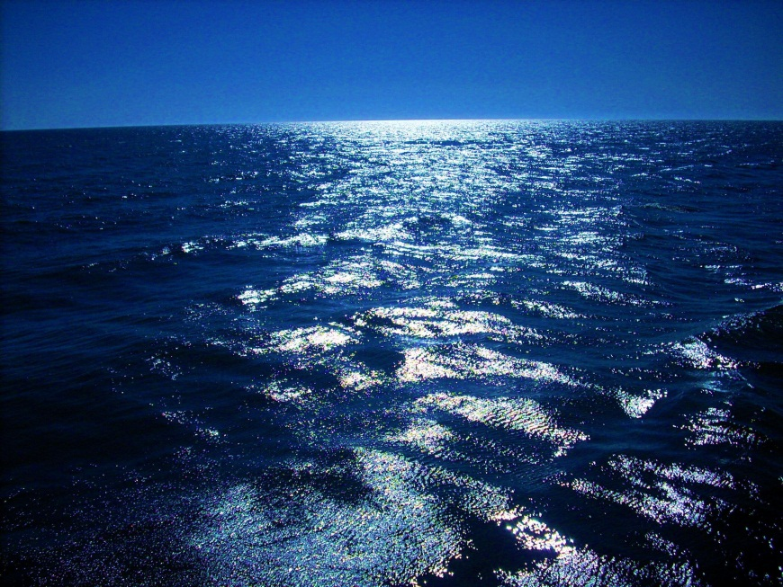
The Ground below us
There are always rocks somewhere underneath us!
But what might be between us and that rock?

Slide 6
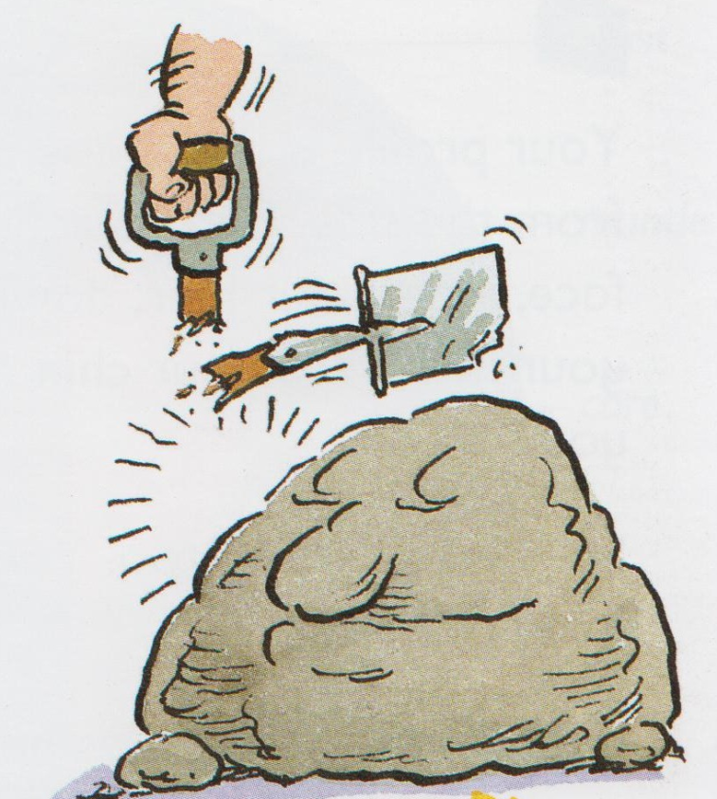
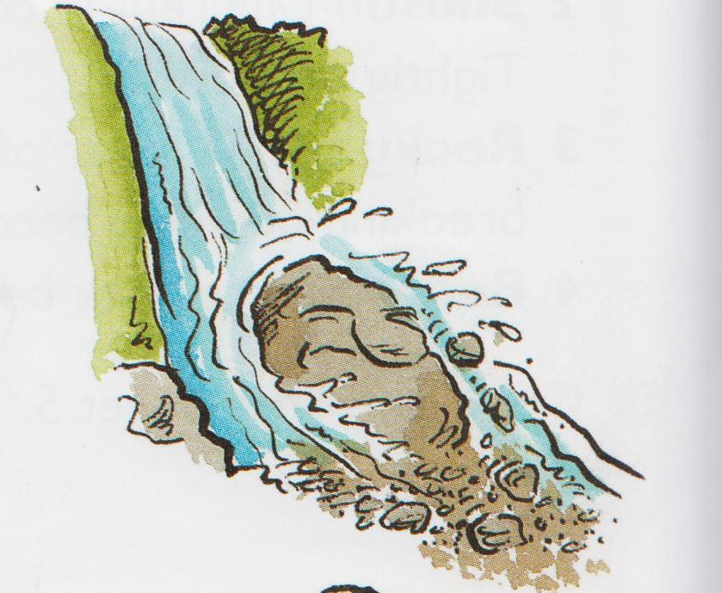
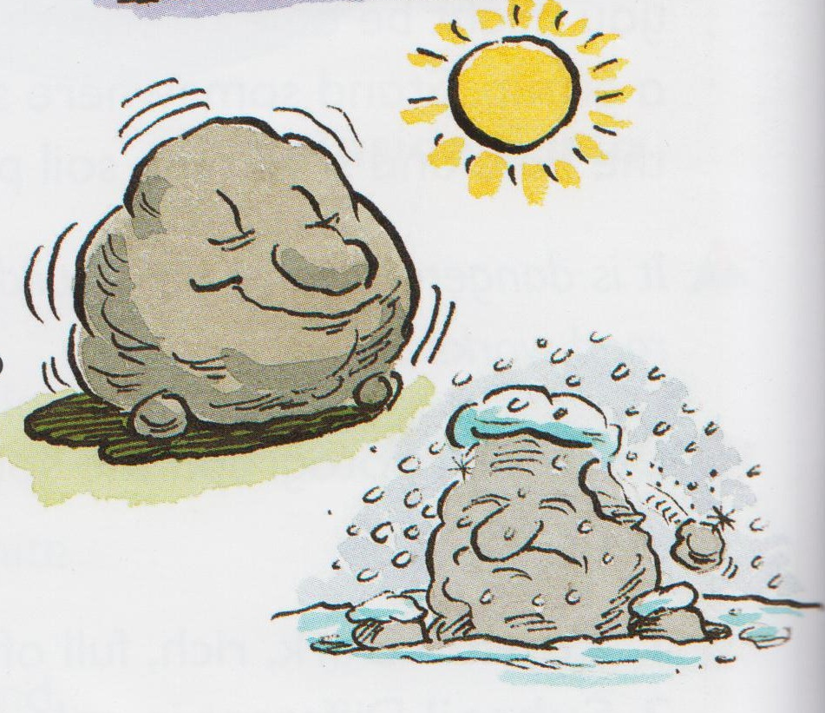
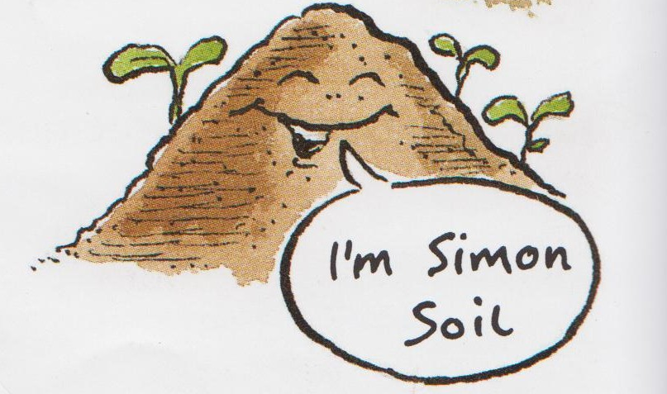
Clcik me to have a look at why a rock changes!
Then there was the river that swept past him. That river would rub little rocks against him over and over again. When the rocks rubbed him little pieces wore off. Then, when the river swept big rocks past him they would smash off other pieces from him and carry them away!
Over time, Roger Rock crumbled to stone. However, even those stones got smaller and smaller! As they were rubbed and banged together by the river they became even smaller. They turned to gravel, then grains of sand and finally a fine powder!
Roger Rock was hard! People broke hammers and spades on his hard, rocky shape. He was proud of being unbreakable. However, he was getting worried. Strange things were happening to him. He seemed to be getting smaller!
One day, Roger looked at himself and noticed he looked so different from before. He realised now that he had the wrong name!
¨I´m Simon Soil!¨ he said!
When the sun shone on him in the day he swelled up. When he was cold at night, he shrank! After all of this growing and shrinking bits were starting to break off!
In the middle of winter, his cracks filled with water. The water froze, and the ice began to push at him. Then… CRACK! The ice made him split and more pieces were falling off!
The powder mixed with bits of rotting plants that had bacteria and tiny funghi. All this stuff mixed with air and water.
The story of Roger Rock

Slide 7
What happened in the story?
1 | 2 | 3
4 | 5 | 6
Work with a partner. Can you remember the stages?

Slide 8
Your Task
Tell the story of Roger Rock

