Slide 1
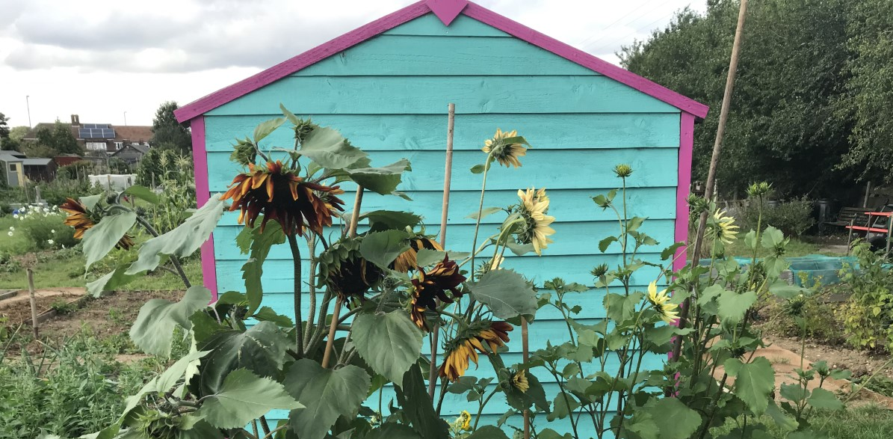
Buckden Academy allotment and school gardening.
Buckden Academy allotment and school gardening.
Buckden Academy allotment and school gardening.
SDG1 No Poverty – if you grow your own food you don’t have to buy it.
SDG2 Zero Hunger – sharing produce means no one needs to be without food.
SDG3 Good Health and Well-Being – fresh fruit and vegetable contain essential vitamins and minerals and gardening is also good for physical and mental health.
SDG4 Quality Education – everyone should be taught gardening to develop useful skills.
SDG 5 Gender Equality – gardening brings people together, it doesn’t matter who pulls up the weed.
SDG 6 Clean Water – by saving rainwater for our garden we are reducing use of processed drinking water.
SDG 7 Clean Energy – by growing our own produce we reduce air-miles for food transport such as importing green beans from Kenya.
SDG 8 Decent Work – as long as there are people then there will be work for them growing food.
SDG 9 Infrastructure – by eating food produced locally transport is reduced.
SDG 10 Reduced Inequalities – everyone should have the right and space to grown their own food.
SDG 11 Sustainable cities – any town planning should provide space for community gardens.
SDG12 Responsible Consumption – growing our own means there is less plastic packaging and less food waste.
SDG 13 Climate Action – plants take up carbon dioxide through photosynthesis.
SDG 14 Life below Water – by growing organically we reduce pesticide use and protect aquatic animals.
SDG 15 Life on Land – plants provide pollinating insects with food and increase biodiversity.
SDG 16 Peace, Justice and Institutions – have rules to stay safe at the allotment
SDG 17 Partnerships for the Goals – learn from other countries
SDG1 No Poverty – if you grow your own food you don’t have to buy it.
SDG2 Zero Hunger – sharing produce means no one needs to be without food.
SDG3 Good Health and Well-Being – fresh fruit and vegetable contain essential vitamins and minerals and gardening is also good for physical and mental health.
SDG4 Quality Education – everyone should be taught gardening to develop useful skills.
SDG 5 Gender Equality – gardening brings people together, it doesn’t matter who pulls up the weed.
SDG 6 Clean Water – by saving rainwater for our garden we are reducing use of processed drinking water.
SDG 7 Clean Energy – by growing our own produce we reduce air-miles for food transport such as importing green beans from Kenya.
SDG 8 Decent Work – as long as there are people then there will be work for them growing food.
SDG 9 Infrastructure – by eating food produced locally transport is reduced.
SDG 10 Reduced Inequalities – everyone should have the right and space to grow their own food.
SDG 11 Sustainable cities – any town planning should provide space for community gardens.
SDG12 Responsible Consumption – growing our own means there is less plastic packaging and less food waste.
SDG 13 Climate Action – plants take up carbon dioxide through photosynthesis.
SDG 14 Life below Water – by growing organically we reduce pesticide use and protect aquatic animals.
SDG 15 Life on Land – plants provide pollinating insects with food and increase biodiversity.
SDG 16 Peace, Justice and Institutions – have rules to stay safe at the allotment
SDG 17 Partnerships for the Goals – learn from other countries
SDG1 No Poverty – if you grow your own food you don’t have to buy it.
SDG2 Zero Hunger – sharing produce means no one needs to be without food.
SDG3 Good Health and Well-Being – fresh fruit and vegetable contain essential vitamins and minerals and gardening is also good for physical and mental health.
SDG4 Quality Education – everyone should be taught gardening to develop useful skills.
SDG 5 Gender Equality – gardening brings people together, it doesn’t matter who pulls up the weed.
SDG 6 Clean Water – by saving rainwater for our garden we are reducing use of processed drinking water.
SDG 7 Clean Energy – by growing our own produce we reduce air-miles for food transport such as importing green beans from Kenya.
SDG 8 Decent Work – as long as there are people then there will be work for them growing food.
SDG 9 Infrastructure – by eating food produced locally transport is reduced.
SDG 10 Reduced Inequalities – everyone should have the right and space to grown their own food.
SDG 11 Sustainable cities – any town planning should provide space for community gardens.
SDG12 Responsible Consumption – growing our own means there is less plastic packaging and less food waste.
SDG 13 Climate Action – plants take up carbon dioxide through photosynthesis.
SDG 14 Life below Water – by growing organically we reduce pesticide use and protect aquatic animals.
SDG 15 Life on Land – plants provide pollinating insects with food and increase biodiversity.
SDG 16 Peace, Justice and Institutions – have rules to stay safe at the allotment
SDG 17 Partnerships for the Goals – learn from other countries
https://www.cdec.org.uk/2019/04/introducing-a-little-bit-of-magic-into-school-life/
https://www.cdec.org.uk/2019/04/introducing-a-little-bit-of-magic-into-school-life/
https://www.cdec.org.uk/2019/04/introducing-a-little-bit-of-magic-into-school-life/

