Slide 1
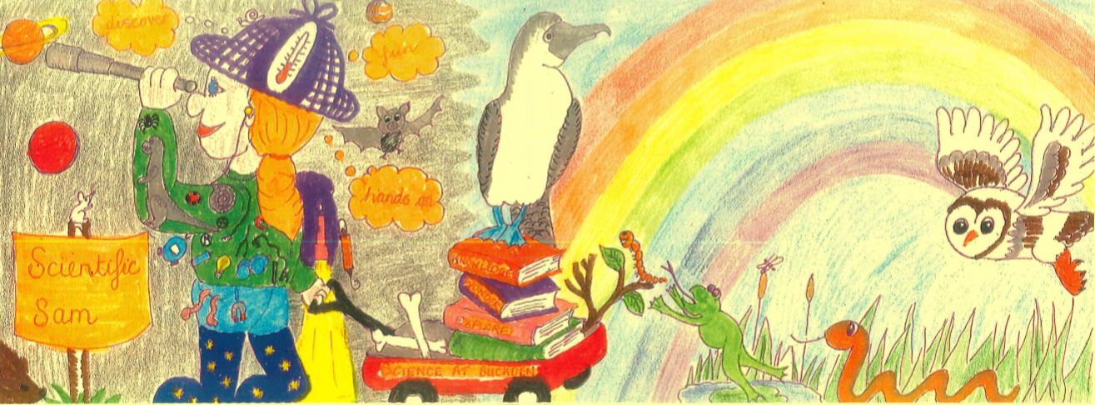
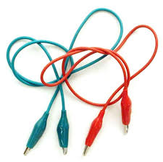
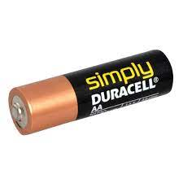
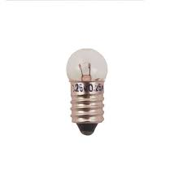
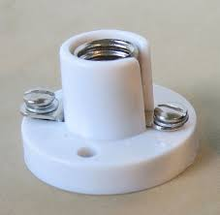
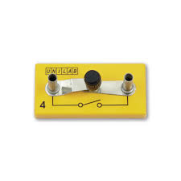
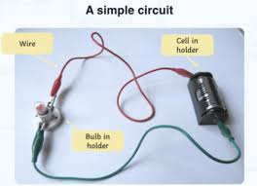
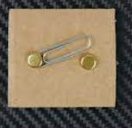
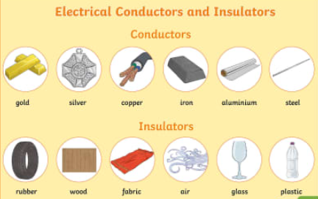
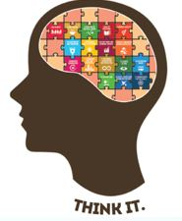
Year 4
Term Summer 1
Science Knowledge Organiser Is poverty increasing or decreasing?
Electricity
What do I need to make a circuit?
Electricity
Electricity is a flow of charged particles. An important form of energy, electricity powers things around us. We use it every day in our homes to power lights, TVs, computers, fridges, and ovens.
Crocodile clip
Wire
Cell
What uses electricity?
Bulb
Bulb holder
Switch
How can we make our own switches?
Switch
It needs to open and close to allow the electricity to pass and stop.
Conductors
Materials that allow electricity to pass through them easily.
Insulators
Materials that DO NOT allow electricity to pass through them easily.
Vocabulary Tier 2
Electricity
Bulb
Bulb holder
Switch
Wire
Vocabulary Tier 3 Conductor
Insulator
Circuit
Cell
Crocodile clip

