Slide 1
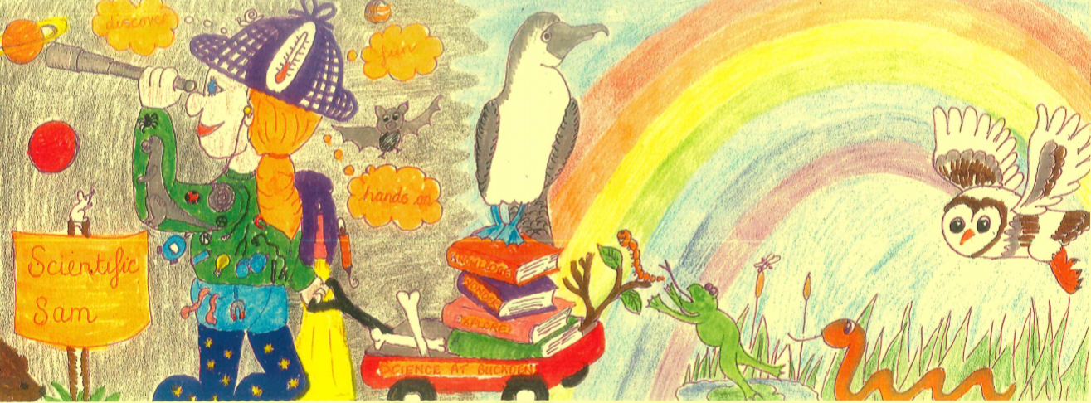




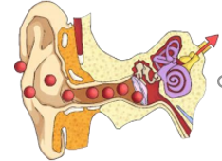

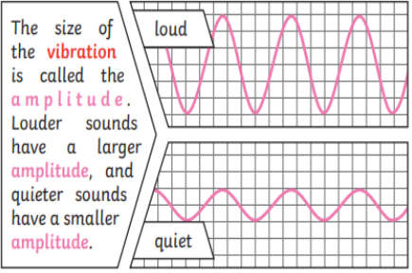
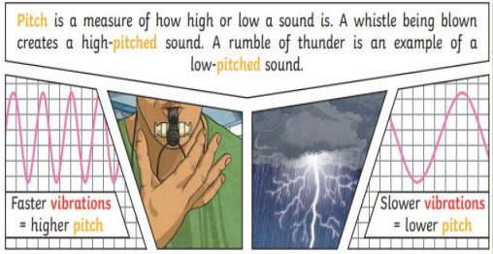












Science Knowledge Organiser
Sound
How does inequality affect someone's life?
Year 4
Term Spring_2
Sound
Sound is a type of energy that is created by vibrations. The louder the sound, the bigger the vibration.
Vibration
Vibration is a key part of making sound. It is a quick movement back and fourth, some are weak vibrations and some are strong. . A strong vibration, like a hammer hitting a nail will make a loud sound.
The ear catches these vibrations that travel through the air and this makes the eardrums vibrate. These vibrations are converted into electric signals in the ear and the electric signals are sent to the brain to understand.
Science
Sound
Source
Travel
Pitch
Volume
Loud
Insulation
Vibrate
Vibration
Faint
Reduced ineqeuality
Can name sound sources and state that sounds are produced by the vibration of the object
Can state that sounds travel through different mediums such as air, water, metal
Can give examples to demonstrate how the pitch of a sound are linked to the features of the object that produced it
Can give examples of how to change the volume of a sound e.g. increase the size of vibrations by hitting or blowing harder
Can give examples to demonstrate that sounds get fainter as the distance from the sound source increases
identify how sounds are made, associating some of them with something vibrating
recognise that vibrations from sounds travel through a medium to the ear find patterns between the pitch of a sound and features of the object that produced it
find patterns between the volume of a sound and the strength of the vibrations that produced it
recognise that sounds get fainter as the distance from the sound source increases
Aristotle
Amplitude
Pitch
Sound can travel
Sound can travel through solids, liquids and gases. Sound will always travel as a wave, vibrating the particles in the item it is traveling through which then collide with one another.
Sound travels much slower than light, in both air and water. You can often hear things before you see them, for example you can see lightening before you can hear it.
Soundproofing
Soundproofing is when we absorb the sound so that we cannot hear it. Absorbing sound is useful when you live near or work in busy places. It is important to protect the ear from loud years.
Vocabulary Tier 2
sound
travel
volume
vibration
Vocabulary Tier 3
source
pitch
loud
insulation
vibrate
decimal

