Slide 1

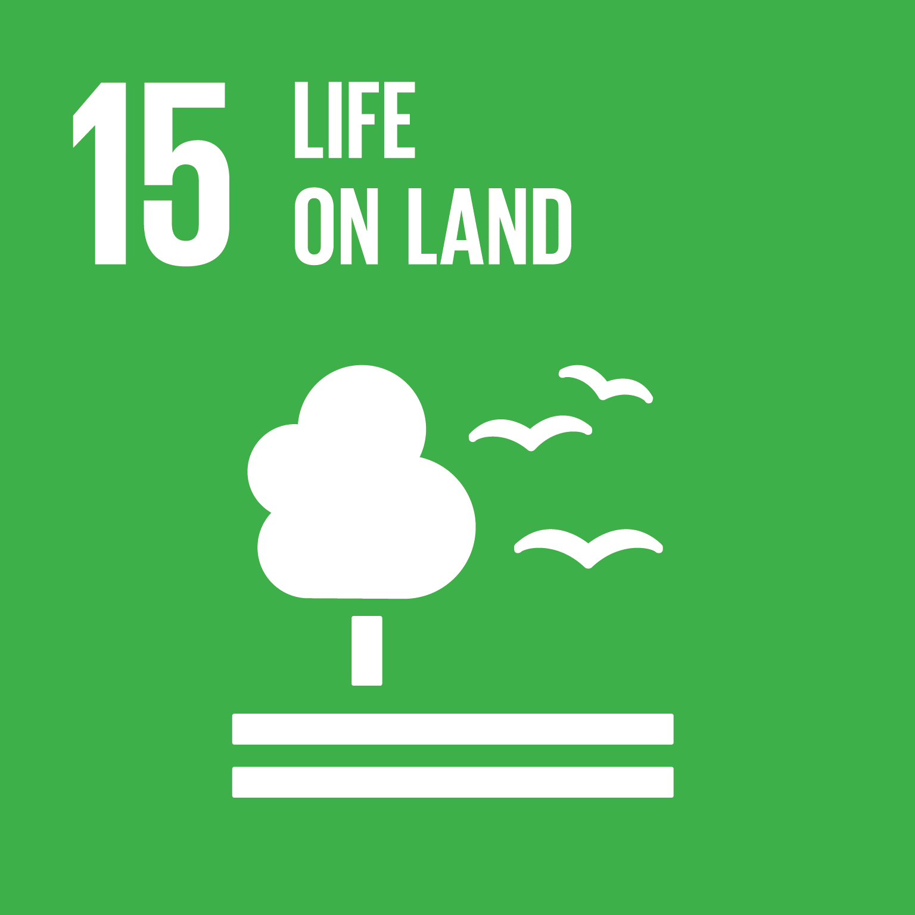

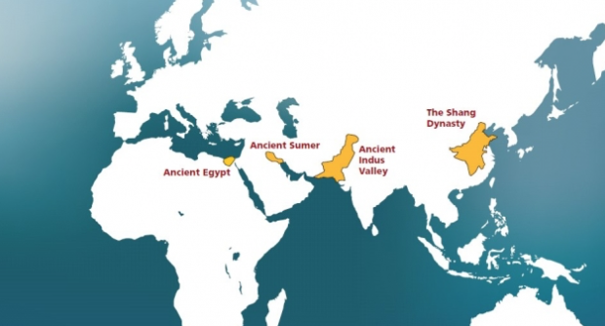
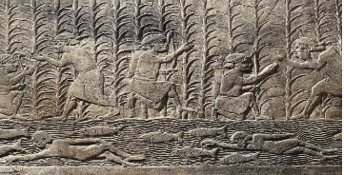
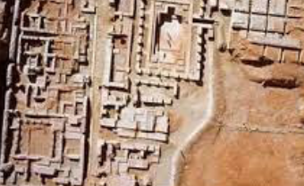
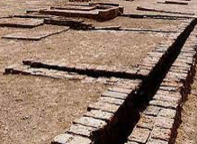
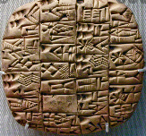
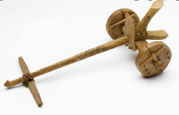
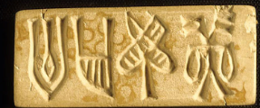
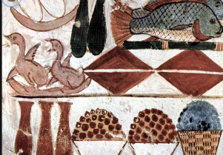
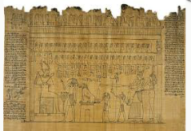
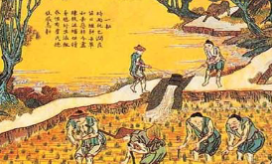
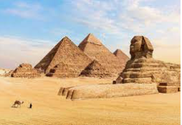
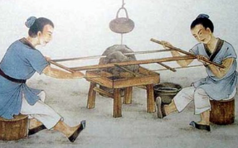
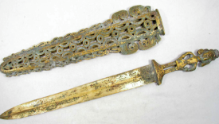
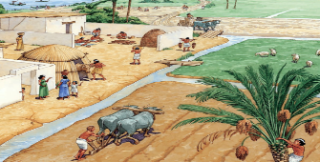
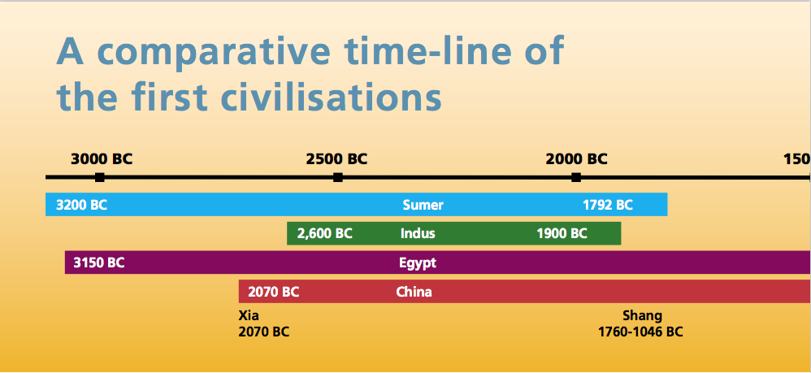
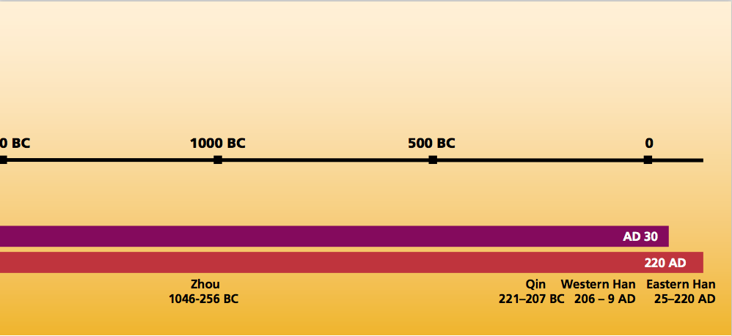
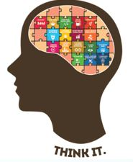


Year 4
Knowledge Organiser
Early civilisations
Term Autumn_1
Ancient Civilisations
What do we already know…
We know that people in the Stone Age were hunter-gathers and progressed to farming in the Iron Age.
Ancient Greeks educated their children.
What are going to learn…
How to compare similarities and differences between the first civilisations.
How to place these early civilisations in chronological order.
Around the world there were many civilisations. Four early civilisations that start and ended at different times but there is one period when all four civilisations were building cities.
Ancient Sumer 3200BC – 1792BC Known as ‘Cradle of civilisation’
Irrigation, writing, laws, wheel, plough
Indus Valley Civilisation - 2600BC- 1900BC
Town planning, trade, drainage system, writing
Modern day Iraq
Modern day Pakistan
Rivers Tigris and Euphrates
Rivers Indus
Declined and deserted
Drought + overuse of land.
Ancient Egypt – 3150BC- 30BC
Writing, trade, pyramid,
Papyrus.
Shang Dynasty – 1760BC – 1046BC
Writing, calendar, chariots,
bronze bowl and weapons
Modern day Egypt
Modern day China
Rivers Nile
Yellow River
Revolution
Bronze Age 3000BC to 800BC
Iron Age 1000BC to 5AD
In Britain
Stonehenge 3000BC – 2000BC
Vocabulary Tier 2 achievement
location
river valley
Vocabulary Tier 3
civilisation
dynasty
irrigation
BC – Before Christ
AD – Anno Domini

