Slide 1
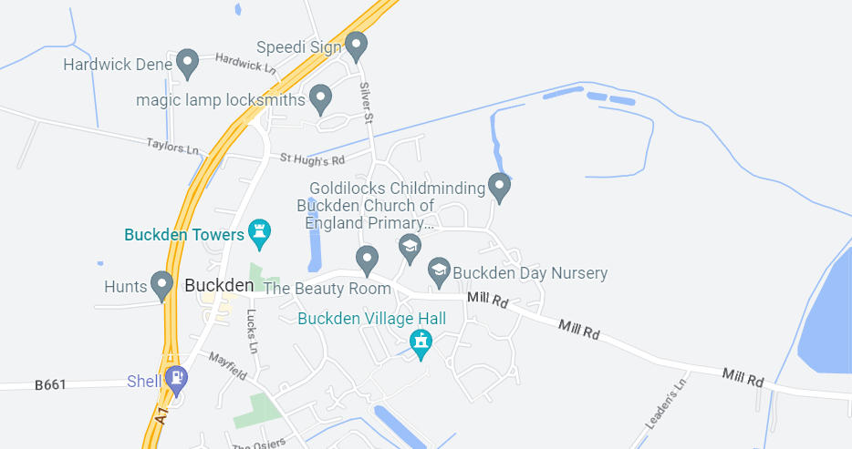
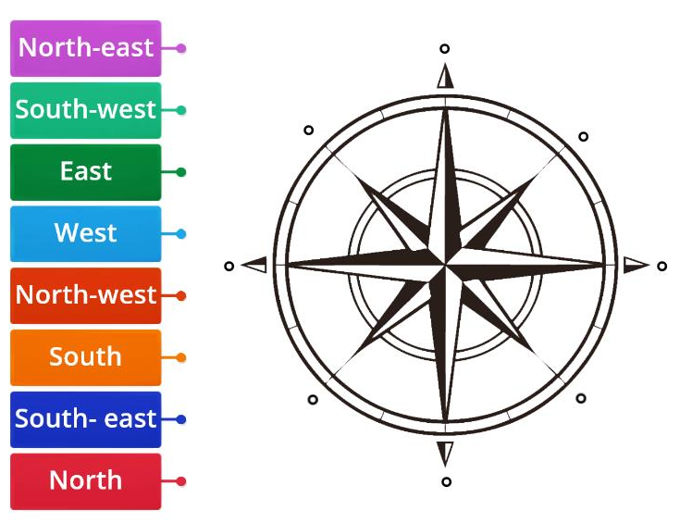
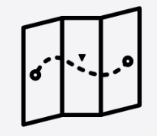
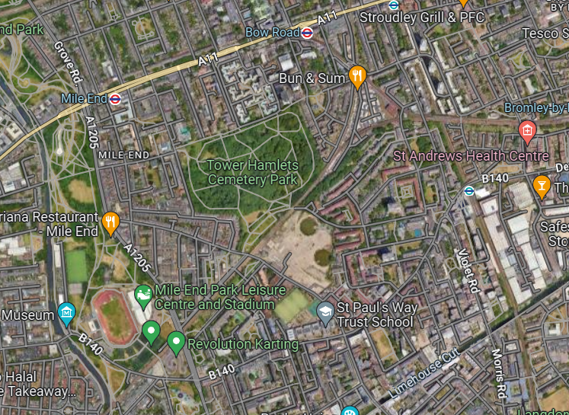
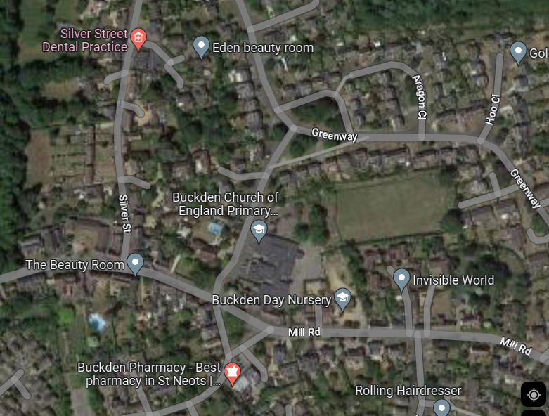
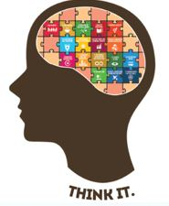
Geography
Knowledge Organiser Is poverty increasing or decreasing?
Year 4
Term Summer_1
Physical and human features
As we look around our world, we see many different features. Some of the things that we see are naturally occurring, we call these physical geographical features. Other elements are features which have been created by humans, we call these human geographical features.
Maps and Compass
Maps can help you find where you are or your way using directions. They can be drawings or models. They show symbols (pictures) for places such as car parks or churches. They also have a key, which tells you what the symbols mean.
Compass
You can use a compass to find out which direction you are facing. The four cardinal directions are North (N), East (E), South (S), West (W). On an 8 point compass also has four intercardinal directions (NE, SE, SW, NW).
What? Where?
How? Why?
Fieldwork study
Fieldwork is when you go outside the classroom and find things out for yourself. You will need to think like a geographer, to observe, plan, question and research both the local area and wider areas around the world.
Map comparison
Identifying the human and physical features on a map can help us to understand the living environment and the surroundings can impacts a populations life.
Vocabulary Tier 2
Local
Fieldwork
Map
Comparison
Vocabulary Tier 3
Compass
Navigation
Direction
Features

