Slide 1
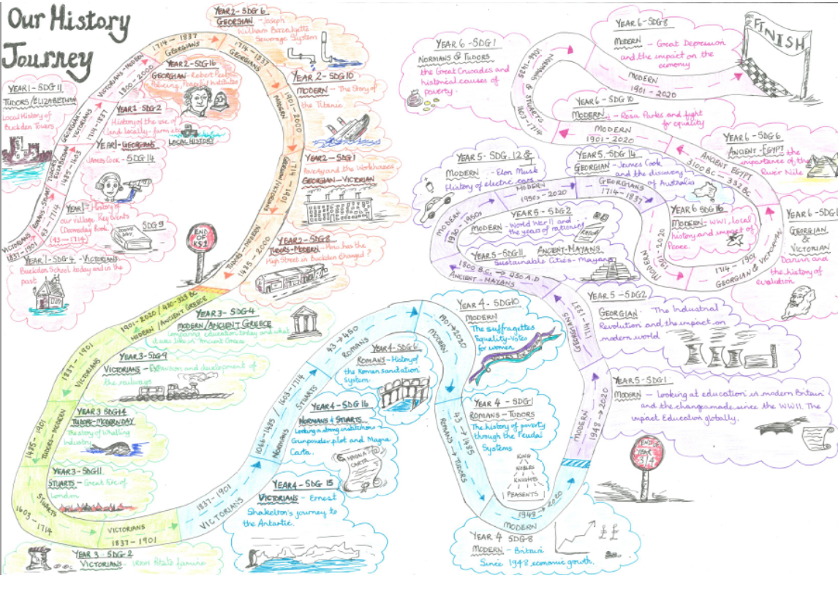


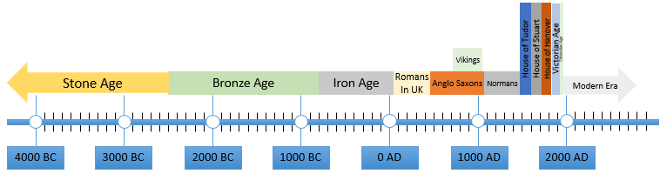
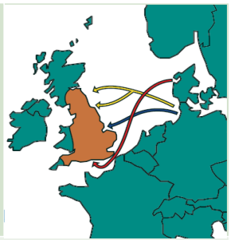
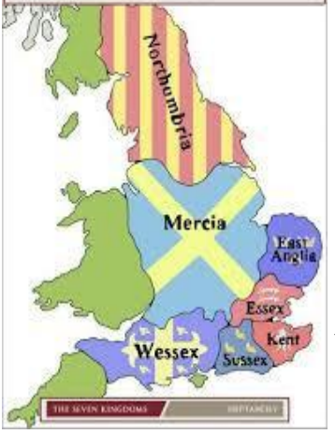
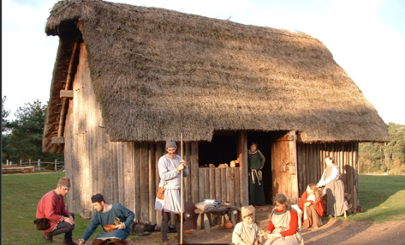
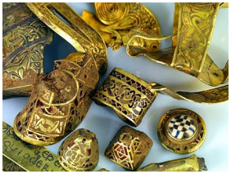



Year 4
History Knowledge Organiser
Is it fair to call the Anglo Saxon era the Dark Ages?
Term Spring 2
410AD​ The Romansleave Britain | 450AD Anglo Saxon warriors arrive in Britian​ | 597AD​ St Augustine brings Christianity to England from Rome​ | 613AD​ The Saxons rule over most of England​ | 633AD Lindisfarne monastery built​ | 660AD Britain was split into seven kingdoms​ | 731AD​ Bede completes Ecclesiastical History of the English people​ | 793AD The Vikings attack and capture the city of York​ | 1066AD The Normans the Battle of Hastings
The Romans left Britain to protect their empire against the barbarians from the east. This meant that Britian was no longer protected from invasion. The Anglo Saxons were made up from different groups of people who migrated from modern day Denmark, the Netherlands and Northern Germany. There were the Angles, the Saxons, the Frisians and the Jutes. These tribes had different rulers, but they all shared the same language.
Kingdoms
By around 600 AD, after much fighting, there were five important Anglo-Saxon kingdoms. They were Northumbria, Mercia, Wessex, Kent and East Anglia. Sometimes they got along, sometimes they went to war.
Settlements
The Anglo Saxons lived in settlements. There would be farmers and other craftsmen. People lived in wooden huts with thatched roofs.
Art and Culture
The Anglo Saxons were great craftsmen and at burial sites, archaeologists have found jewellery, armour, musical instruments
Vocabulary Tier 3
archaeology
excavation
settlement
Kingdom
Pagan
Vocabulary Tier 2
Invasion
Immigrants
kingdom

Slide 2
Century
1st century – 0AD to 100AD

