Slide 1
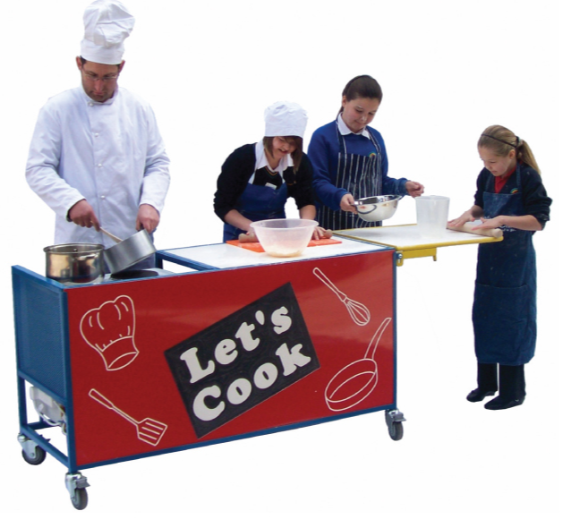
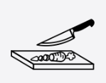
Design & Technology
Knowledge Organiser Is poverty increasing or decreasing?
Year 4
Term Summer_1
Research
Ingredients are grown all around the world, often this is due to the climate they grow best in. The ingredients from specific parts of the world will dictate the type of cuisine traditionally found in that area. Different foods can also grow better at different times of the year, this is called seasonality.
Ingredients and tasting
Ingredients can be identified and sorted depending on where they come from, how they can be prepared and their flavours.
Tasting different foods can provide the opportunity to discover new flavours, engage our taste buds, understand our likes and dislikes and how to build on flavours in cooking.
Design brief
Each design of a recipe can be adapted to suit peoples individual taste buds and food likes. This can include the sweetness, spiciness, inclusion of different herbs, vegetables and meat. Individual dietary requirements should be considered as some people are allergic to specific ingredients.
Food safety and Hygiene
An important part of cooking and preparing food is how we handle it safely and hygienically.
Steps should be taken to prevent the spreading of germs, through washing the produce, tools and our hands.
Safety must be taken when using sharp knives and moving around the cooking area.
Reading labels on products will tell you the safest way to store the product and for how long.
Preparation and cooking
Chopping: Hold the knife in your strongest hand and the ingredient in the other, with your fingers and thumb tucked away from the knife. Slice the food, moving your hand backwards and away from the knife as you chop.
Vocabulary Tier 2
Tasting
Cutting
Chopping
Flavour
Vegetable
Vocabulary Tier 3
Protein
Meat
Raw
Dietary
Ingredient

