Slide 1

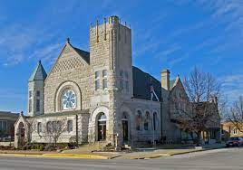
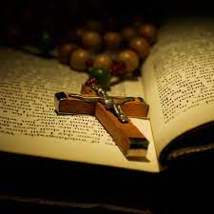


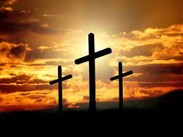
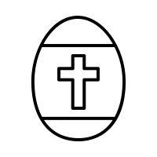
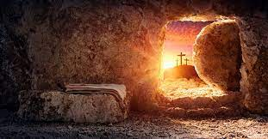

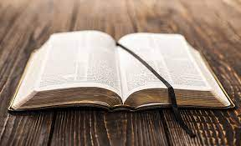

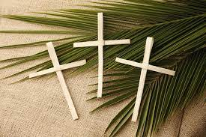
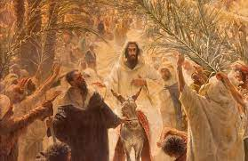

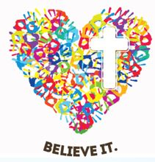

Year 4
Knowledge Organiser
Sikhism: Why do Christians call the day Jesus died ‘Good Friday’?
Term Spring 2
Good Friday is a Christian holiday commemorating the crucifixion of Jesus and his death at Calvary. It is observed during Holy Week.
Good Friday – the day Jesus died and was crucified on a cross.
Easter Sunday - Easter, also called Pascha Resurrection Sunday, is a Christian festival and cultural holiday commemorating the resurrection of Jesus.
A Gospel – A Gospel is a religious story
Palm Sunday - the Sunday before Easter, on which Christ's entry into Jerusalem is celebrated in many Christian churches by processions in which branches of palms are carried.
Vocabulary Tier 2
Death, Easter,
Jesus, Church,
Creation, communities,
Fall, Bible,
Jerusalem,
Christians
Vocabulary Tier 3 Resurrection
Gospel
Salvation
Palm Sunday
Good Friday
Easter Sunday

