Slide 1
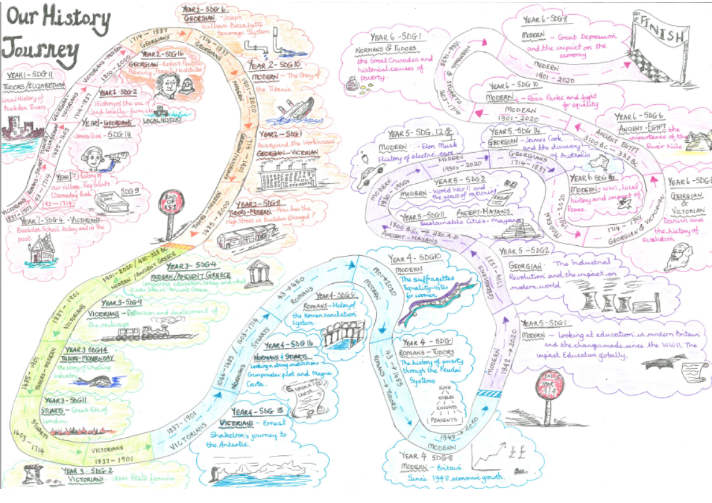
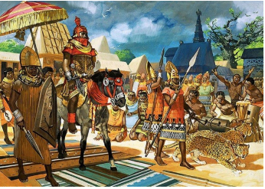
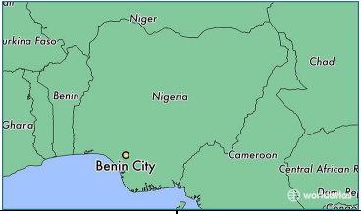
History Knowledge Organiser Is poverty increasing or decreasing?
What stories could the Ancient Benin bronze plaques tell us?
Year 4
Term Summer 1
900 CE The kingdom of Benin began | 1180AD The dynasty of the Oba began | 1100 AD Power struggles meant the Ogisos lost control of their kingdom | ​1100-1500 AD Oranmiyan chose his son EwekaI I to be the first Oba of Benin. | 1283 AD Oba Oguole had the Benin City Wall built | 1440AD​ Oba Ewuare the Great expands the Kingdom of Benin and it prospers. | 1451AD Oba Ewuare the Great set up trade with Portugal​. | 1700AD The Benin Kingdom declines due to civil war and ending the slave trade with Europe. | 1897AD Benin City is destroyed by British troops.
Ancient Benin 900 – 1900AD
Ancient Benin was a powerful African nation around the time of the Tudors. The Golden Age, when it was at its most powerful, was in the 16th century.
In the beginning, there were small villages that joined together to improve trading and security. People were mainly farmers and craftsmen. The kingdom grew more powerful when it started to trade with foreigners.
As the Kingdom of Odo grew is became exceptionally rich for more that 200 years and it built up a large and strong army.
It was destroyed when British troops invaded in 1897 AD.
Ancient Benin is now the location of modern day Benin City in Nigeria which is in south western Africa.
Vocabulary Tier 2
Kingdom
Trade
Benin City
Dynasty
Bronze
colonisation
Vocabulary Tier 3
Oba
Yoruba
Ife
Edo
Ogiso
plaque

