Slide 1
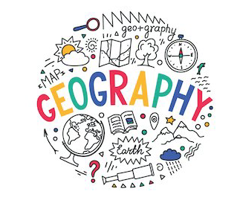











Da
Year 4
Geography Knowledge Organiser
The importance of rivers
Term Spring 1
Rivers – provide humans with water, food transport and sanitation. Rivers follow a course from inland to join other rivers, lakes or sea.
Rivers
Water is one of our valuable resources and rivers transport it across the land. It starts at a source and passes through different stages to end at the mouth of a river.
They are powerful enough to change the landscape around them.
They provide for humans, animals and the environment.
Journey of a river
Start at a source and passes through different stages to end at the mouth of a river.
They are powerful enough to change the landscape around them.
They provide for humans, animals and the environment.
Other waterways
There are many other types of bodies of water. Some of these contain fresh water and others contain sea water.
Flooding and its impact
Flooding occurs for many different reasons. The impact of flooding can affect the landscape and or human lives.
Pollution and solutions
We need to keep our water sources clean for the environment and our use.
Tier 2 Vocabulary
Rivers
Coast
Canals
Valley
Waterfall
Tier 3 Vocabulary
Oxbow lake
Meander
Sediment
Estuary
channel

