Slide 1





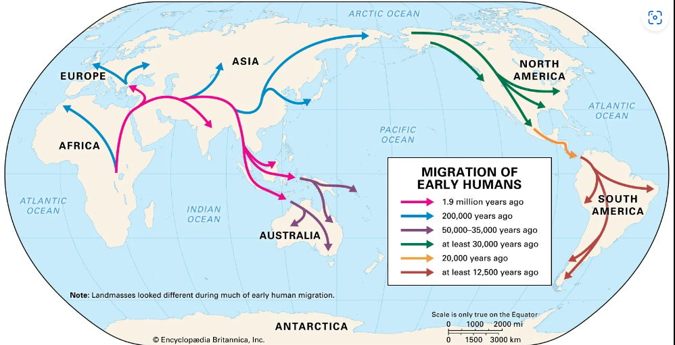





Da
Year 4
Geography Knowledge Organiser
Human Migration
Term Spring 2
Migration – is the movement of a person or animals from one place to another. Human migration often refers to people moving from one country to another country. Migration can be for a short or a longer amount of time.
Reasons for migration
Economic – to find work or a career
Social – to move closer to family
Political – to escape from dangers, e.g. war
Environmental – to escape natural disasters, e.g. volcano eruptions
Types of migration:-
Internal migration – people moving within the same country.
Economic migration - people moving so they can make a better income – more money.
Forced migration - people moving due to dangers in their own country.
Historical migration
Scientists believe that humans have been migrating since prehistorical times. They think that humans travelled from Africa to Europe and Asia.
People who have migrated to Britain include the Romans, Anglo Saxons, Vikings and Normans.
After James Cook arrived in Australia, people from Britain have migrated to Australia.
Push / pull factors
Push factors – are reasons why people want to leave an area.
Pull factors – are reasons why people want to move to the area.
Impact of migration
When people migrate to another country, they often bring with them new cultures, cuisines, skills, and traditions into the country.
Tier 2 Vocabulary
economic
international
internal
forced
Tier 3 Vocabulary
refugee
asylum seeker
immigrant
emigrant

